Slide 1
NBER Panel Discussion: Implications of COVID-19 for Social Security
COVID-19 Epidemic:
US Update and Economic Outlook
Jim Stock
Department of Economics, Harvard University
Outline
Activity and official orders – brief review
Public health data as of this morning
Policy dependence of pre-vaccine economy – simulations
What will the recovery look like?
July 22, 2020

Slide 2
The decline in activity is largely an endogenous response to the spread of the virus
There is now a consensus that the low levels of economic activity are largely an endogenous response to the spread of the virus, and threat of infection and deaths, not the result of business closure orders.
There are exceptions where orders bind
School closing/reopenings
Closings keep bars closed, but reopenings don’t ensure customers return
The implication is that a recovery hinges on controlling the virus, not merely lifting shutdown orders
Selected papers (US data)…
Bartik, Bertrand, Lin, Rothstein, and Unrath (2020) (hours, mobility)
Chetty, Friedman, Hendren, Stepner et al (2020) (spending)
Coibion, Gorodnichenko, Weber (2020) (Nielsen spending)
Goolsbee and Syverson (2020) (business foot traffic – Safegraph)
Gupta et al (2020a, b, c) (mobility, employment)
Kahn, Lange, Wiczer (2020) (vacancies, UI claims)
Lin and Meissner (2020) (cases, employment)
And a couple of charts:

Slide 3
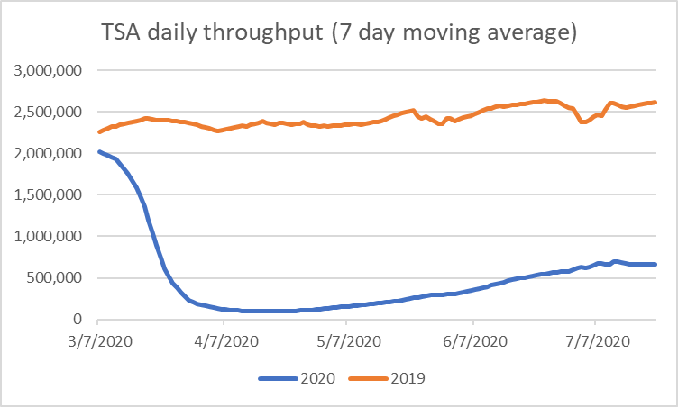
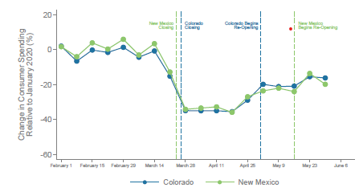
The decline in activity is largely an endogenous response to the spread of the virus
Spending and official re-openings
Source: Chetty et al. (2020))

Slide 4
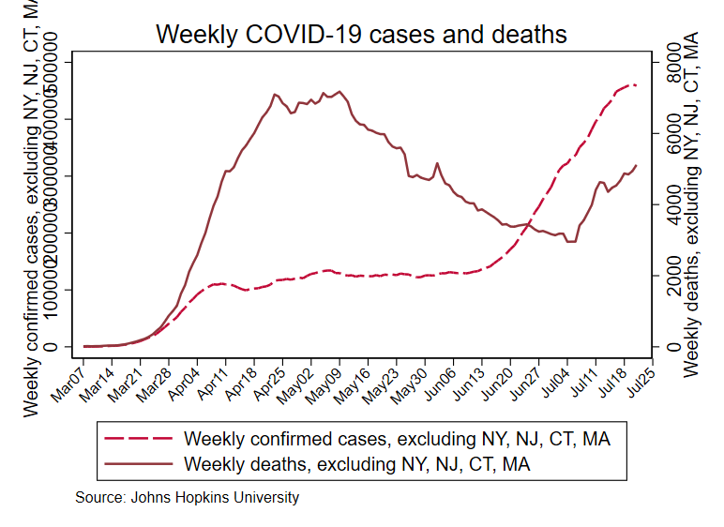
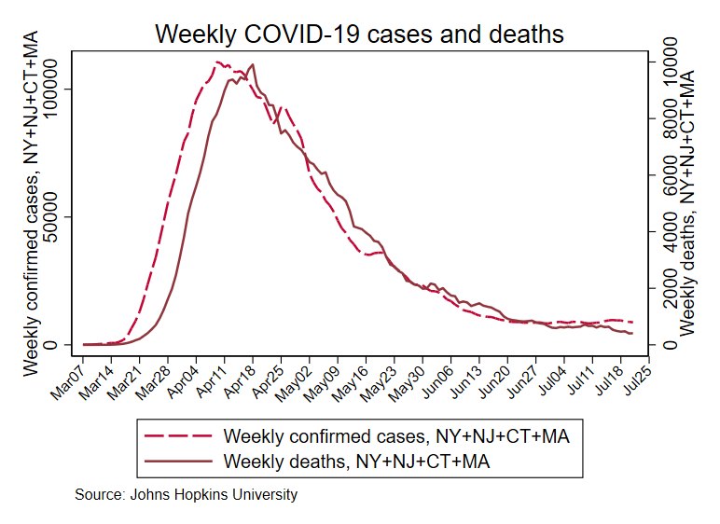
Cases and deaths through July 21
New York, New Jersey, Connecticut, Massachusetts
Rest of U.S.

Slide 5
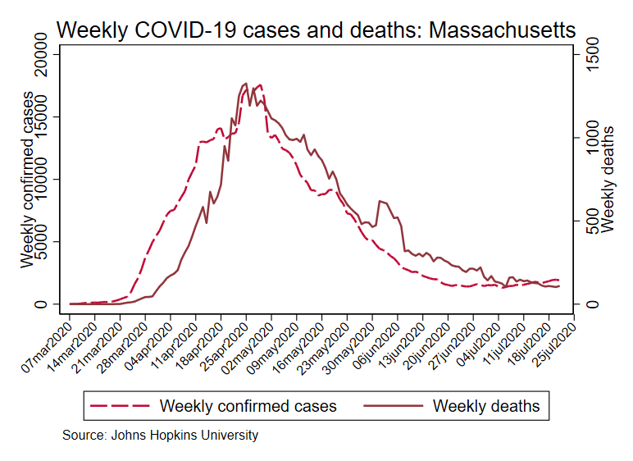
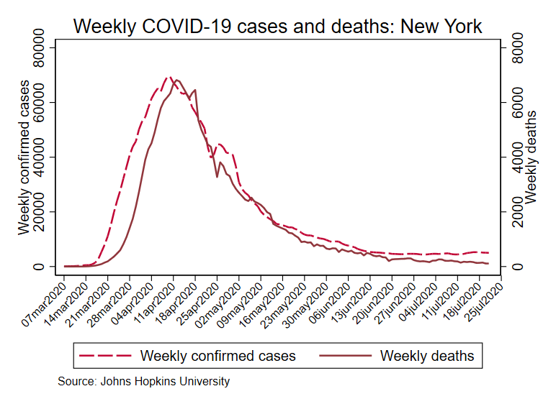
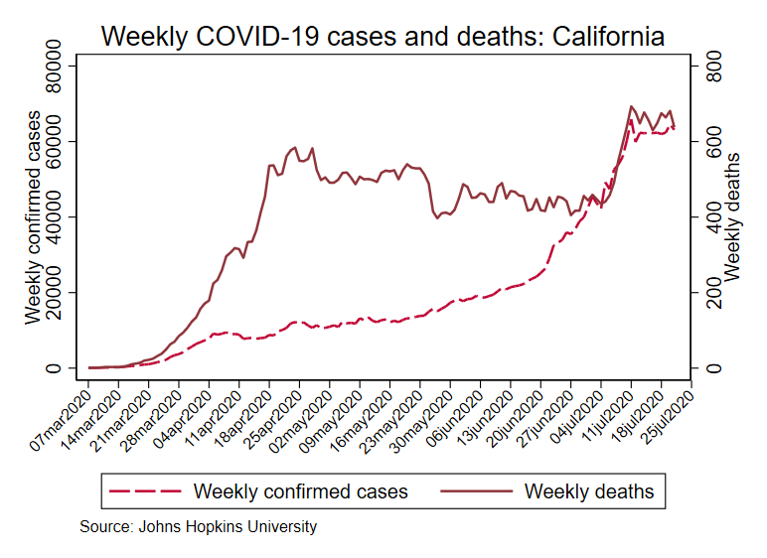
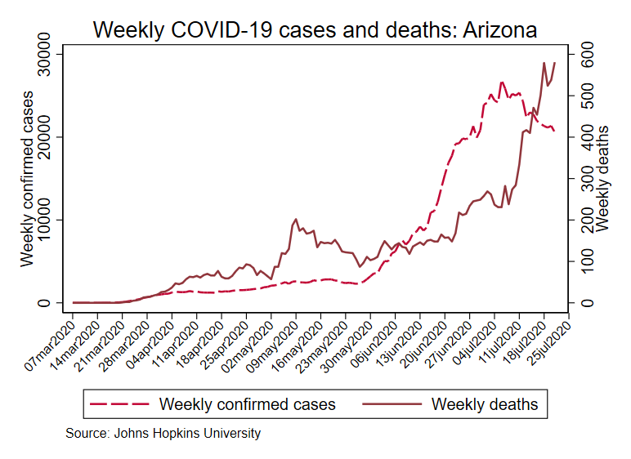
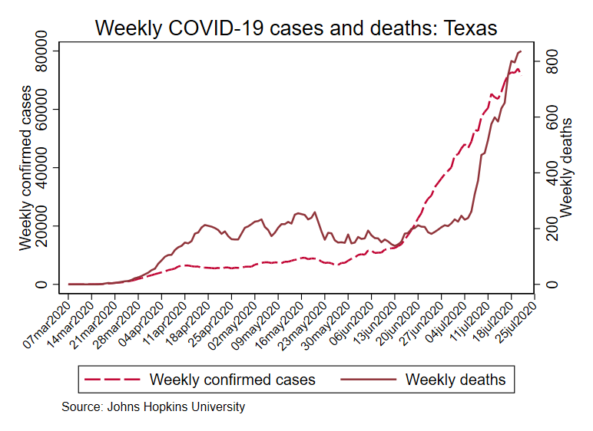
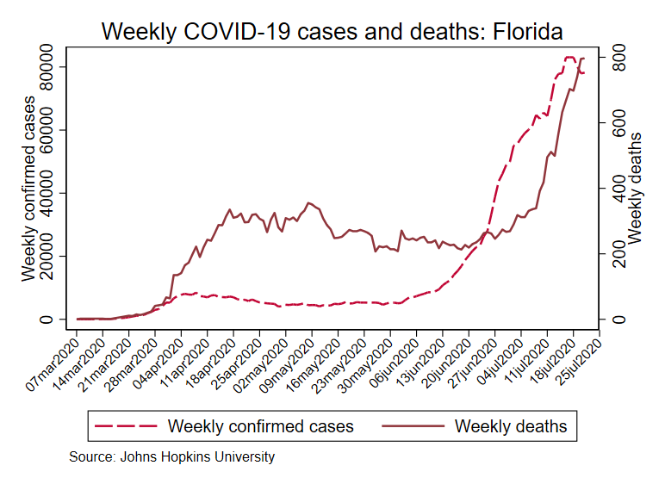
Cases and deaths through July 21

Slide 6
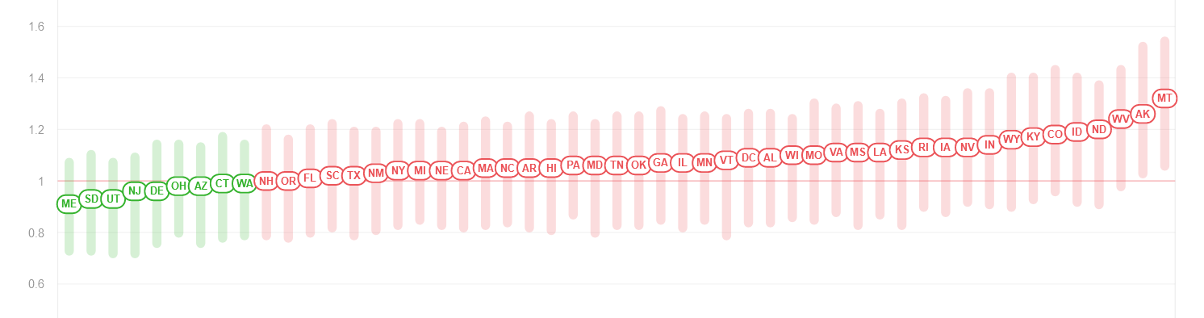
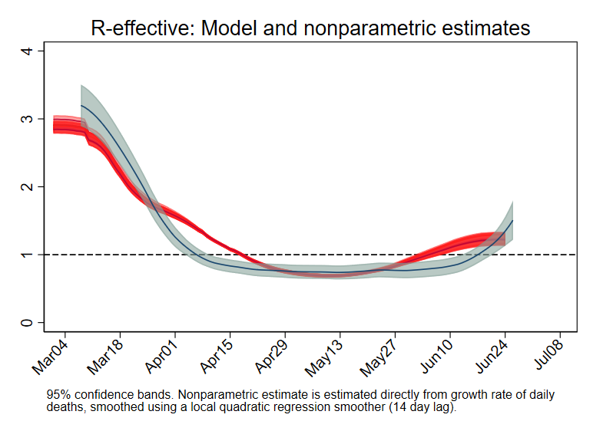
Estimates of R^{effective}(t) = R₀(t) x (S/N)
Source: Rt.live (updated 7/21/20)
Estimates of R^{effective}
Nonparametric:
 | Rt.Live (7/22/20) | F-V & Jones (6/21/20)
MA | 1.05 | 0.78
CA | 1.00 | 1.01
AZ | 0.97 | 1.17
TX | 1.01 | 1.08
FL | 1.00 | 1.08
5-age national SIR
Source: Baqaee, Farhi, Mina, & Stock (2020), updated 7/10/10

Slide 7
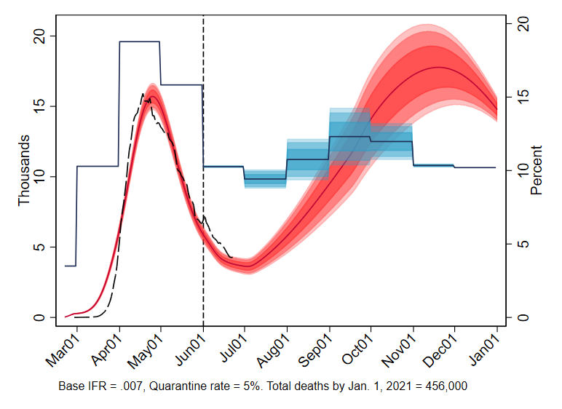
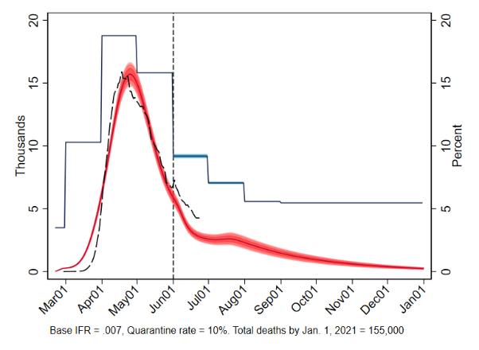
Policy dependence of pr-vaccine economy: Simulation evidence
Unemployment
rate
Weekly deaths
Source: Baqaee, Farhi, Mina, Stock (2020)
Source: Baqaee, Farhi, Mina, Stock (2020)
Relaxed social distancing, limited masks
Close schools, economic shutdown
Masks, social distancing, enhanced protections for elderly
Open schools, no economic shutdown
“Smart containment,” not deaths v. jobs
Unlike most economic problems, we have more instruments than targets
The “economic lockdown” tool is by itself not especially effective, and very costly
Masks and personal distancing
Testing & isolation
Support protections for elderly; etc.

Slide 8
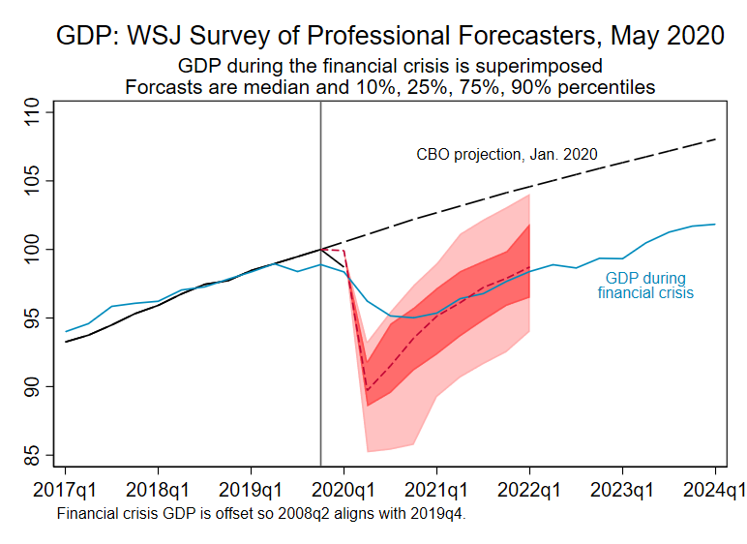
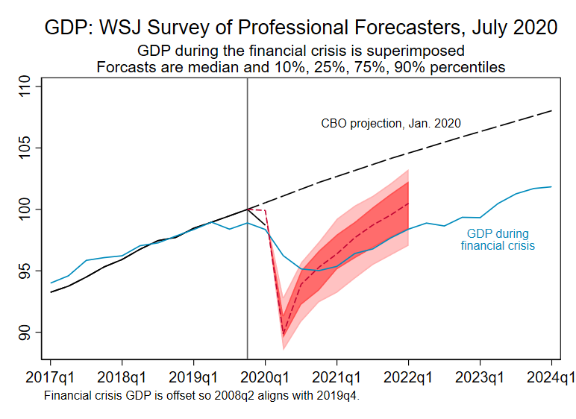
The post-vaccine recovery: WSJ survey of forecasters

Slide 9
The post-vaccine recovery: Time series evidence
How different is this recession, really?
Two time series exercises:
Can the weekly data tell us anything about the transition from fast to slow dynamics?
Fit two-factor (fast and slow) model to weekly data
Have monthly co-movements changed?
Fit 5-factor model to monthly US data set (81 series) through December 2019
Compute the five factors using the pre-COVID factor loadings (“old factors”)
How well do the “old factors” track the current co-movements
The temporal dynamics of this recession are clearly different – this exercise tracks asks whether the co-movements are different

Slide 10
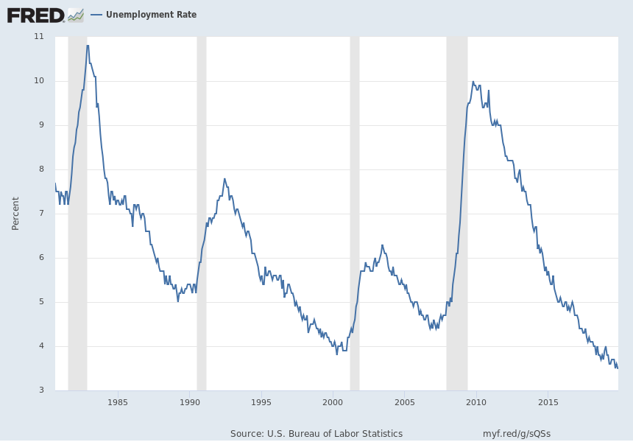
The post-vaccine recovery: historically, slow dynamic
-0.9pp/yr
-0.7pp/yr
-0.5pp/yr
-0.5pp/yr

Slide 11
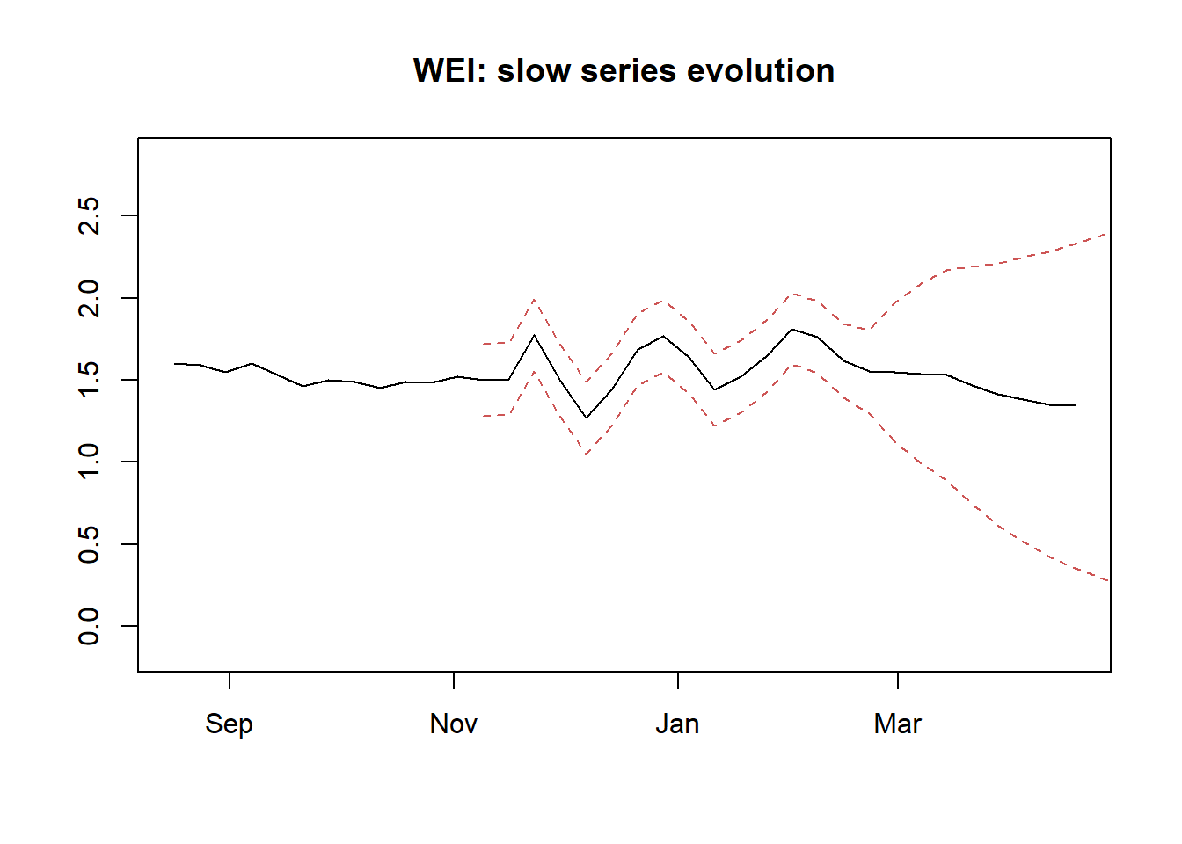
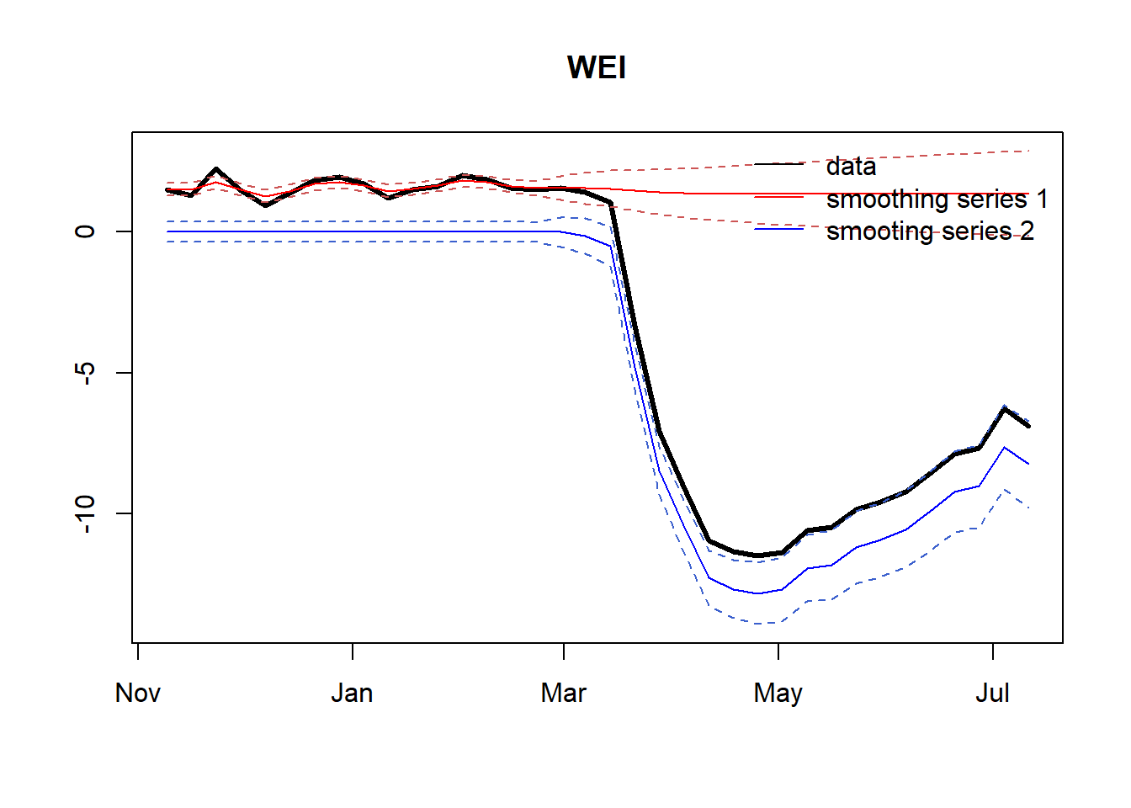
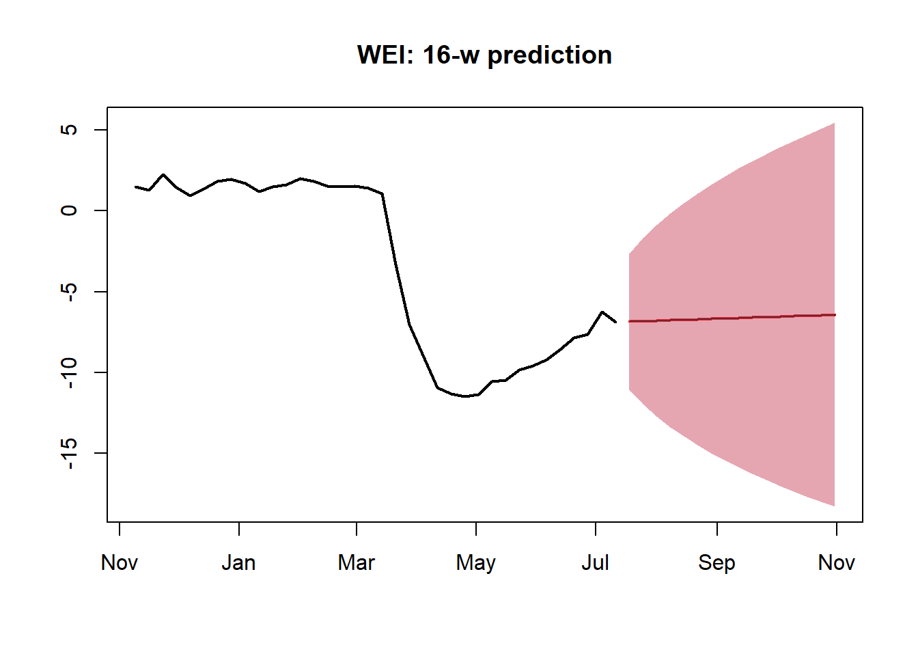
The post-vaccine recovery: Transition from fast to slow dynamics?
Fast and slow factors in weekly data: FRB NY-Dallas Weekly Economic Index

Slide 12
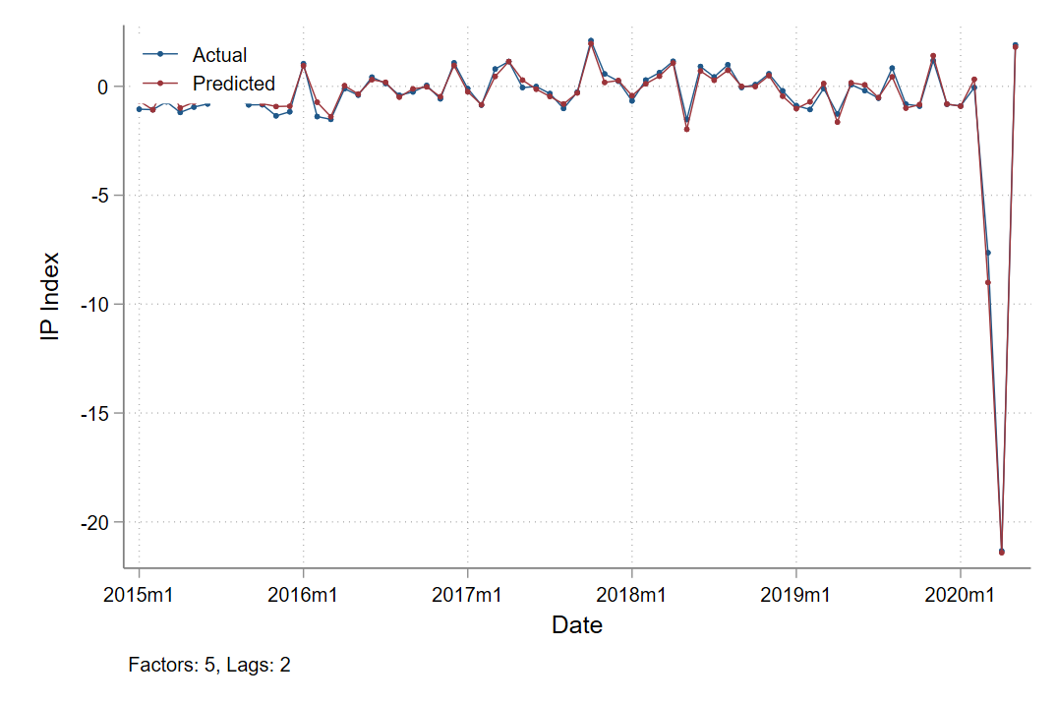
The post-vaccine recovery: Stability of monthly comovements?
Industrial production

Slide 13
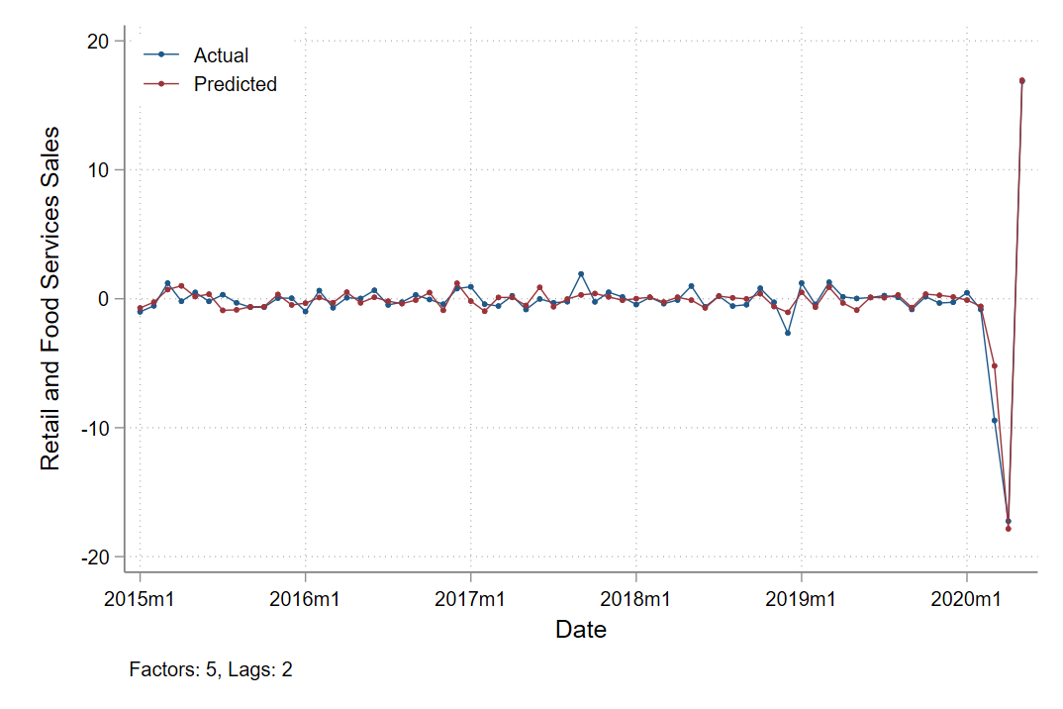
The post-vaccine recovery: Stability of monthly comovements?
Retail sales

Slide 14
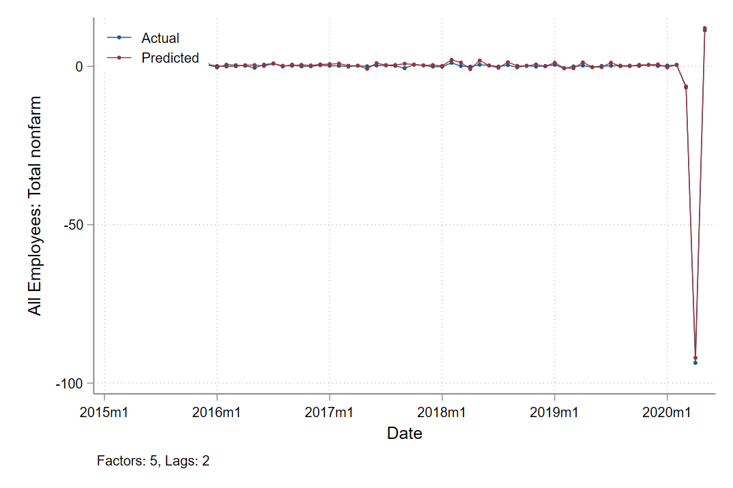
The post-vaccine recovery: Stability of monthly comovements?
Payroll employment

Slide 15
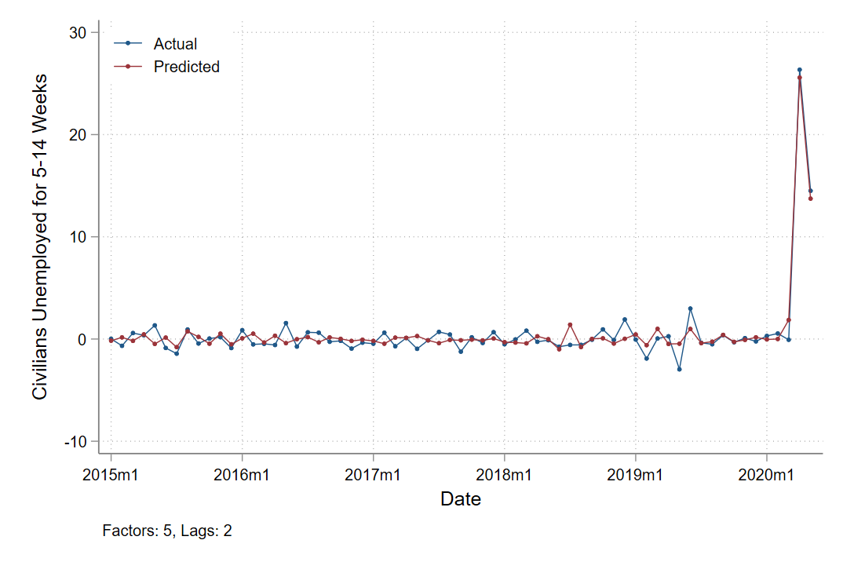
The post-vaccine recovery: Stability of monthly comovements?
Unemployment,
5-14 weeks

Slide 16
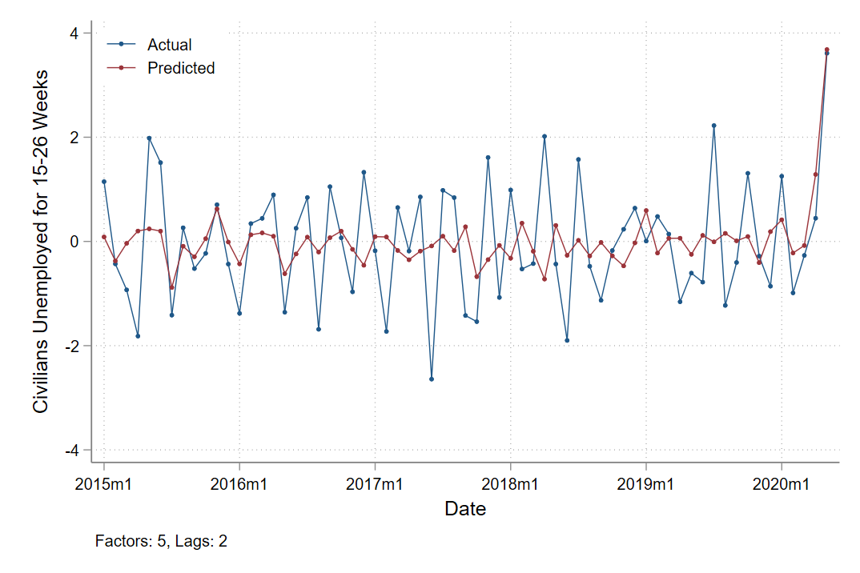
The post-vaccine recovery: Stability of monthly comovements?
Unemployment,
15 – 26 weeks

Slide 17
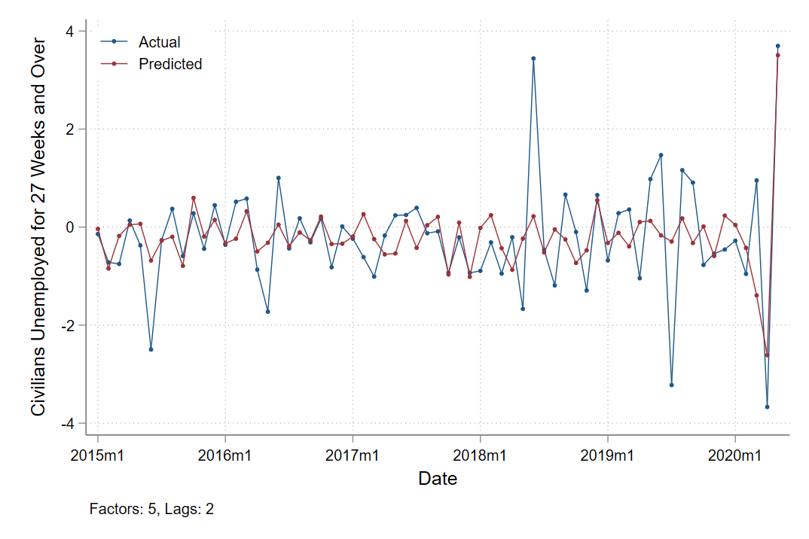
The post-vaccine recovery: Stability of monthly comovements?
Unemployment,
27+ weeks

Slide 18
The post-vaccine recovery: Concluding remarks
There has been a lot of speculation on long-term consequences of the COVID-19 recession
Productivity growth
Labor force participation
Major sectoral shifts?
Structure of the workplace?
To me, this speculation seems premature

Slide 19
Additional Slides

Slide 20
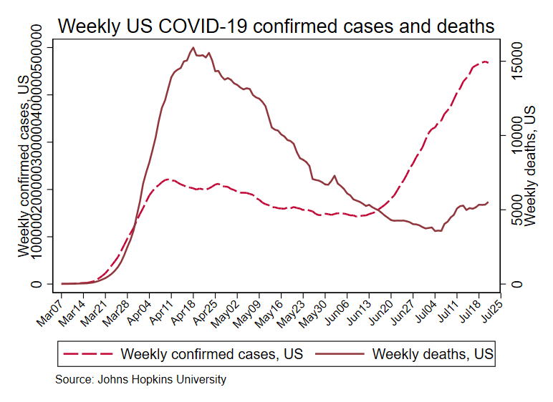
Cases and deaths through July 10
United States

Slide 21
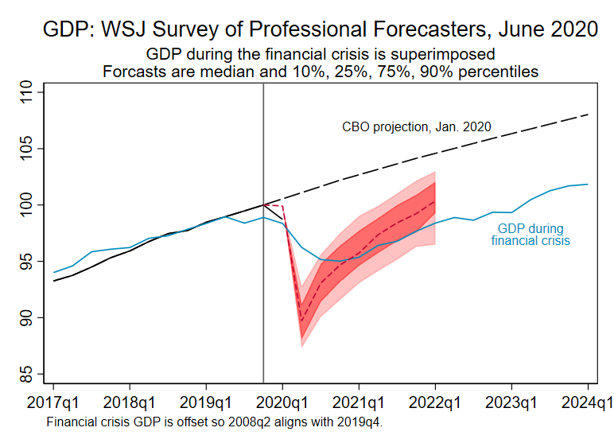
WSJ Macro forecasts

