Slide 1
Capital Flow Management when Capital Controls Leak Julien Bengui & Javier Bianchi
Comments by
Michael Klein
Fletcher School, Tufts University

Slide 2
Capital Controls Redux*
Keynes 1933: “Above all, let finance be national”
Bretton Woods: Capital Controls
1980s, 1990s: Capital account liberalization
Dornbusch 1998 “Capital Controls: An Idea Whose Time Has Passed”
Early 2000s: “More Eclectic” view
Mid-1st Decade: Increasing Use
After Crisis Onset: IMF “Reformation”
Regular tool?
Jeanne, Subramanian & Williamson
Blanchard et al.
Other? Macroprudential “Easier to implement, harder to circumvent” than Capital Controls (Erdem Başçi)
* Brought back, restored

Slide 3
This Conference:
Research & Policy
Policy shift prompts research
Theory: Bianchi, Korinek, Mendoza, Jeanne, Werning & Farhi, Schmitt-Grohe & Uribe
Empirics: Klein, Forbes, Fratzscher, Shambaugh
Research refines policy
Theory: Conceptual
Empirics: Parameters, other factors
Bengui & Bianchi: Empirics informs Theory.
Efficacy of Capital Controls
“Gates” vs. “Walls”

Slide 4
CFM: Towards What End?
Macro Stabilization
Theory: Farhi & Werning, Schmitt-Grohe & Uribe
Empirics: Klein & Shambaugh
Prudential
Theory: Korinek, Bianchi, Mendoza
Empirics: Klein, Forbes, Forbes & Warnock, Forbes & Klein, Forbes & Fratzscher

Slide 5
Bengui and Bianchi
Sophisticated modelling, carefully done
Transparent: Good job of developing intuition.
Important Contribution
1st Generation: τ chosen optimally, effective
τ resolves pecuniary externality of overborrowing
But tension between theory & empirics: efficacy
2nd Generation: τ efficacy differs across groups.
τ imposed only on “Regulated,” so must be bigger to address pecuniary externality
τ also causes allocative inefficiency between Regulated and Unregulated groups.
2nd Generation vs. 1st Generation: Welfare gains from capital controls mitigated

Slide 6
Main Channel
Collateral may constrain borrowing, b
Two Groups: Restricted & Unrestricted
↓b_{R,0} →↓C_{R,0} →↑W_{R,1} →↑P_{N,1} →↑W_{U,1} →↑ b_{U,0}
Tax on inflows, τ₀, affects b_{R,0}
↑τ →↓b_{R,0}→↑W_{R,1}→↑ p_{N,1}→↑ W_{U,1}→↑b_{U,0}
Mitigates aggregate effect of tax on inflows
Where would inflows have gone?
If p_{N} is housing, could ↑τ →↓ p_{N,1}?

Slide 7
Efficacy and Character of τ
Focus of paper
Main result: Unregulated reduces τ efficacy
Thus, τ must be bigger with increase (U/R)
Optimal τ bigger w/ bigger initial wealth of the Unregulated?
Who are Unregulated?
Alfaro, Chari & Kanczuk: Differential effects across firms.

Slide 8
Efficacy and Character of τ
Different assets rather than different agents?
Short Maturity vs. Long Maturity
Debt vs. Equity
Some assets seen as more likely leading to a bust

Slide 9
Table 1: Capital Controls in Brazil, 2008-2012
2 asset classes

Slide 10
Efficacy and Character of τ
Dynamics: Multi-period, but when is τ imposed?
Gates vs. Walls: Long-Standing or Episodic?
Recognition / Implementation lags?
τ more leaky over time? (like ↑ U/R w/time)
Widening net as τ more leaky, not just increasing value of τ

Slide 11
Table 1: Capital Controls in Brazil, 2008-2012
Episodic

Slide 12
Quantitative Implications: Rate
Small optimal tax: 1% to 1.7%. Reasonable?

Slide 13
Table 1: Capital Controls in Brazil, 2008-2012
Size of Tax

Slide 14
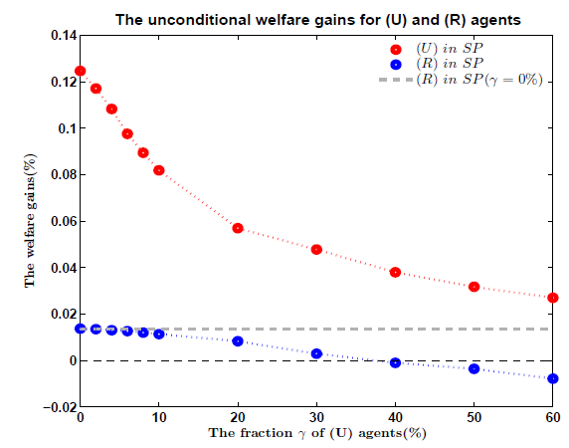
Quantitative Implications; Welfare
Small optimal tax: 1% to 1.7%.
Small welfare effects (as in Lucas). Utility?

Slide 15
Concluding Thoughts
Important topic, bridging theoretical insights and empirical considerations.
Elegant modeling, strong in building intuition so provides good insights.
Can be extended in variety of ways:
What would inflows have done? Also raised wealth through, say, real estate boom?
Better targeted policies dominate capital controls?
Gates or Walls? If Gates, when are policies imposed, does their efficacy erode over time?
What do we learn from welfare comparisons?

