Slide 1



Monetary Regimes
For Emerging Markets
Jeffrey Frankel
Harvard University & NBER
Panel on Monetary Policy,
Conference on Monetary Policy
and Financial Stability in Emerging Markets,
NBER & Central Bank of the Republic of Turkey,
Istanbul, Turkey, June 13-14, 2014

Slide 2
Instruments & Goals
3 Instruments
  Monetary policy: interest rate
  Foreign exchange intervention
  Macro-prudential regulation.
3 Goals
  External balance: balance of payments
  Internal balance: price & output stability
  Financial stability.

Slide 3
Macro-prudential regulation
A neat “assignment” would let prudential regulation
deal with financial stability and let monetary policy
deal solely with the macro-economy.
But this is too constraining:
  both policies should address both issues:
1) “Prudential” should be “macro”, not just micro:
  Counter-cyclical. E.g., loan-to-value ratios should be tighter
  during overheating than after a crash.
2) CBs should also pay attention to financial stability,
beyond if prudential regulation.
  A CB governor can say “housing prices look high to me.”
  Can tighten requirements: loan/value ratio, reserves, margins…
  Ultimately, if needed, can follow up by tightening monetary policy.

Slide 4
The Choice of Monetary Regimes for Emerging Markets
How are EMs structurally different
from Advanced Economies?
Choice of exchange rate regime
Alternative anchors for monetary policy

Slide 5
I. How are EMs different from Advanced Economies?
Monetary policy-maker has more need for credibility
  a) due to high-inflation histories,
  b) absence of credible institutions,
  c) or political pressure to monetize big budget deficits.
Economy is more exposed to supply shocks
  a) such as natural disasters,
  b) other weather events,
  c) strikes and social unrest,
  d) productivity shocks.
More exposed to terms of trade shocks
  because country tends to be price-taker
  Volatility in price of export commodity on world markets
  Volatility in price of imports like oil on world markets.

Slide 6
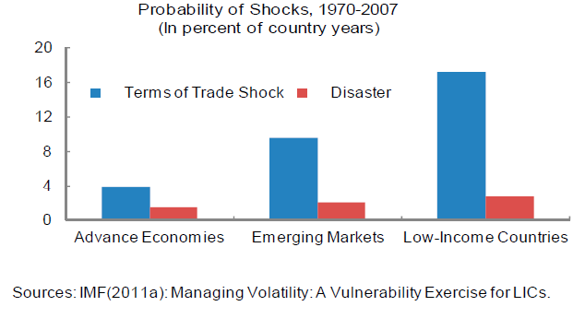

Trade & Supply Shocks are More Common
in Emerging Markets & Low-Income Countries
IMF SPRD & World Bank PREM, 2011, “Managing Volatility in Low-Income Countries:
The Role and Potential for Contingent Financial Instruments,” approved by R.Moghadam & O.Canuto

Slide 7
II. What is the desirable exchange rate regime?
Very small, very open, economies will continue to want to fix their exchange rates, in most cases.
Most countries are in between,
  particularly middle-sized middle-income countries.
Most of these countries should have intermediate exchange rate regimes,
  neither firm fixing nor free floating.
  They include band & basket arrangements.

Slide 8
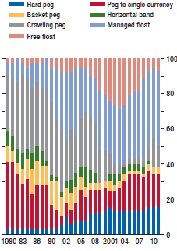
Distribution of EM exchange rate regimes
The big rise is in the “managed float” category
Distribution of Exchange Rate Regimes in Emerging Markets, 1980-2011
(percent of total)
}
Atish Ghosh, Jonathan Ostry & Mahvash Qureshi, 2013, “Exchange Rate Management and Crisis Susceptibility: A Reassessment,”
IMF ARC , Nov..

Slide 9
So I reject the Corners Hypothesis.
But Stan Fischer has a good point: giving speculators
a target to shoot at is often a losing proposition (“disastrous”),
    such as the boundary of a declared band.
A particular intermediate regime could be useful,
a systematic sort of managed floating:
A rule could say that for every 1% of Exchange Market Pressure,
the central bank takes x % as an appreciation of the currency
and (1-x) % as an increase in reserves (relative to the monetary base).
  This arrangement, tho rather obvious, has seldom been formalized.
  The parameter x calibrates exchange rate flexibility,
    and can range from 0 (fixing) to close to 1 (full flexibility).
  Thus one can have ½ monetary independence
  + ½ exchange rate stability.

Slide 10
Systematic managed floating
refutes the corners hypothesis,
  but without capital controls,
  without violating the Impossible Trinity,
  and even without giving speculators
  a line to shoot at.
≈ what some central banks do anyway.
  Attempts at econometric estimation
    G.Adler & C.Tovar, 2011, “Foreign Exchange Intervention:
    A Shield Against Appreciation Winds?” IMF WP 11/165.
    J.Frankel & D, Xie, 2010, “Estimation of De Facto Flexibility Parameter and Basket Weights in Evolving Exchange Rate Regimes,” AER.

Slide 11
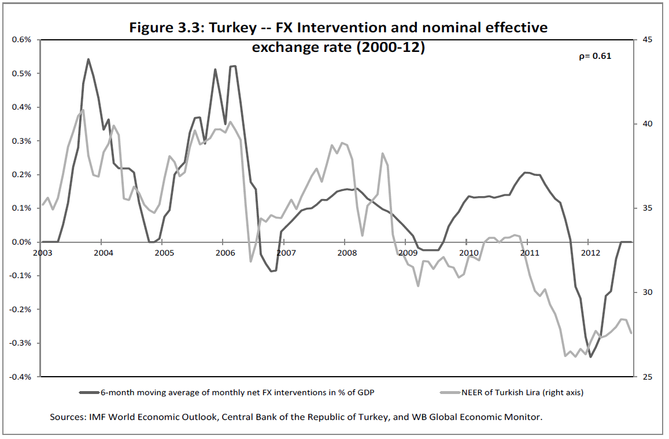

Systematic managed float (“leaning against the wind”):
Turkey’s central bank buys lira when it depreciates,
and sells when it is appreciates.
Kaushik Basu & Aristomene Varoudakis, Policy RWP 6469, World Bank, 2013,
“How to Move the Exchange Rate If You Must: The Diverse Practice of Foreign Exchange Intervention by Central Banks and a Proposal for Doing it Better” May, p. 14

Slide 12




Korea & Singapore took them mostly in the form of reserves,
Example: Renewed capital inflows to Asia in 2010
while India & Malaysia took them mostly
in the form of currency appreciation.
more-managed floating
Slope
= 1/x
less-managed floating
GS Global ECS Research

Slide 13


Renewed inflows in 2010 in Latin America
were reflected mostly as reserve accumulation in Peru,
but as appreciation in Chile & Colombia.
more-managed floating
Slope
= 1/x
less-managed floating
Source: GS Global ECS Research

Slide 14
III: If the exchange rate is not to be the anchor for monetary policy, what is?
The need for an alternative anchor led many EMs to IT,
  after the currency crises of the late 1990s
  pushed them off exchange rate targets.
IT (Inflation Targeting) was in many ways successful.
Two problems with IT:
  Neglect of asset bubbles
  Neglect of exogenous supply & trade shocks.
    Remember the textbook maxim: the exchange rate
    should accommodate terms of trade shocks.
    If IT sets the CPI, it doesn’t allow the exchange rate
    to rise & fall with the terms of trade.
    When the world price of imported oil rises, a literal CPI target says to tighten monetary policy enough to appreciate the currency,
      the opposite of accommodating the adverse trade shock.

Slide 15
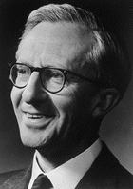
Nominal GDP Targeting
NGDPT is more robust with respect to
supply shocks & terms of trade shocks,
  compared to the alternative of IT.
The logic holds whether the immediate aim is
  Disinflation (as in 1980s, and today among some EMs);
  Monetary stimulus (as among big ACs recently);
  or just staying the course.

Slide 16
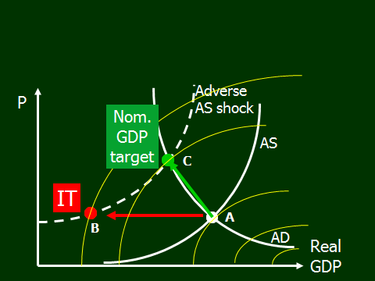
Figure 2: When a Nominal GDP Target
Delivers a Better Outcome than IT
Supply shock is split between output & inflation objectives
rather than falling exclusively on output as under IT (at B).

Slide 17
Last point: NGDPT for EMs
The proponents of Nominal GDP Targets
have focused on the biggest countries.
But middle-size, middle-income countries
are better candidates.
Why? They suffer bigger supply shocks & trade shocks.
Evidence suggests that the AS curve is indeed sufficiently steep so that NGDPT minimizes quadratic loss function:
  “Nominal GDP Targeting for Middle-Income Countries,”
  June 2014 for Central Bank Review, of CBRT.
Conclusion: EMs should consider NGDPT
as a serious alternative to IT & exchange rate targeting.

Slide 18
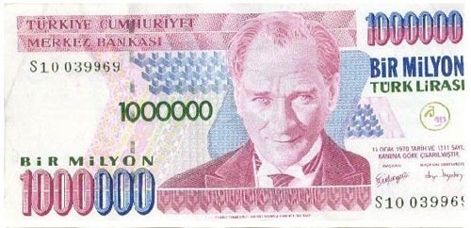
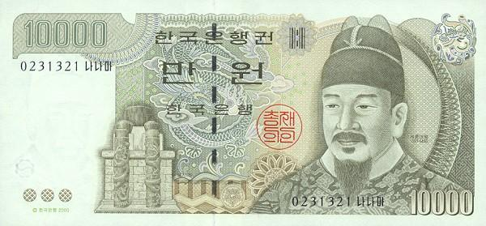


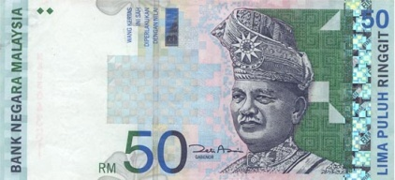
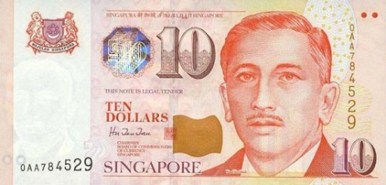
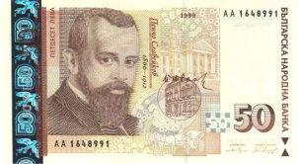
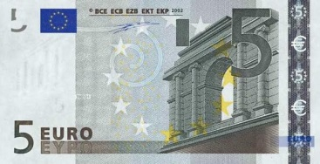

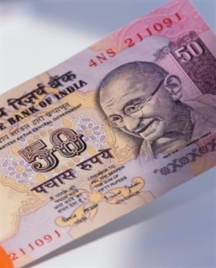
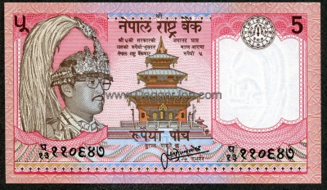

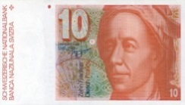

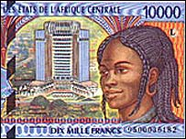
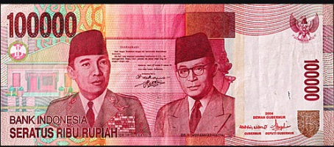
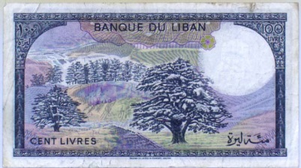
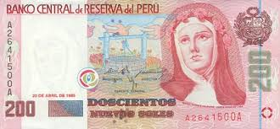

Slide 19
Appendices
Boom-bust cycle in EM capital flows
External shocks
  “Risk off”
  US interest rates
Which countries withstand shocks
  In 2008-09 and previous crises?
  In 2013 temper tantrum?

Slide 20
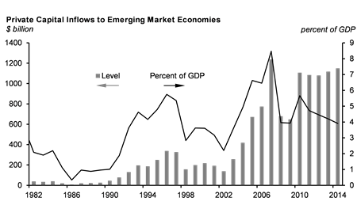
3 waves of capital flows to Emerging Markets:
late 1970s, ended in the intl. debt crisis of 1982-89;
1990-97, ended in East Asia crisis of 1997-98;
and 2003-2008, ended … when?
IIF
http://www.iif.com/press/press+406.php

Slide 21
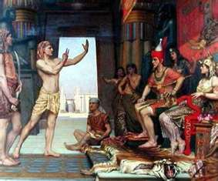
The Joseph cycle
Joseph prophesied 7 years of plenty,
with abundant harvests from a full Nile
-- followed by 7 lean years of drought & famine.
The Pharaoh empowered his technocratic official (Joseph) to save grain in the 7 years of plenty,
  building up sufficient stockpiles to save the Egyptian people
  from starvation during the bad years.
  -- a valuable lesson for today’s government officials in industrialized & developing countries alike.
21

Slide 22
Biblical cycle, cont.
For emerging markets,
the first phase of 7 years
of plentiful capital flows occurred in 1975-1981,
  recycling petrodollars as loans to developing countries.
  The international debt crisis that began in Mexico
  in 1982 was the catalyst for the 7 lean years,
    known in Latin America as the “lost decade.”
  The turnaround year, 1989, saw the 1st Brady bond issue.
22

Slide 23
Biblical cycle, cont.
The second cycle of 7 fat years was
the period of record capital flows
to emerging markets in 1990-96.
  The 1997 “sudden stop” in East Asia
  was then followed by 7 years of capital drought.
The third cycle of inflows, often identified with
“carry trade” & “BRICs” came in 2004-2018
  and persisted even through the Global Financial Crisis.
If history repeats, it may be time for a 3rd
sudden stop of capital flows to emerging markets!
23

Slide 24
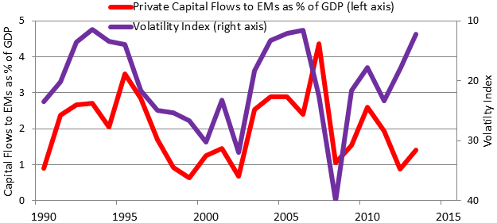
When implicit volatility is high (↓ in graph), capital flows to EMs fall: “Risk off” (e.g., 2009 GFC)
Kristin Forbes, 2014 http://www.voxeu.org/article/understanding-emerging-market-turmoil
Notes: Data on private capital flows from IMF's IFS database, Dec. 2013. Capital flows are private financial flows to emerging markets and developing economies. Volatility index measured by the Chicago Board's VIX or VXO at end of period. 2013 data are estimates.
See K.Forbes & F.Warnock (2012), “Capital Flow Waves: Surges, Stops, Flight and Retrenchment”, J. Int.Ec.

Slide 25
The role of US monetary policy
Low US real interest rates contributed to EM flows
in late 1970s, early 1990s, and early 2000s.
The Volcker tightening of 1980-82 precipitated
the international debt crisis of 1982.
The Fed tightening of 1994 helped precipitate
the Mexican peso crisis of that year.
But the correlation is not always there.

Slide 26
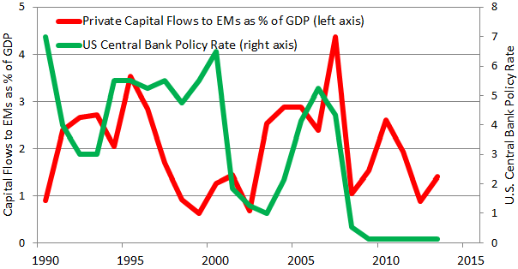
The relationship between the Fed’s interest rate and EM capital flows does not always hold.
Kristin Forbes, 2014 http://www.voxeu.org/article/understanding-emerging-market-turmoil
Notes: Data on private capital flows and policy rates from IMF's IFS database, Dec. 2013 version. Capital flows are private financial flows to emerging markets and developing economies. Policy rates measured at end of period. Data for 2013 are estimates.

Slide 27
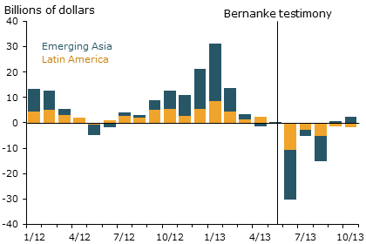
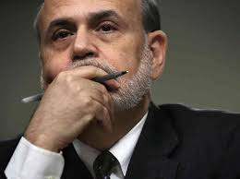
After Fed “taper talk” in May 2013, capital flows to Emerging Markets reversed again.
Powell, Jerome. 2013. “Advanced Economy Monetary Policy and Emerging Market Economies.”
Speech at the Federal Reserve Bank of San Francisco Asia Economic Policy Conference, November .
http://www.frbsf.org/economic-research/publications/economic-letter/2014/march/federal-reserve-tapering-emerging-markets/

Slide 28
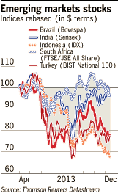
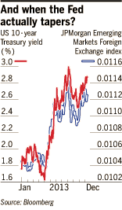
When Ben Bernanke
warned of tapering QE
in May/June 2013,
US interest rates rose,
and EMs fell.
Financial Times

Slide 29
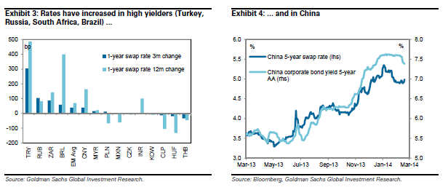
Global investors required higher interest rates from EMs after May 2013
Global Economics Weekly: 14/07 - The downside risks to EM growth and their market implications, 2/19/2014

Slide 30
Which EM countries are hit the hardest?
For past studies of past crises, such as 1997-98,
Early Warning Indicators that worked well include:
  Foreign exchange reserves
    especially relative to short-term debt;
  Currency overvaluation;
  Current account deficits.
E.g.,
  J. Frankel & A. Rose (1996) "Currency Crashes in Emerging Markets," JIE.
  G. Kaminsky, S. Lizondo, & C.Reinhart (1998) “Leading Indicators of Currency Crises," IMF Staff Papers.
  G. Kaminsky, & C.Reinhart (1999)
  J. Frankel & G. Saravelos (2012) “Are Leading Indicators Useful for Assessing Country Vulnerability? Evidence from the 2008-09 Global Financial Crisis.” JIE.

Slide 31
The variables that show up as the strongest predictors of country crises in the past are:
(i) reserves and (ii) currency overvaluation
Source: Frankel & Saravelos (2012)

Slide 32
Many EM countries learned lessons from the crises of the 1990s, which better-prepared them to withstand the Global Financial Crisis of 2008-09
More-flexible exchange rates
Higher reserve holdings
Less dollar-denominated debt
    More local-currency debt
    More equity & FDI
Fewer Current Account deficits
Stronger government budgets

Slide 33

Foreign exchange reserves are useful
One purpose is dampening appreciation,
  thus limiting current account deficits.
Another is the precautionary motive.
The best predictor of who got hit in the 2008 Global Financial Crisis was reserves
      Frankel & Saravelos (2012).
      Dominguez & Ito.
  This was the same Warning Indicator that also had worked in the most studies of earlier crises.

Slide 34



Best and Worst Performing Countries in Global Financial Crisis of 2008-09-- F&S (2010), Appendix 4

Slide 35
Which EM countries were hit the hardest by the “taper tantrum” of May-June 2013?
Those with big current account deficits,
or with exchange rate overvaluation.
Reserves did not seem to help this time.
E.g.,
  B. Eichengreen & P. Gupta (2013) “Tapering Talk: The Impact of Expectations of Reduced Federal Reserve Security Purchases on Emerging Markets,” Working Paper.
  Jon Hill (2014), “Exploring Early Warning Indicators for Financial Crises in 2013 & 2014,” HKS, April.

Slide 36
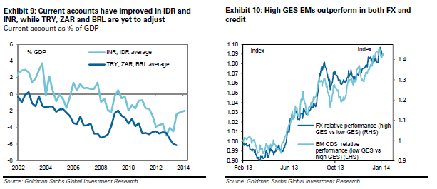
Current account deficits opened up among the “Fragile Five” after 2005
Global Economics Weekly: 14/07 - The downside risks to EM growth and their market implications, 2/19/2014

Slide 37
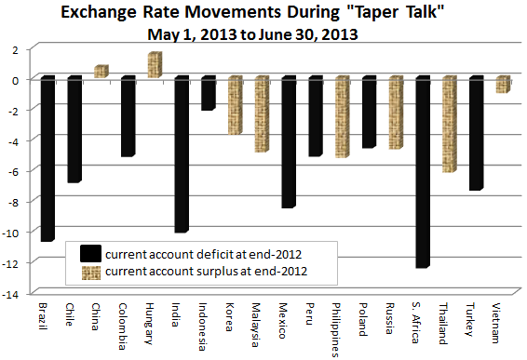
Countries with current account deficits were hit in June 2013.
The “Fragile Five”
Kristin Forbes, 2014
http://www.voxeu.org/article/understanding-emerging-market-turmoil

Slide 38
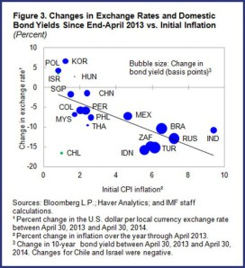
Countries with high inflation rates were also hit in the year since May 2013.
A.Klemm, A.Meier & S.Sosa, IMF, May 22, 2014
Taper Tantrum or Tedium: How U.S. Interest Rates Affect Financial Markets in Emerging Economies

Slide 39
Conclusion
Many EMs learned lessons from the 1980s & 1990s,
and by 2008 were in a stronger position to withstand shocks:
  More flexible exchange rates
  More fx reserves
  Less fx-denominated public debt
  Stronger budget positions
  Stronger current account positions.
Some backsliding since 2009:
  Weaker budgets
  Current account deficits
  The return of fx-denominated private debt.
A promising direction: macroprudential regulations
  E.g., counter-cyclical loan-to-value ratios for mortgages.

