Slide 1
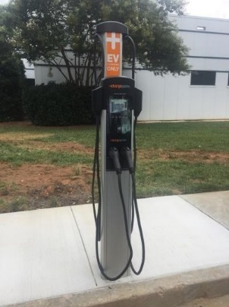
Connecting your Driver Account to Charge at your location
Step 1: Download ChargePoint Mobile App to your smart phone.
Follow the instructions to create a ChargePoint account. You will be asked to provide payment method (Credit Card, PayPal, or Apple Pay) when creating a new account.
Step 2: You’ll need a connection code from your location (code is listed on page 3)
Contact your property/program manager to get the ChargePoint Connection Code so you can access charging at your location. If your property/program manager needs assistance with approving your driver account, please ask them to contact ChargePoint Support. (U.S. and Canada Toll Free: 1-877-850-4562 menu option 2. Hours: Mon - Fri, 5am PST - 6pm PST)
Step 3: Enter the connection code into your driver account (steps listed on page 2)
Step 4: Charge using your mobile app (or network card once it arrives in the mail)

Slide 2
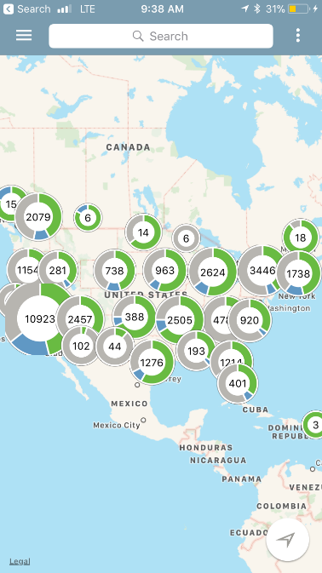
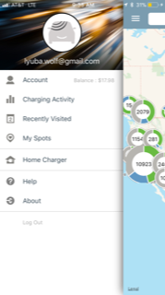
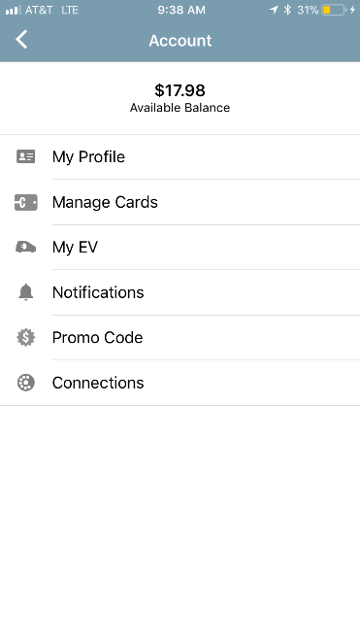
How to enter your connection code
1. Tap on menu icon
2. Select Account
2. Select Connections
2. Select Browse

Slide 3
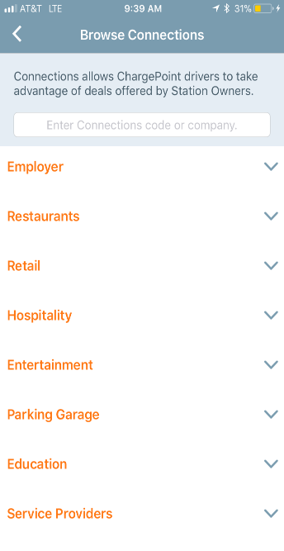
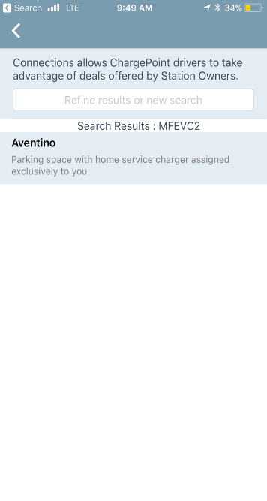
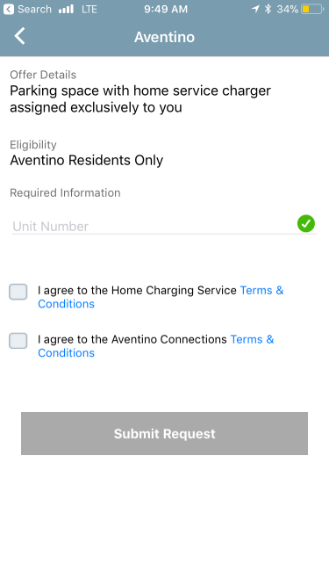
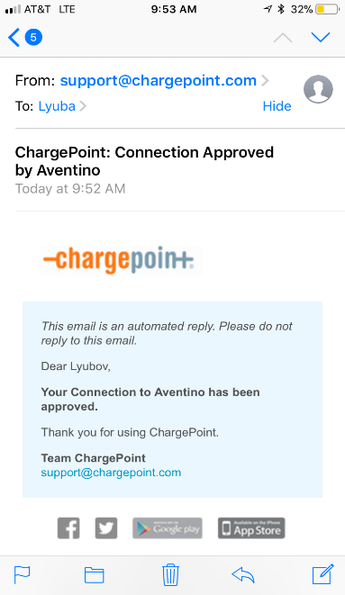
How to enter your connection code (continued)
Company Connection Code: Lincoln10
5. Enter the code from above in green
6. Click on your site
7. Enter info requested
8. You’ll receive an email once your driver account has been approved

