Slide 1
Health Care in the U.S.: The Demand Side
Jonathan Gruber
December, 2019

Slide 2
Distribution of the U.S. Population Across Health Insurance Types
Table 15-1
 | People (millions)
Total population | 320.4
Private | 216.2
Employment-based | 178.5
Direct purchase | 52.0
Public | 119.4
Medicare | 53.4
Medicaid | 62.3
Tricare/CHAMPVA | 14.6
The uninsured | 28.1
Data from: U.S. Bureau of the Census (2018b), Table 1.

Slide 3
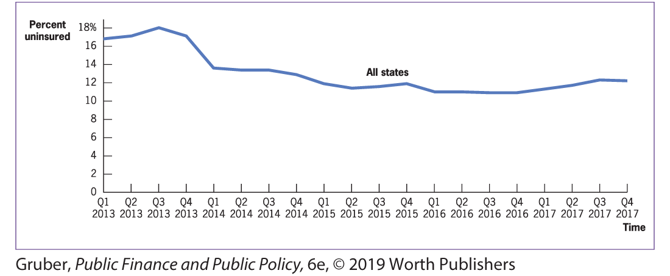
Trends in Uninsurance for Adults Ages 18 to 64
Figure 16-5
Uninsurance rates among the states declined precipitously from 2014 through 2016 before rising again in 2017.

Slide 4
Why is Most Private Insurance from Employers?
Risk pooling and Economies of Scale
99% of firms > 200 employees offer
48% of firms <10 employees offer
Tax-subsidy to employer-provided insurance
$250 billion in foregone income/payroll tax
Subsidy to employees, not employers
Tax subsidy is regressive and inefficient
Five-sixth of benefits to upper half of income distribution
Leads to excessive spending on insurance

Slide 5
Failures of Non-Group Insurance Market
Pre-ACA - Failure in non-group insurance market
Pre-existing conditions exclusions & rejection
Hendren: Can be optimal if private info correlated with costs
Risk rating
Experience rating
No dynamic insurance
Perhaps a second-best argument for tax exclusion
Preserve a working market in face of a non-working one
But first best would be to fix this market and get rid of tax exclusion (foreshadowing…)

Slide 6
Uninsured
Why uninsured
Insurance market failure (selection & administrative costs)
Strategic underinsurance - EMTALA
Irrational underinsurance
Little empirical decomposition
Why do we care?
Externalities: physical (small) & financial (large - $50+ billion)
Decomposition/measurement of financial externalities
Inefficiencies of care delivery
Paternalism
Job lock & labor market efficiencies

Slide 7
The Health Insurance Problem
Standard social insurance tradeoff
Benefits of more generous insurance
Primary: better consumption smoothing
Secondary: better health
Costs of more generous insurance
Ex-ante moral hazard (e.g. safety)
Ex-post moral hazard (e.g. overuse)

Slide 8
Consumption Smoothing Benefits (I)
Finkelstein & McKnight – introduction of Medicare
Use pre-existing variation in insurance coverage before 1965
40% decline in OOP spending for top quartile
Input into expected utility function
Suggests welfare gains from risk reduction = 40% of program costs
Engelhardt & Gruber – Introduction of Medicare Part D
Little impact on oop spending on average
Large reduction in tails
Argue that welfare gains equal to DWL of financing program

Slide 9
Consumption Smoothing Benefits (II)
Baicker, Finkelstein et al. – Oregon Health Insurance Experiment
Randomized lottery of 100,000 folks to 10,000 slots
Survey & administrate data for 12000 treatments & controls
Lots of slippage due to takeup & dynamics of insurance
Sizeable consumption smoothing effects
35% decline in odds of any OOP medical expense (remember: very poor)
Significant decline in collection agency activity for medical debt
40% decline in having to borrow money/skip paying bills for medical costs

Slide 10
Ex-ante Moral Hazard
Very little evidence on this front
OHIE – no impact of health insurance on risky behaviors like smoking and drinking
Huge increase in preventive care
But this could be price effect
Bottom line: no evidence that this is significant issue

Slide 11
Ex-Post Moral Hazard

Slide 12
Ex-Post Moral Hazard – RAND HIE (I)
RAND Health Insurance Experiment
Began in 1974
2000 families across 6 locations
Randomized into five health insurance options
Free Care
Three varying coinsurance rates
Individual deductible for outpatient care only

Slide 13
Ex-Post Moral Hazard – RAND HIE (III)
Health care is modestly elastic: -0.2 elasticity
No evidence for offsets
Inpatient utilization lower with outpatient deductible
Relatively consistent (percentage) impacts across services
Reduction in both “appropriate” and “inappropriate” care
In particular, immunizations & pap smears reduced
But also criticism
Finkelstein: linear elasticity not well identified with dynamic structure
Suggests that need structural simulations to estimate impact on spending

Slide 14
Ex-Post Moral Hazard – Post HIE
HIE remains the gold standard – but others have confirmed
Striking evidence in Shigeoka (2014) – next slide
Large volume of studies on prescription drug elasticity – wider range, some higher elasticities
Part D response implies fairly high elasticity
Chandra et al. first to look at elderly
Similar elasticities to RAND
But do find offset effects
Concentrated in chronically ill – 50% plus for this population

Slide 15
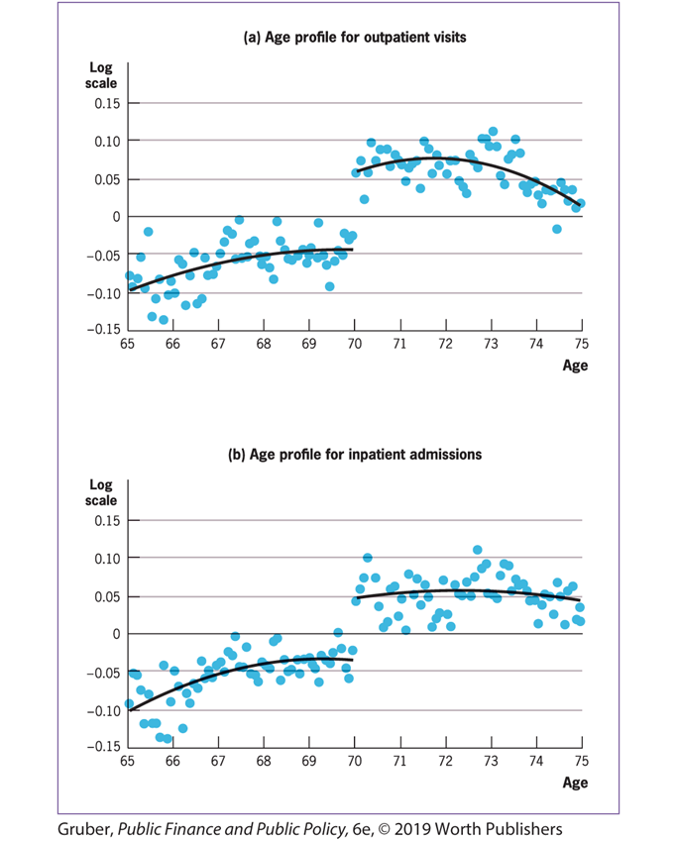

Slide 16
Impacts of Insurance on Health
Two overview issues
Measurement of health is a challenge
Best possible measure: mortality
Self-reported is correlated
But need to worry about information effect
Lab testing is expensive
Process measures mix moral hazard & outcomes
Need to distinguish here marginal impacts of more generous insurance from broader impacts of being insured

Slide 17
Health Insurance Generosity and Health
Starting point is RAND HIE
No impacts on health (within standard errors)
Suggestion of impacts for low income/chronically ill
Only one measure, not highly significant
Very little work since due to data limitations
Chandra et al.: offset effect for chronically ill may suggest worse health

Slide 18
Health Insurance Coverage and Health (I)
Observational literature suffers from selection problems
Quasi-experiments show consistently large effects
Lurie et al.: removal of public insurance in CA in 1980s – higher blood pressure
Hanratty: expansion of public insurance in Canada in 1960s – 4% decline in infant mortality
Currie & Gruber: Medicaid expansions of the 1980s
Variation by state/year/age – complicated function of demographics
Create “simulated instrument” to parameterize
Strong reductions in newborn/child mortality
Somers et al.: Massachusetts reform
Compare to other states, and focus on target groups
Sizable reductions in mortality – one death saved per 800 covered

Slide 19
Health Insurance Coverage and Health (II)
Oregon experiment considers wider variety of outcomes – and has more mixed results
No significant impacts on physical health measures in near term
Enormous effects on mental health – 30% reduction in depression
Large effects on self-reported health – mostly mental
Why contrast with quasi-experiments?
Power: confidence intervals include clinically relevant values
But then so do confidence intervals for RAND HIE
General equilibrium/treatment style effects

Slide 20
Suggests “Flat of the Curve”

Slide 21
Lessons for Optimal Health Insurance
First dollar coverage is rarely optimal
DWL from moral hazard highest
Consumption smoothing benefits lowest – all comes from tails
Value of income-relating OOP limits
Exception may be for chronically ill – particularly low income
Suggestion from RAND HIE
Chandra et al. evidence
Argument for “Value-Based Insurance Design”
Fendrick et al. (2001)
Case studies suggest value, but broader design issues await
That’s not what HI in the U.S. looks like!

Slide 22
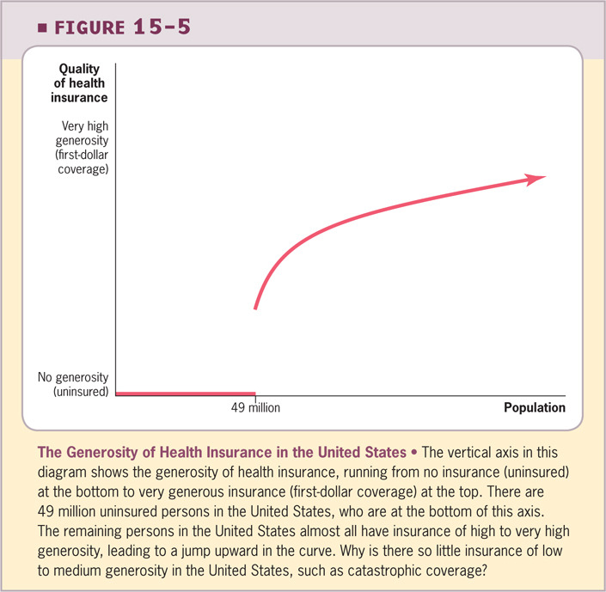

Slide 23
Why “Overinsurance” in U.S.?
Tax subsidy
Gruber & Lettau – elasticity of 0.7
But not large enough
Access motive
Not all higher use is moral hazard – could be relaxing liquidity constraints
Hard to imagine this is important for first dollar coverage
Behavioral motivations
Commitment device to have money and get care you need
Irrationality around tradeoffs between money & health

Slide 24
Overinsurance is eroding
Rapid growth in high deductible plans
Important evidence in Brat-Goldberg et al.
Ben to review!

Slide 25
Designing Health Insurance Markets
Two issues to discuss
First, what are the alternative structures of insurance arrangements?
Second, how do we design systems to allow individuals choice across insurance products?

Slide 26
Problem of Fee-for-Service Medicine
Third form of moral hazard on compensation side
Interacts with lack of patient cost sharing
Led starting in 1980s to rapid growth of two alternatives

Slide 27
Preferred Provider Organization (PPO)
Dranove, Satterthwaite & Sindelar paper
Monopolistic competition in hospital market
PPO is middleman shopping on behalf of employer
Raises price elasticity of demand – lowers prices
Rise of PPO did significantly reduce hospital prices
Is this lower costs or just lower rents
Lower costs could be converting from quantity/quality competition (“medical arms race”) to price competition
Evidence unclear

Slide 28
Health Maintenance Organizations (HMO)
Coordinate payment for and delivery of care
HMO receives flat payment and bears risk
Prospective reimbursement model shifts the risk burden and mitigates moral hazard
Two forms
Traditional HMO (Kaiser)
Independent Practice Organization (IPA)
Large growth within Medicare – Medicare Advantage plan
Seniors given choice between traditional FFS Medicare and MA plan
If choose MA plan typically provides wrap around benefits

Slide 29
Evidence on HMOs
Clear evidence of selection
Lower costs – not just selection
RAND HIE suggests 25% lower spending
Why? Evidence mixed
Cutler, McClellan & Newhouse – heart attacks for non-elderly – all prices
Curto et al. TM vs. MA – no price differential, reduced utilization throughout spectrum of care
But both have potential selection
Duggan, Gruber & Vabson - natural experiment from plan exits - 50% decline in inpatient care with no mortality consequences
Managed care seems to improve delivery efficiency
But MUCH more work needed on outcomes – comes back to measurement issues
What about heterogeneity across plans – BEN to discuss

Slide 30
Choice in Medical Markets
Traditionally little choice unless in a large employer
Small employers: single plan
Nongroup: discrimination could limit plan options & can’t effectively shop
Government – monopoly
Huge expansion in choice
Medicare advantage
Medicare Part D
Exchanges
Even choices across MMCOs for Medicaid enrollees
And many policy arguments to go further
Move to “premium support” in Medicare

Slide 31
Pros and Cons of Choice
Pros come from standard econ 101
Competitive pressure on production efficiencies
Match consumer tastes
Duggan & Scott-Morton: Medicare Part D competitive markets lowered costs
Cons come from imperfections in the market
Risk selection by insurers
BEN to discuss
Choice frictions/inconsistencies

Slide 32
Choice Inconsistencies – Abaluck & Gruber
Individuals may not be choosing according to the standard model
Medicare Part D
Standard benefits package (deductible, coinsurance, donut hole)
90% of plans differ – more generous, priced in premium
Huge variety of choices – more than 50 PDPs, plus MA plans
Reduced form fact: elders do not cost minimize/portfolio maximize
Add total costs: premium plus expected oop costs
Alternative models of expectations
12% of elders choose lowest cost – can save 30% on average
Very few elders on efficient frontier

Slide 33
Structural Model of Choice Inconsistencies
Derive logit choice model to show rejection of standard assumptions
Dollar of premiums worth 4-5 times dollar of OOP costs
Elders value plan characteristics independent of individual effect
Large welfare loss from inconsistent choices
Is there learning (2016 paper)? No – choices become worse over time
Most elders don’t switch
Those that do switch don’t do any better

Slide 34
Is this approach valuable?
Debate in 2016 AER with Ketcham et al.
Under sufficiently broad preferences, can’t reject consistent choice
How broad is reasonable?
Most convincing: dominated choices
Bhargava, Lowenstein & Sydnor; Handel – case studies
Liu & Sydnor – systematic evidence across firms
HD dominates LD across half of firms!

Slide 35
Addressing Choice Inconsistencies - Information
Can information do the trick?
Decision support can work if used – but rarely used
Abaluck and Gruber (2017) on bad decision support – Bundorf et al (2019) on good decision support
What about experts? Gruber, Handel, Kina & Kolstad
Experts don’t do much better – same structural errors
But if you give them good decision support, they do much better

Slide 36
Addressing Choice Inconsistencies – Structured Choice
Structured choice can improve outcomes
Massachusetts connector moved to standardized choices
Consumers more satisfied
Erickson and Starc: structural model suggests better choices
Limiting choice set size improves choices – Abaluck and Gruber
Next slide
This isn’t “choice overload”
Coefficients don’t change
It is due to worse choices on average
Benefits of heterogeneity don’t matter if folks don’t choose well

Slide 37
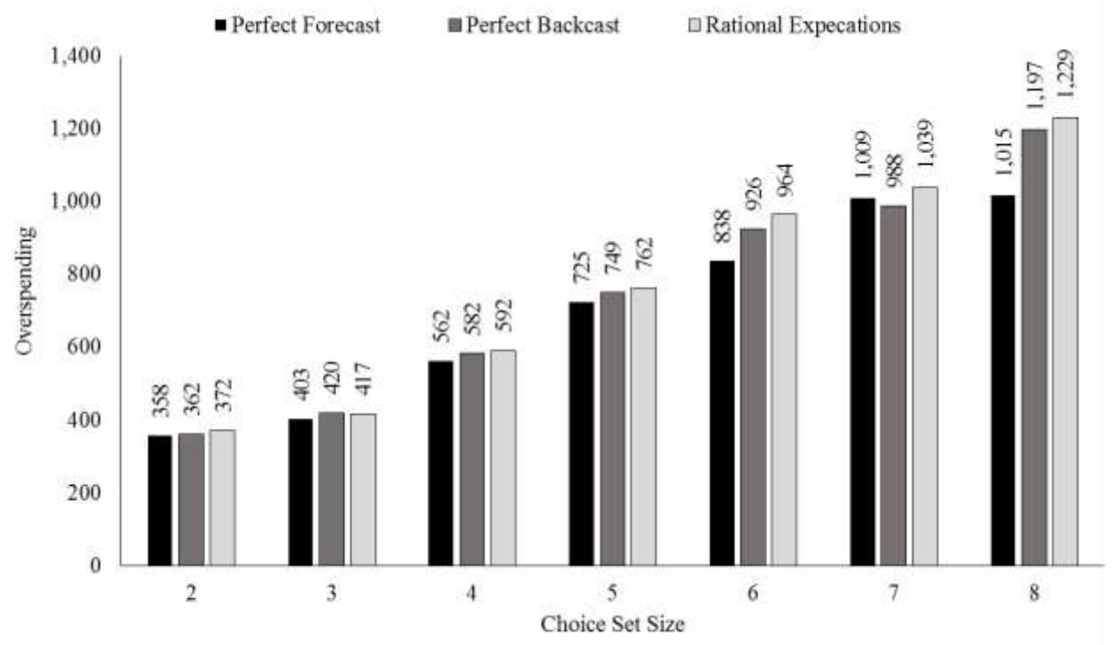
More Choices = More Mistakes
Overspending by Choice Set Size – MODA Only
Figure IIIB from Abaluck and Gruber (2016), NBER WP 22917

Slide 38
Expanding Health Insurance Coverage (JEL article)
Historically no appetite for single payer
Starr (2011): Have built a system that works for most
Incremental approaches face problem of imperfect targeting
Tuna & dolphins: e.g. one-quarter of uninsured turn down ESI, but only 7% of those who turn it down are uninsured
Leads to concern about “crowd out”
Not necessarily an issue for social efficiency
But major issue for government “bang for the buck”
Not just coverage per dollar – depends on who is covered
Dollars of coverage value per dollar of government spending

Slide 39
Crowd Out Not Just for Public Insurance!
Crowd-out is about efficiency of public spending on insurance
Contrast with making all insurance tax deductible (e.g. treating non-group insurance like ESI)
Level playing field with ESI
But largely infra-marginal
Half of uninsured don’t pay taxes!
And reduces incentive for employers to offer
If they drop, then more may become uninsured
Gain in insurance value per dollar of government expenditure small
But does increase horizontal equity

Slide 40
Behavioral Responses – Private insurance
What do we know about relevant behavioral responses?
Employer offering decision price sensitivity varies (Gruber & Lettau)
0.7 elasticity for small firms
Small or no elasticity for medium & large firms
Takeup of ESI incomplete but not price sensitive
Gruber & Washington: tax deductibility for federal employees had no effect
Inefficient population to target with government subsidies

Slide 41
Behavioral Responses – Public Insurance
Takeup of Medicaid only partial
Partly because some already have insurance
But also large issue with non-takeup of free insurance
Stigma?
Information?
Cutler & Gruber: 50% crowdout from Medicaid expansions
Smaller effects with longitudinal approach
Need to consider effect on families & firms & non-entry
Takeup fairly sensitive to even small price changes – Finkelstein, Hendren and Sheppard – next slide
Does this mean that insurance isn’t worth much? Or that individuals are making mistakes?

Slide 42
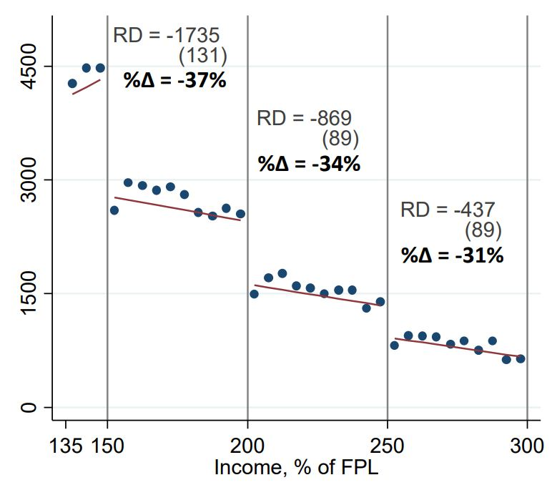
Price matters for insurance enrollment
CommCare Enrollment and Average Insurer Costs, 2009-2013
Average Monthly Enrollment by Income
Figure 4A from Finkelstein, Hendren, and Shepard (2017), NBER WP 23668

Slide 43
Incremental Universalism
Biggest innovation in Massachusetts in 2006 – “Three legged stool”
Insurance market reforms – community rating, guaranteed issue
One of several states in 1990s
Destroyed non group market – highest in the country
Individual mandate to purchase insurance
Bring healthy individuals into the pool
End strategic uninsurance
Subsidies to make insurance affordable
Extensive subsidies to those below 300% poverty line

Slide 44
Effects of MA reform
Covered 2/3 of uninsured – uninsured rate down to 3%
Improved non group market – rates down 50% relative to nation
Crowd-in: Employer sponsored insurance increases
Kolstad & Kowalski (AER): Individual mandate causes rise in demand for ESI that is offset with lower wages
No impact on employer premiums – rates rose at national average
Broadly popular
Becomes basis for ACA

Slide 45
Affordable Care Act
Insurance market reforms nationwide:
Just age (3:1), tobacco (1.5:1) & geography as rating factors
Guaranteed issue & no pre-existing conditions exclusions
Individual mandate
Tax penalty rising to greater of $695 or 2.5% income
exemption if very poor or cost >8% of income
Subsidized insurance
Medicaid expansions for those <133% FPL – selective state takeup
Tax credits for 133-400% FPL – sliding scale with income
State/federal exchanges to improve shopping
Wide variety of cost control steps – mostly on supply side
Exception is cadillac tax

Slide 46
ACA Effects to date – Gruber and Sommers
Impacts on insurance coverage (Frean et al.)
Large gains overall
Most of gains from Medicaid – half new, but half “woodwork”
Very modest price effects of subsidies – lower elasticities than used in modeling
No crowd-out!
Most behavioral work on Medicaid expansions – using state decisions
Improved access to care, more screening, reduced financial distress, better self-reported health
Miller et al. – significant reduction in mortality – 9.4% decline!
Reduced uncompensated care – probably self-financing for states!

Slide 47
Research Questions: Exchanges
Optimal design of exchanges
Active vs. passive purchasing agent?
Role of standardization?
Role of decision support – how are choices made?
Role of exchange in larger market
Monopoly exchange?
What is the role of brokers?
Narrow network plans
Major source of cost savings
Gruber & McKnight: MA results show through more efficient utilization
Shepard: Selection through network design

Slide 48
Insurance for Long Term Care
Institutional care in nursing homes: 70%, but falling
Medicaid is primary insurer – pays about half of costs
Home care: 30%, but rising
Medicare is primary insurer through part A
Major debate over financing
Individuals must “spend down” wealth before getting Medicaid
Happens rapidly with nursing home costs > $60k/year
Crowds out savings for old age
Small market for LTC insurance
Clear market failure problems & crowd out from Medicaid
Simulations (Brown & Finkelstein) suggest large crowd out

Slide 49
Research Question: What to do about LTC?
Existing system: essentially tax estate to pay for LTC – bias towards nursing homes
ACA attempted to set up voluntary LTC insurance through employers
Huge selection issues – couldn’t break even
CLASS Act repealed
Could have mandatory public insurance
Moral hazard? Existing evidence is that it is small for nursing homes
Depends on how widely dollars could be used
Shift the burden from children to the senior
Savings crowd-out – better or worse?

