Slide 1
Demand for older workers – NBER workshop
Gad Levanon
October 2019
Notes:
The Conference Board Economics Watch title slide

Slide 2
Overview
This is a topic where employers are not very forthcoming about
Labor shortages solutions survey
Surprisingly, one of the least used solutions was “Providing new incentives to retain older workers in full or partial capacity”
But the impact of labor shortages makes a difference. We divided companies to “more impacted” versus “less impacted”
20 percent of the “more impacted” companies use this solution
Versus zero percent of the “less impacted”
Labor shortages are much more visible in blue-collar and manual services occupations
Overall, companies are not eager to retain older workers, but some will do it in a severe labor shortages environment

Slide 3
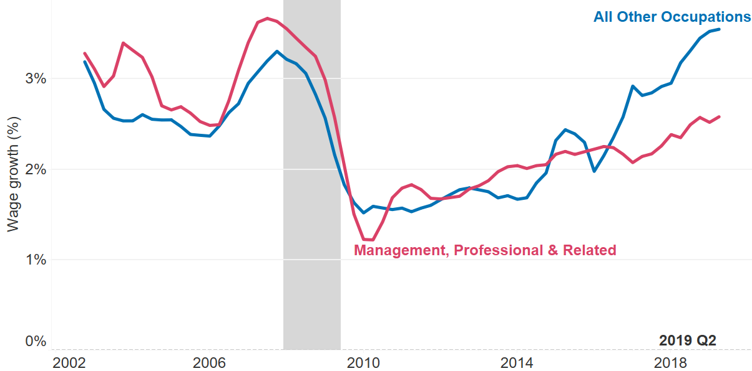
Wages are accelerating, especially for new hires and for blue-collar and manual services occupations
Year-over-year growth in the Employment Cost Index (wages and salaries), 2002 Q4 to 2019 Q2, 4-quarter moving average.
Source: US Bureau of Labor Statistics and calculations by The Conference Board.

Slide 4
The share of mature workers in employment is increasing, especially in blue-collar occupations
Share of workers aged 55 and above in employment by occupation group, 12-month moving average, 2005 to July 2019
Source: The Conference Board using microdata from IPUMS-CPS, University of Minnesota.

Slide 5
Delaying retirement beyond 65 is more difficult in physically demanding blue-collar jobs
Share of workers aged 65 and above in employment by occupation group, 12-month moving average, 2005 to July 2019
Source: The Conference Board using microdata from IPUMS-CPS, University of Minnesota.

Slide 6
Additional insights
Company programs dedicated to retaining older workers often focus on providing mature staff with scheduling flexibility along with additional opportunities for engagement and training.
Some employers eager to hold on to older blue-collar staff pursued additional investments in automation and robotics to adapt work to mature workers facing physical limitations.
Some companies that don’t have formalized programs for retiring older workers, use their white-collar retirees for consulting work on a case-by-case basis.

