Slide 1
Aging and the Production of High-Impact and Transformative Science (HITS)
Katy Bӧrner and Robert Light (Indiana U)
Jerry Marschke and Huifeng Yu (SUNY Albany)
Joseph Staudt and Bruce Weinberg (Ohio State)
Progress report prepared for Innovation in an Aging Society meeting,
Cambridge, MA, July 16, 2015. Thanks to Akina Ikudo and Kelly Chian
for research assistance.

Slide 2
Aim 1
  Develop metrics and visualization tools to identify high impact and transformative science (HITScience),
  Identify the periods in which HITScience is produced,
  Document how these periods relate to the underlying features of fields, including researcher age.
Aim 2
  Document the nature of high-impact and transformative science relative to other work
  Study the inter-relationship between high-impact and transformative work
Notes:
Keep

Slide 3
Outline
Highlights of last six months’ progress:
  New definition of concept of field
  HITS metrics for all of Medline, and some new HITS
    Relating metrics to one another
    Relating metrics to age of field
  A new metric display tool (for vetting with domain experts; for research)
Next steps

Slide 4
Metrics
 | Field Level
High Impact (but not necessarily transformative) | Works highly cited Large number of articles, authors Increase in scientist flows into field
Transformative (and high impact) | Reduction in backward citation ages Durable forward citations Works cited broadly New Concepts, especially new concepts mentioned frequently in future articles Obsolescence: reduction in mentions of/citations to concepts, articles, authors, important in past
Notes:
Orient this and next around what we’ve done

Slide 5
Expanded to all of Medline
Last report: As an initial step we used Neurodegenerative and Alzheimer's (NDA) as our platform for formulating measures
Now all of Medline: Define fields, organize papers into fields and five year bins (1968-1972, 1973-1977, 1978-1982,…,2008-2012)
  Then characterize each field-year bin by HITS measures
Notes:
Focus on career age

Slide 6
How we define an article’s field
Options: MeSH, journal subject categories, text…. We use MeSH
MeSH issues
  Multiple MeSH terms per article
  One-to-many mapping of terms to tree locations
  Not fully hierarchical
Notes:
Focus on career age

Slide 7
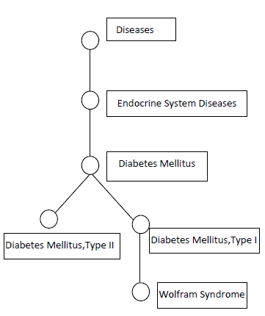
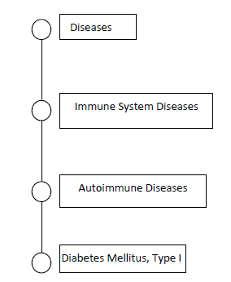
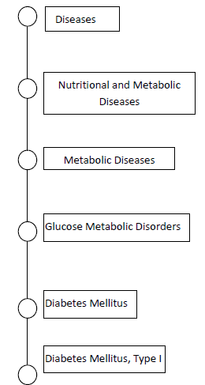
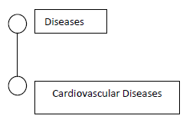
How we define an article’s field
Example Article—MeSH terms: Diabetes Mellitus, Type 1; Cardiovascular Diseases
Level 3
⅓
⅓
⅓
Notes:
Focus on career age

Slide 8
HITS in Medline
First look at HITS
  Do these measures make sense?
  HITS measures “log residualized”—we log measures and take deviations from field and year means, because
    Some measures are size dependent and size of subfields vary
    End point of data affects our measures (e.g. forward citations are right censored)
Notes:
Focus on career age

Slide 9
Validity of our HITS metrics
Alternative HITS metrics should be positively correlated and they mostly are
  Forward citation-based measures are strongly positively correlated with each other
  Forward citation-based, text-based, size-based measures are positively correlated
  Some surprises: In field-year bins with many forward citations, citations peter out relatively quickly (forward citations negatively correlated with forward citation age)
Notes:
Focus on career age

Slide 10
Correlation of HITS and Age Measures
Overall, field age-based measures negatively correlated with citations, text measures, and entry (the entry correlation is partially mechanical)
Ages of entrants positively correlated with citations and text measures
Notes:
Focus on career age

Slide 11
Metric Display Tool
We will use it to solicit expert feedback on our metrics
Practitioners can select their field and the metrics.
The tool will display a heat map representation of the ups and downs over the last 45 years in the field selected, according to the metrics selected.

Slide 12
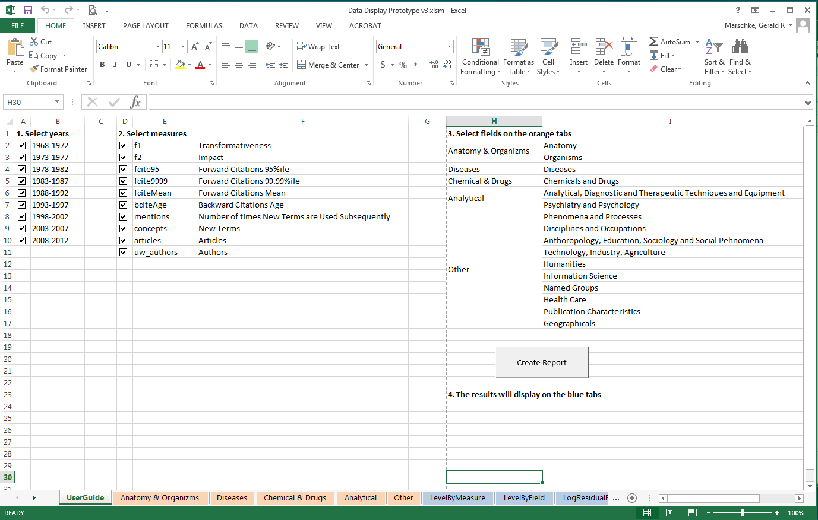

Slide 14
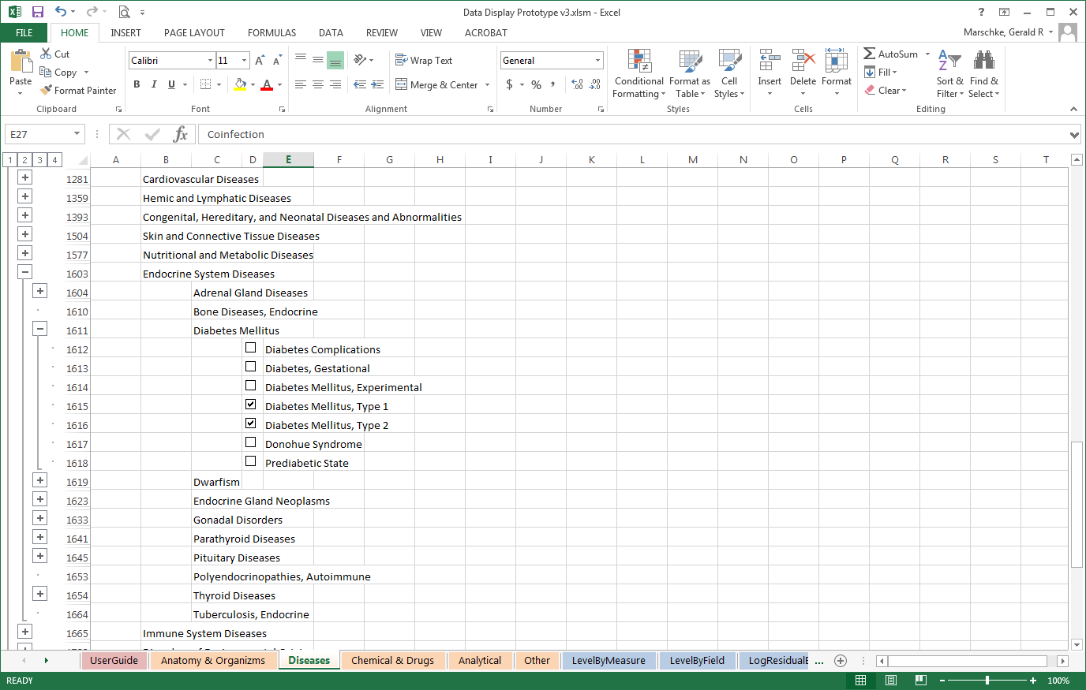

Slide 15
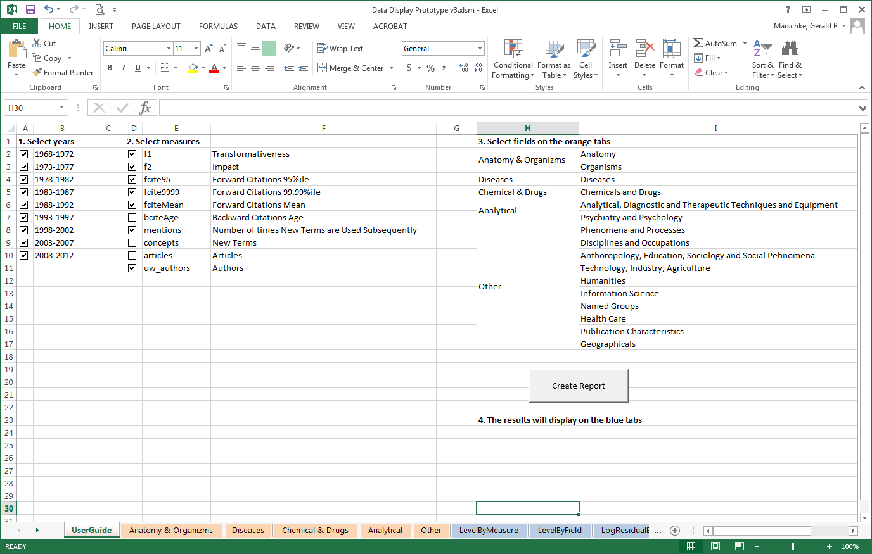

Slide 16
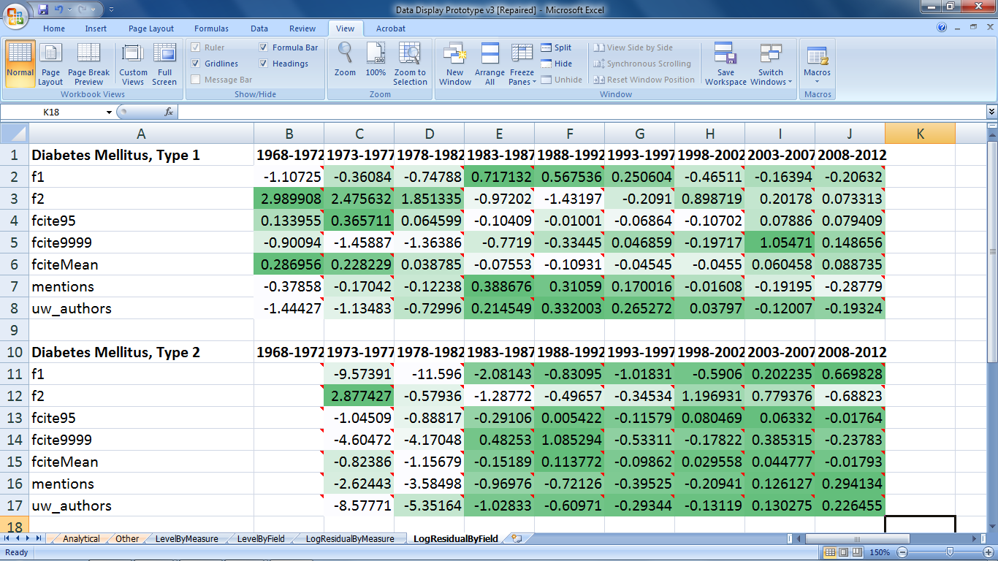

Slide 17
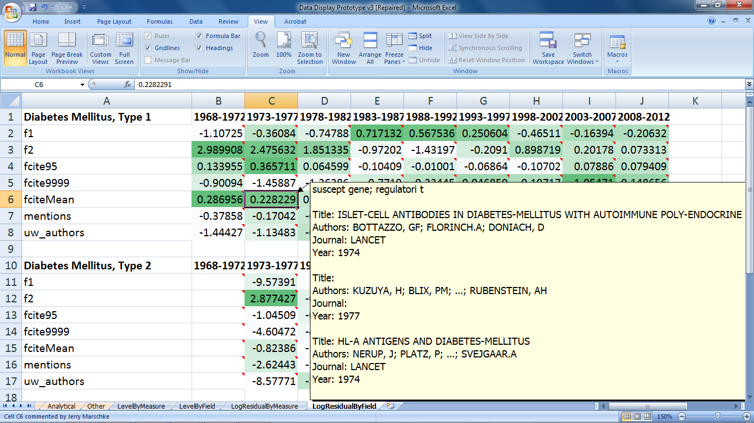

Slide 18
Next steps
Vetting ideas for measures (Survey Monkey-WoS emails; Conferences; NIH Study Section scores)
We are now wrapping up article-level measures of scientific impact/transformativeness and age (team age, age of oldest collaborator, etc)
Publications:
  We’re close to having the field-level measures we said we would produce
    Submit 1-2 articles to general science journals
  Article-based measures for article based analysis
Notes:
Focus on career age

