Slide 1
LATE-CAREER RESEARCH PRODUCTIVITY AND THE TIMING OF RETIREMENT
John Ham (National U Singapore)
David Blau, and Bruce Weinberg (Ohio State)

Slide 2
Overview
Researchers are typically viewed as being most innovative early in their careers
Our scientific community is aging
We don’t know how productivity evolves at the end of the career / near retirement

Slide 3
Overview
Document trends in innovative output over the late career
Understand factors behind aging scientific workforce
Estimate effect of retirement on output using discontinuities in DB pensions
Estimate how the aging of our research workforce will affect innovative output.

Slide 4
DB Pension Coding
We have collected, coded, and are checking all DB plans at top 100 research Univs (~50 plans)
  Cover more schools because of systems
  Will collect systems that cover many schools
Simulated careers for people turning 65 in 2005 with varying start dates

Slide 5
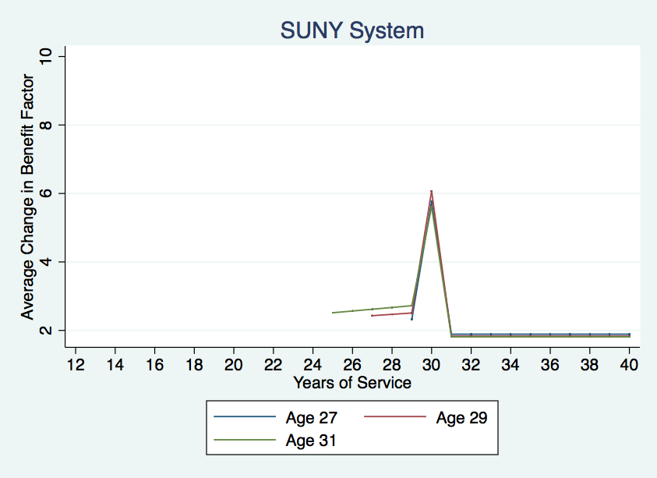
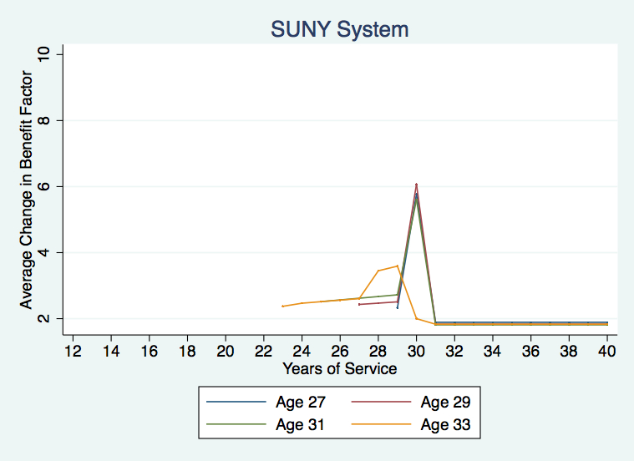
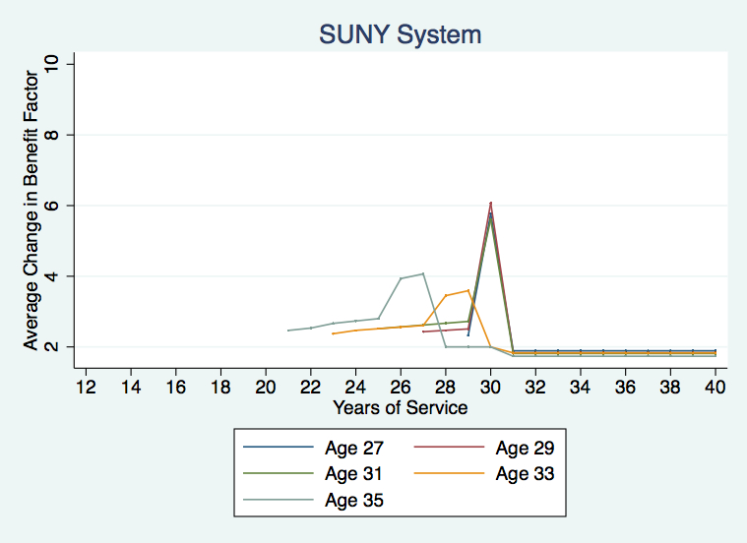
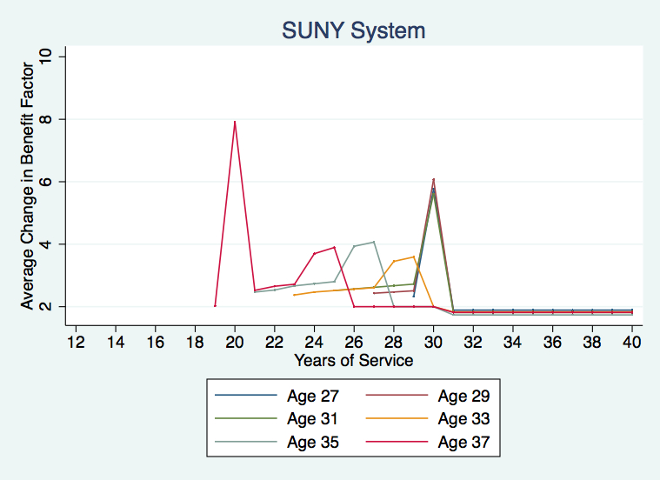
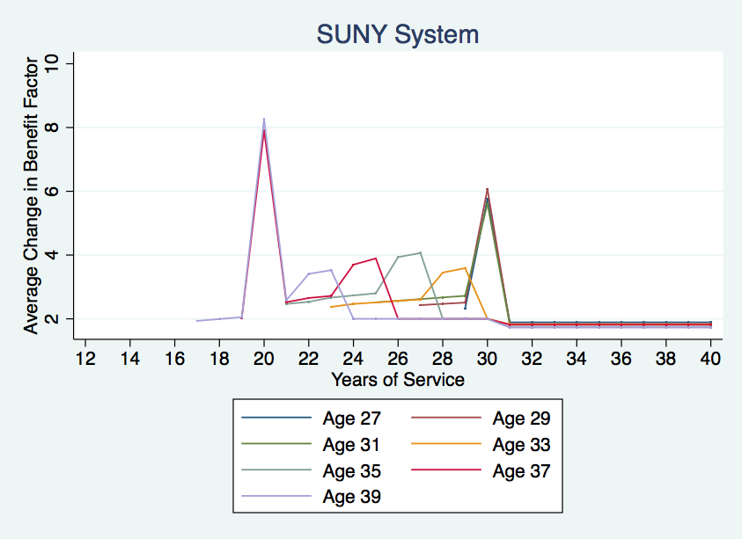
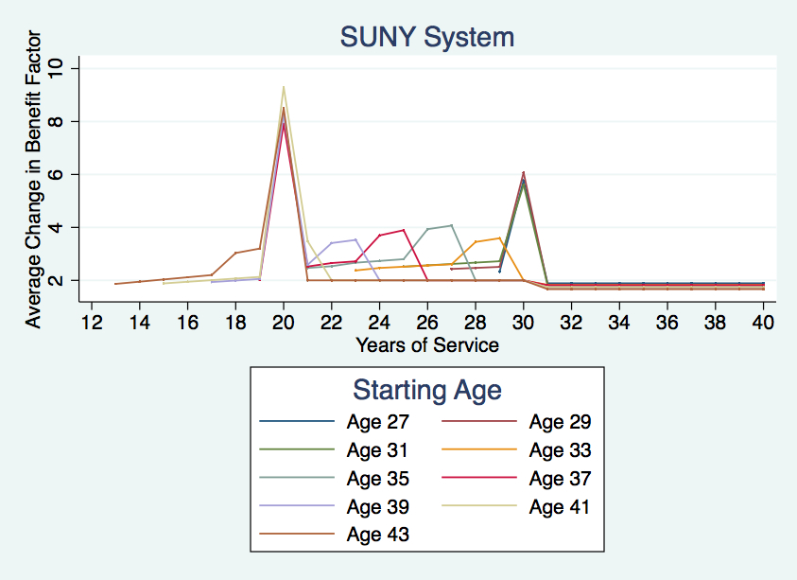
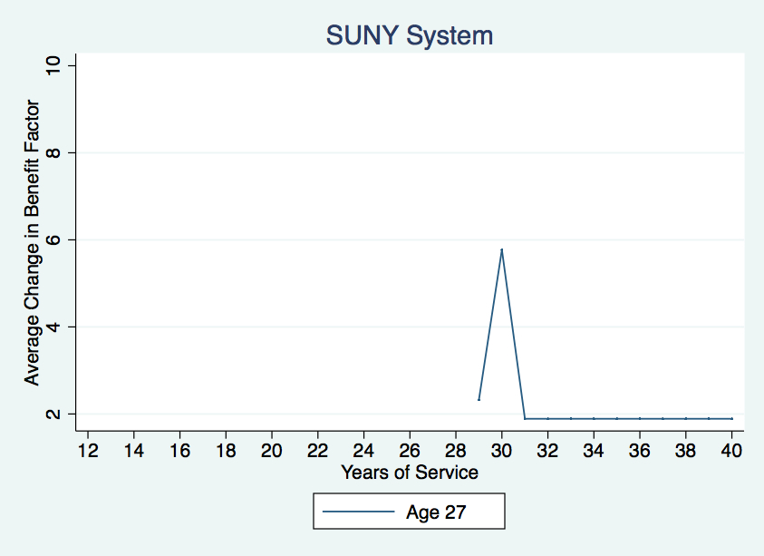
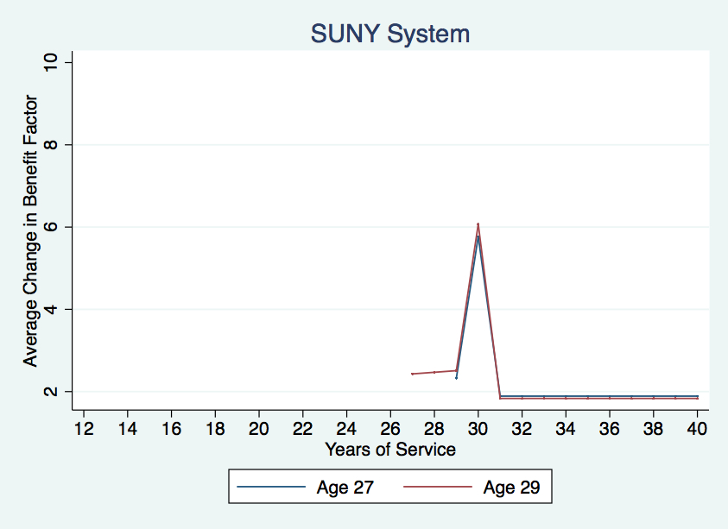
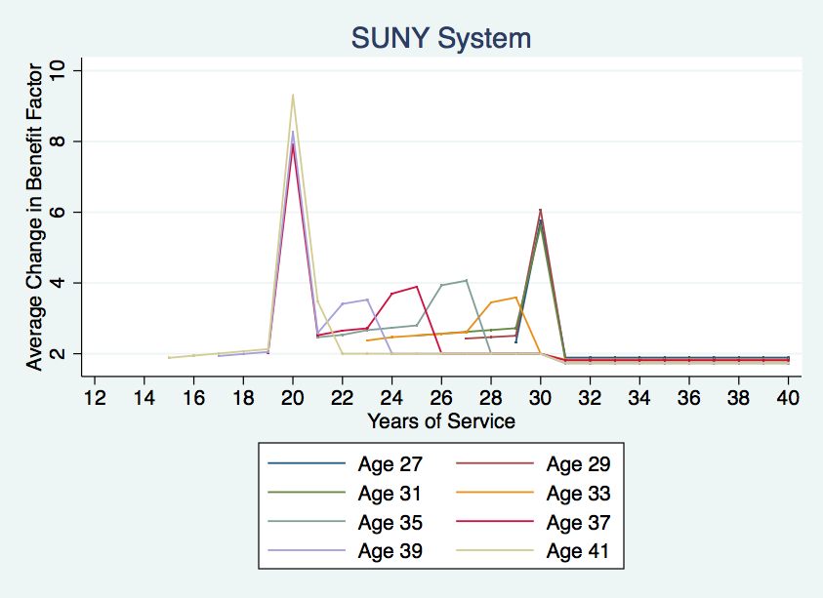

Slide 6
Number of People with Max Δ

Slide 7
Average Δ (Conditional on Max Δ)

Slide 8
Average Δ

Slide 9
DC Pension Coding
Obtained all 16,175 DC pension plans administered by TIAA-CREF
These have been coded
And matched to IPEDS

Slide 10
Match to IPEDS
Organization Type | # Matched | # Unmatched | Total | Share
College (2-Year) | 454 | 132 | 586 | 0.775
College (4-Year) | 817 | 243 | 1060 | 0.771
University | 523 | 161 | 684 | 0.765
Postgraduate | 21 | 11 | 32 | 0.656
Teaching Hospital | 15 | 186 | 201 | 0.075
Other | 256 | 13,356 | 13,612 | 0.016
Total | 2086 | 14,089 | 16,175 | 0.129

Slide 11
SDR
Extract from Restricted-Use SDR
  1993, 1995, 1997, 1999, 2001, 2003, 2006, 2008, and 2010
Harmonized variables (esp. field of study)
Reconciled start dates for jobs
  Use first and modal responses to identify correct start date
Generated full employment history

Slide 12
Consequences of Aging Workforce
We have a draft of a piece showing the aging of the innovative workforce and effect on productivity
Addresses comments from last meeting

Slide 13
Explaining the aging of the US scientific workforce
The population as a whole is aging, thanks to declining fertility, and declining mortality at older ages
An older population is the “new normal;” the baby boom skewed the distribution
Is aging of the scientific workforce just due to population aging, or are other factors at work?

Slide 14
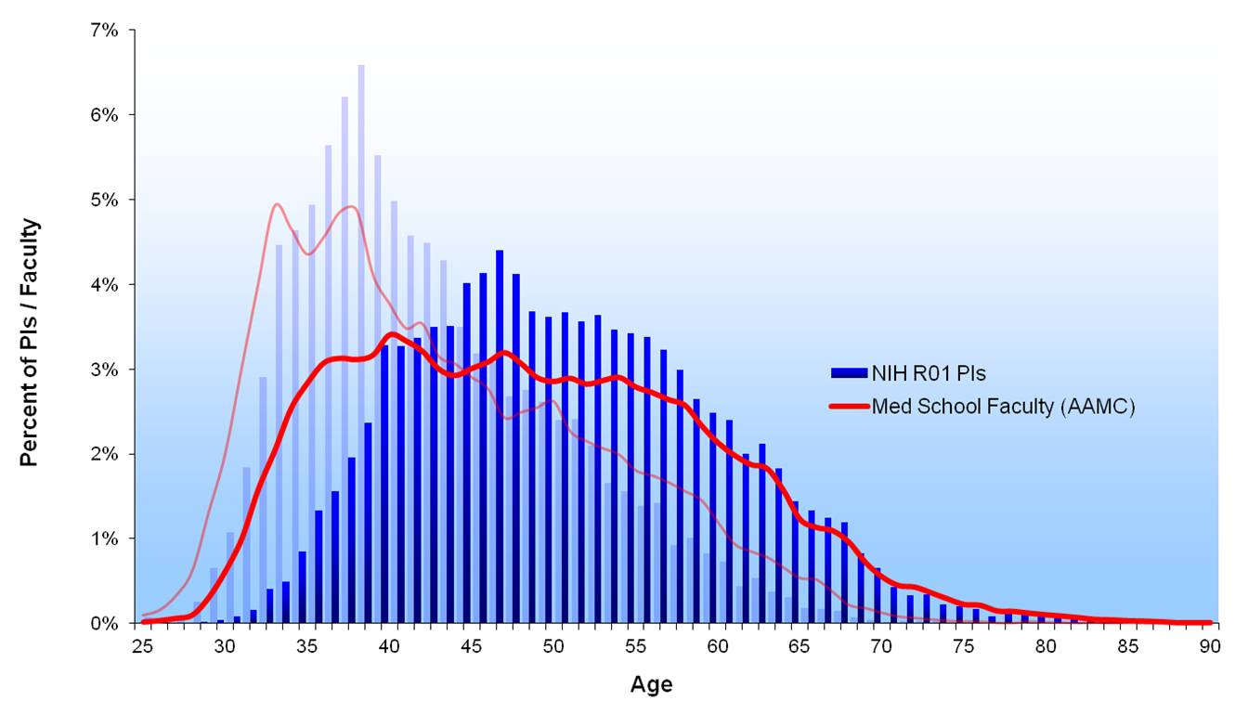
Is the US scientific workforce aging at the same rate as the US population?
Mean age in the range 24-75:
  AAMC: 1980: 43.1, 2010: 48.5
  US pop: 1980: 45.0, 2014: 46.8

Slide 15
Specific factors affecting the age distribution of the US scientific workforce
College and PhD completion rates of the residents
Retention of new US PhDs in science
International flows
  Number of international students completing a science PhD in the US
  International students completing a PhD in the US who enter the US scientific workforce
  The rate and age distribution of immigration to the US by scientists who completed a PhD outside the US
Hazard rate of exit from science to another occupation
Retirement hazard from the US scientific workforce
Mortality of scientists (if different from the population)

Slide 16
We analyze the demographics of the US scientific workforce
Use standard demographic methods to analyze the effects of overall population aging and factors specific to the US scientific workforce
A simulation model, in which the long run implications of a given set of “vital rates” for the age distribution can be studied, as well as transition dynamics
Use data from the Census, SDR, SED, and NCES

Slide 19
Policy issues
Immigration
Subsidies for education and training
Funding policy
Retirement policy

