Slide 1
“Big Data” and Economics Research
Liran Einav, Stanford and NBER
(based on two papers (and many discussions) with Jon Levin)
NBER Digitization
March 6, 2015

Slide 2
Era of Big Data
Eric Schmidt in 2010:
“Between the birth of the world and 2003, there were five exabytes of information created. We [now] create five exabytes every two days.”
Notes:
Eric Schmidt, former CEO of Google, in 2010:
“Between the birth of the world and 2003, there were five exabytes of information created. We [now] create five exabytes every two days.”

Slide 3
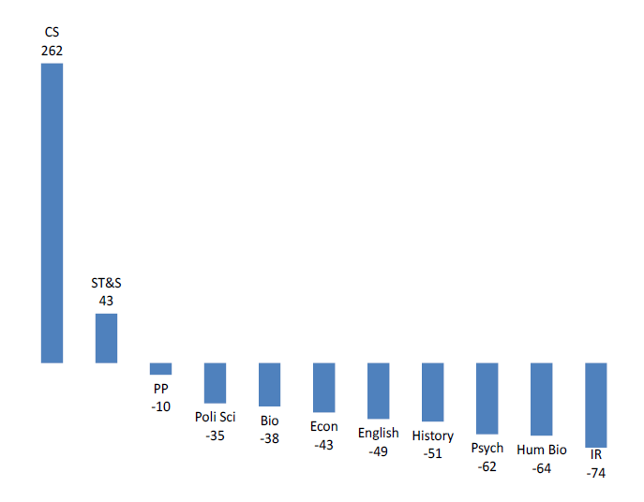
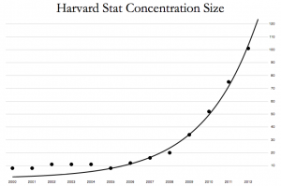
Changes in Majors at Stanford, 2010-12
Statistics Majors at Harvard, 2000-12

Slide 4
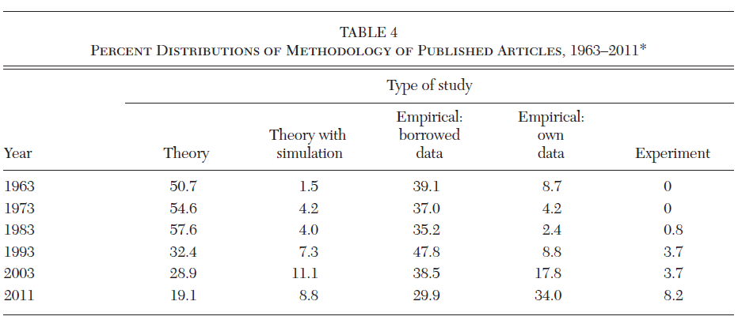
Rise of Empirical Research in Economics
From Hamermesch (2013, JEL): “Six Decades of Economics Publishing”

Slide 5
Rise in (private and public) proprietary data

Slide 6
What’s Different about New Data
Often available in (almost) real time
Large scale, i.e. more observations
Novel types of variables
How to make use of data on activities that weren’t previously observed (internet browsing, social media, tick-by-tick trades, geo-location)
Less obvious structure
Data may be just a recording of events: relative to typical “rectangular” dataset, how to organize the data is a lot less obvious
Many possible “covariates” (entire shopping or credit or health history), and observations inter-related in ways that are hard to summarize parsimoniously (e.g. social networks, communication data)

Slide 7
New/different challenges
A main challenge used to be to get/collect new data; today, finding/getting new data is not as difficult, but common challenge is how to use it and how to find something interesting to do with it
It used to be that the data dictated often what to do with it; today, many data sets are too big to play with, so “interacting” with the data has to have more structure/thought

Slide 8
Big Data Statistics and Economics
Predictive algorithms to improve or create new services
How? Automated “machine learning” algorithms: take large datasets and many possible predictive variables, and try to find the best “in sample” predictors, penalizing for “over use”
E.g., Lasso regressions minimize sum of squared deviations, subject to a constraint on the sum of the absolute value of coefficients
Often “training” and “testing” samples to select the best model
Two differences from typical models in economics:
Economists often focused on causal effect of a single variable or policy, while focus here is on using many variables for prediction
Models are not as useful out of sample, making it difficult to use them for many questions that require ex-ante out of sample analyses
Amazon recommendations Google search & news feed Targeted ads and marketing | Health risk and credit scores High freq trading algorithms Fraud & terrorism detection
Notes:
Premium on interpretability

Slide 9
Combining Economics + Big Data Statistics
One way to think about it: prediction based on assumption of stability: patterns tomorrow will be similar to patterns today
But many changes upset this stability – changing prices, changing products, changing government policies – these all change behavior
One response: no problem, just re-estimate after the change
Works okay if you are Google. You can update the search algorithm every week or even every minute as search behavior changes
But less likely to work if you’re the federal government and you want to know what will happen after a change in the tax code
This is where econometrics and economic models come in – useful for articulating about what will and won’t be invariant to a policy change
Notes:
Premium on interpretability

Slide 10
The production of empirical-micro research
Sequence has somewhat changed:
Once: Identify an interesting question and a research design, and then try to find/collect the data that would best fit it
Today: Find/get/stumble into interesting data, and then think of an interesting question, and a research design that can help with an answer
The sequence has changed, but the issues are still the similar:
The question needs to be interesting, and a research design convincing
Although new types of data could lead to slight difference in the questions asked
Having a big, rich, and granular data, and possibly a fancy machine learning algorithm is a great starting point, not an end

Slide 11
Summary
New data is creating amazing opportunities: for economics research, for businesses, for more informed policy-making
Already huge advances in description + “in-sample” prediction
But at least in economics, biggest questions are “out-of-sample”
Just having great data doesn’t immediately lead you to ask a question the right way or help you to find a great research design for causal inference
So we still face a lot of challenges in taking advantage of new data
Operational: data access & management, privacy issues, etc.
Conceptual: organizing data and finding research designs

