Slide 1
The Business of ai
James Bessen, Technology & Policy Research Initiative, BU School of Law
Lydia Reichensperger, Technology & Policy Research Initiative
Robert Seamans, NYU
Preliminary Results

Slide 2
Survey

Slide 3
Sample Sources
Crunchbase
Creative Destruction Lab
Website (promoted by O’Reilly Media), other

Slide 4
Questionnaire
Firm (size, location)
Customer (size, location, industry, occupation)
Product/technology (speech recognition, image recognition, natural language translation, etc; developed internally vs external vendor)
Data
Type (transactions, unstructured text, images)
Source (firm, customer, public)
Protections (legal contracts, APIs, data encryption)
Customer benefits/costs
Skill & training requirements
Impact on jobs by occupation

Slide 5
Crunchbase Response
Interim responses: 177
Crunchbase response rate: 7%
Comparison of Crunchbase respondents / live non-respondents
Variable | Not in Survey | Survey | H0: Diff = 0 Prob
Number of Employees | 1.85 | 1.64 | 0.052
Founding Year | 2013.4 | 2013.6 | 0.525
No. of Rounds | 2.27 | 2.27 | 0.996
No. of Investors | 2.5 | 2.3 | 0.118
Money Raised ($M) | 10.5 | 4.2 | 0.312

Slide 6
Customer Location

Slide 7
Small Firms

Slide 8
Selling across sectors

Slide 9
White collar users

Slide 10
3 questions

Slide 11
Is AI for Big Firms Only?
Large firms make largest investments
Investment in AI-related projects by established firms $18 - $27B (McKinsey 2017)
Access to customer data as barrier to entry for AI startups?
AI startups need access to relevant training data
Large tech firms have big data, but little evidence of increasing returns to data (e.g., Varian; Bajari et al; Chiou and Tucker)
And, newer algorithms relying on Bayesian methods need less data

Slide 12
Startups serve mid-size firms
Source: US Census, Longitudinal Business Database

Slide 13
Data not always a barrier

Slide 14
Augment or Replace humans?
Q: How does your technology help your customers? *“strongly agree”

Slide 15
Augment or Replace humans?

Slide 16
Create or Destroy Jobs?
* “strongly agree”

Slide 17
Create or Destroy Jobs?
* “strongly agree”

Slide 18
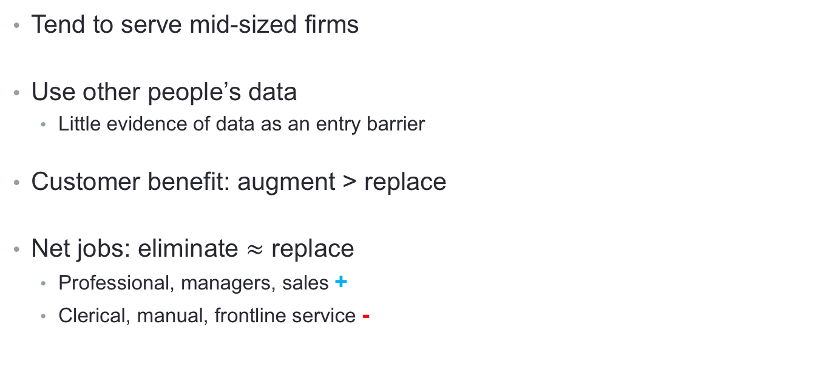
Conclusion: AI Startups
Tend to serve mid-sized firms
Use other people’s data
Little evidence of data as an entry barrier
Customer benefit: augment > replace
Net jobs: eliminate $≈$ replace
Professional, managers, sales +
Clerical, manual, frontline service -

Slide 19
The Business of ai
James Bessen, Technology & Policy Research Initiative, BU School of Law
Lydia Reichensperger, Technology & Policy Research Initiative
Robert Seamans, NYU
Preliminary Results

