Slide 1
From Transactions Data to Economic Statistics: Constructing Real-time, High-frequency,
Geographic Measures of Consumer Spending
Aditya Aladangady, Shifrah Aron-Dine, Wendy Dunn,
Laura Feiveson, Paul Lengermann, Claudia Sahm
Federal Reserve Board
laura.j.feiveson@frb.gov
March 14, 2019
We thank staff at Palantir, First Data, Kelsey O’Flaherty, and Felix Galbis-Reig for their many contributions to this project. The views expressed here are those of the authors and not necessarily those of other members of the Federal Reserve System.

Slide 2
Overview of the project
Goal is to create high-frequency, geographically detailed spending measures to monitor economic conditions and study events
Partnering with First Data, a large, payments processor with more than $2 trillion in card transactions per year across 6 million merchant locations
Series construction is multi-disciplinary effort: engineers and programmers at Palantir filter and aggregate transaction data into geographic spending indexes; economists at the Board develop algorithms, use indexes in economic analysis
Project benefits from related work at statistical agencies like Census and BEA. Official statistics used for benchmarking and validation

Slide 3
Why use transaction data?
Limitations of official statistics: difficult to study the effects of short-lived, localized events on consumption
  Census retail trade surveys published monthly for nation as a whole
  Other data like BLS CES have limited sample sizes at smaller geographies and available with a long lag
Expanding official surveys would be costly and increases respondent burden
We attempt to fill these gaps using card payments transaction data to construct daily spending indices from 2010 forward at national- state- and MSA-levels and for detailed-industries
New challenges: protecting the privacy of individuals and businesses, confirming the quality of the data, adjusting for non-representative samples

Slide 4
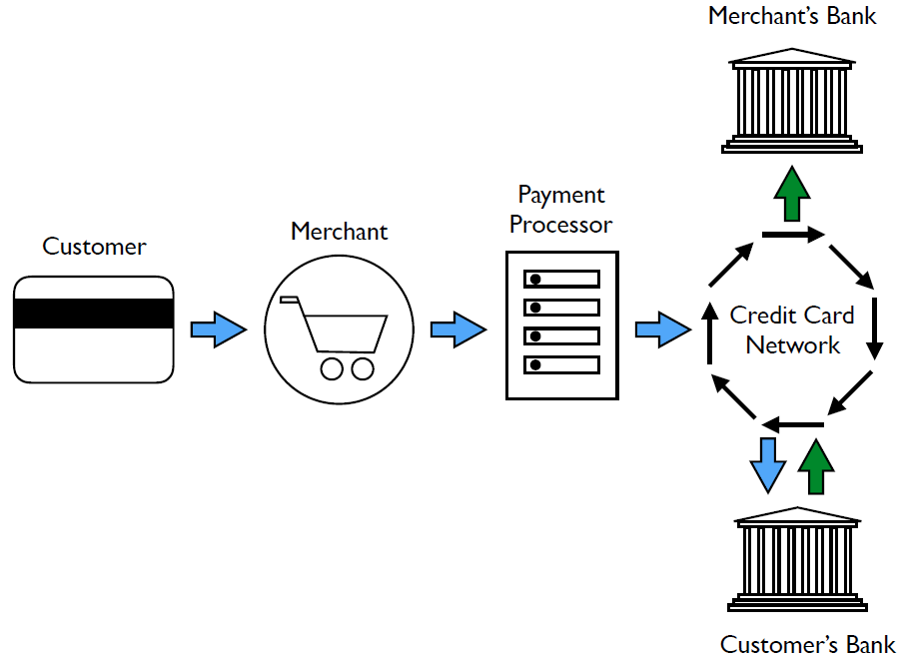
Data source is First Data, a large processor of credit, debit and electronic payment transactions
First Data has business relationships with merchants not consumers
Raw data include the date, authorization, and settlement amounts; merchant name, address, and category code (MCC); and an anonymized card identifier
Data anonymized and aggregated before we receive them
MCCs mapped to NAICs codes
Notes:
Consumers use credit and debit cards for 26 percent of their payments (dollar value). Cash is just 8 percent of dollars paid (2016 Diary of Consumer Payment Choice)
First Data has business relationships with merchants not consumers.
The geography of spending is set by the location of the merchant - likely differs from where consumers live.
We only see the card’s transactions that occur at First Data merchants.
We have focused on spending on retail goods and food services.

Slide 5
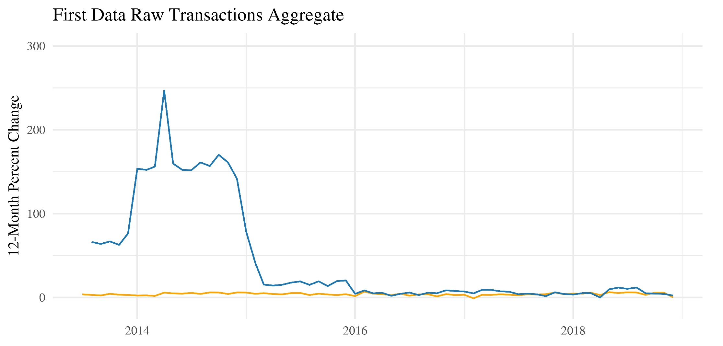
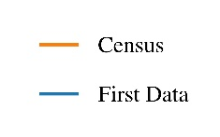
Raw transactions aggregates are not useful
Raw transaction aggregates are not useful
Huge swings reflect First Data’s acquisition of other firms
Cannot distinguish actual merchant births and deaths from “client merchant churn”: filtering algorithms are needed!

Slide 6
Filtering with constant merchant samples
The constant-merchant principle: To eliminate client merchant churn, derive growth rates between two points in time from a set of merchants that exist in both sets of time.
Our methodology: Create overlapping 14-month constant-merchant samples. Each sample contains merchants that transact in 14 consecutive months. 14 months is long enough to filter merchants based on their 12-month growth rates, thus eliminating the risk of capturing abnormal seasonal swings.

Slide 7
Filtering with constant merchant samples
Filtering with constant merchant samples (continued)
Example: Jan 2017 sample is a subset of client merchants that transacted in each month from Dec 2015 to Jan 2017
Shaded column shows the 14 samples used to estimate spending in Dec 2015

Slide 8
Additional filtering criteria for “well-behaved” merchants
 | Cumulative % Dollar volume not filtered | Cumulative % Merchants not filtered
Opt-out Merchants | 100.0% | 100.0%
Misclassified MCCs to NAICS Mapping | 86.7% | 89.5%
Batch Processors | 85.2% | 81.5%
Minimum Monthly Spending/Transaction Days | 85.2% | 80.2%
14-Month Constant Merchant Sample | 52.7% | 29.1%
Growth Outliers | 51.4% | 29.1%
Final, filtered sample comprises about half of the raw dollar transaction volume
Reflects merchants with stable attachment to First Data for whom sales growth appears well-measured.

Slide 9
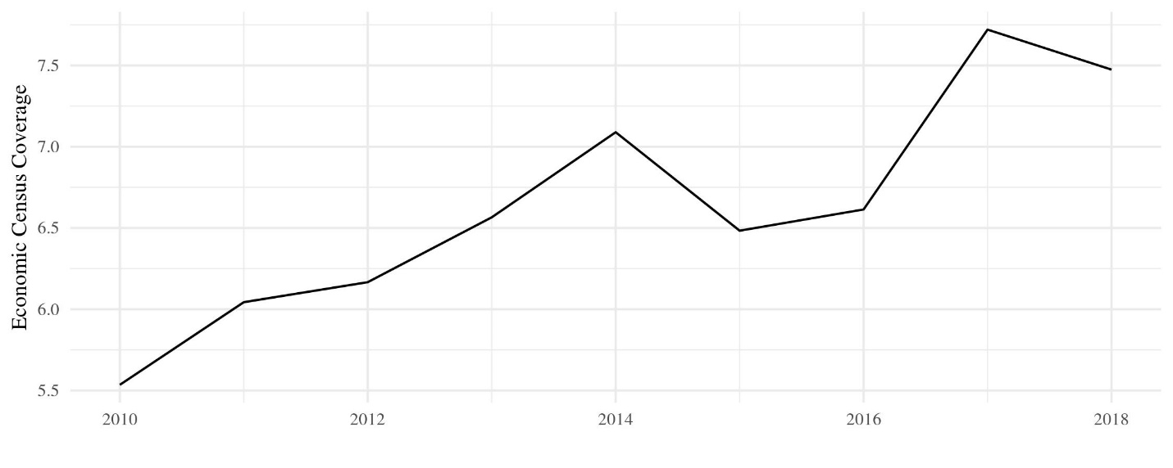
Coverage is increasing over time
Coverage is increasing over time
First Data Coverage of National “Retail Sales Group” Sales
(Retail Sales Group is 25% of GDP)

Slide 10
Combining samples to create a daily spending index
Combine our adjusted 14-month constant merchant samples into a daily spending index for each 3-digit NAICS and geography following three steps:
Level adjust samples to smooth through shifts in the level due to merchant churn or platform acquisition. (First and last month adjustment)

Slide 11
Combining samples to create a daily spending index
Multiply red sample by factor that equates the average spending of the overlapping 13 months
Feb ‘17
Total daily spending ($)
Jan ‘16
Jan ‘17
Dec ‘15
Dec
2015
Jan
2016
Jan
2017
Feb
2017

Slide 12
Combining samples to create a daily spending index
Multiply red sample by factor that equates the average spending of the overlapping 13 months
Total daily spending ($)
Feb ‘17
Jan ‘16
Jan ‘17
Dec ‘15
Dec
2015
Jan
2016
Jan
2017
Feb
2017

Slide 13
Combining samples to create a daily spending index
Combine our adjusted 14-month constant merchant samples into a daily spending index for each 3-digit NAICS and geography following three steps:
Level adjust samples to smooth through shifts in the level due to merchant churn or platform acquisition. (First and last month adjustment)
Average level-adjusted overlapping samples for each day
Benchmark: Renormalize the series so that the 2012 values match the 2012 Economic Census for each 3-digit NAICS and each geography (national, state, and MSA).
-------------------------------------------------------------------------------------------------------------
Revision Properties: The indexes do revise as we add on more 14-month samples. Revisions to Census figures have comparable standard errors.
Birth/death bias: Since this methodology filters out true births and deaths, it is biased at times when births and deaths do not cancel each other out.

Slide 14
Daily spending indexes are independent, timely and detailed
  Timely and independent – lagged by just a few days. Gives us an independent read on economic activity. Still, high correlation with Census retail sales.

Slide 15
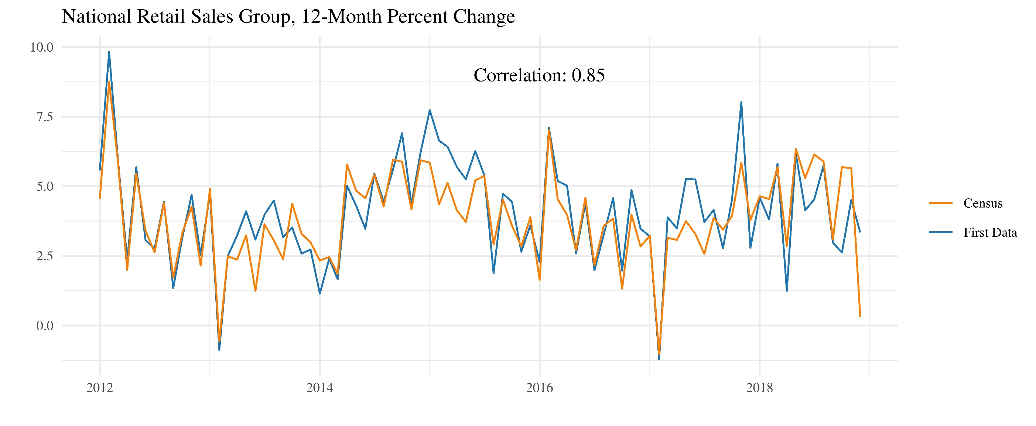
Matches well at national level
Matches well at national level

Slide 16
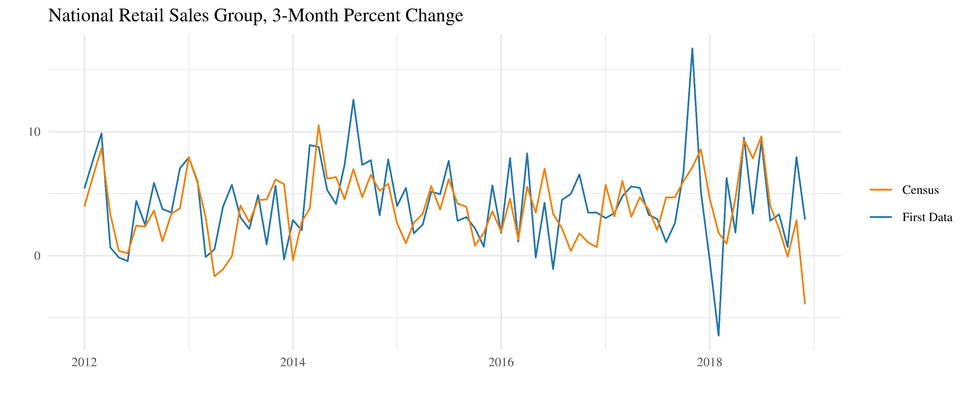
Matches well at national level – seasonally adjusted

Slide 17
Daily spending indexes are independent, timely and detailed
  Timely and independent – lagged by just a few days. Gives us an independent read on economic activity. Still, high correlation with Census retail sales.
  Daily – can study high frequency patterns
  Industry-specific – 3-digit NAICS series
  Geographically diverse – MSA, State, National

Slide 18
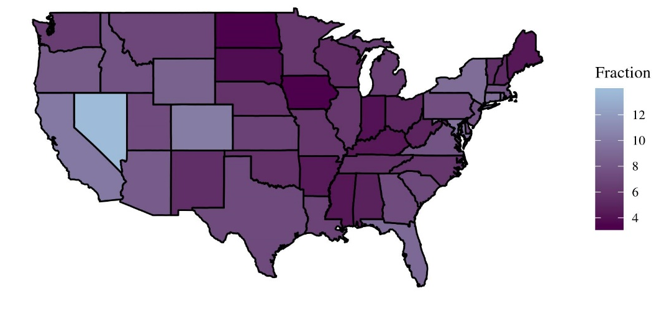
Coverage varies over geographic regions
Coverage varies over geographic region
First Data Coverage of Retail Sales Group Sales by State, 2018

Slide 19
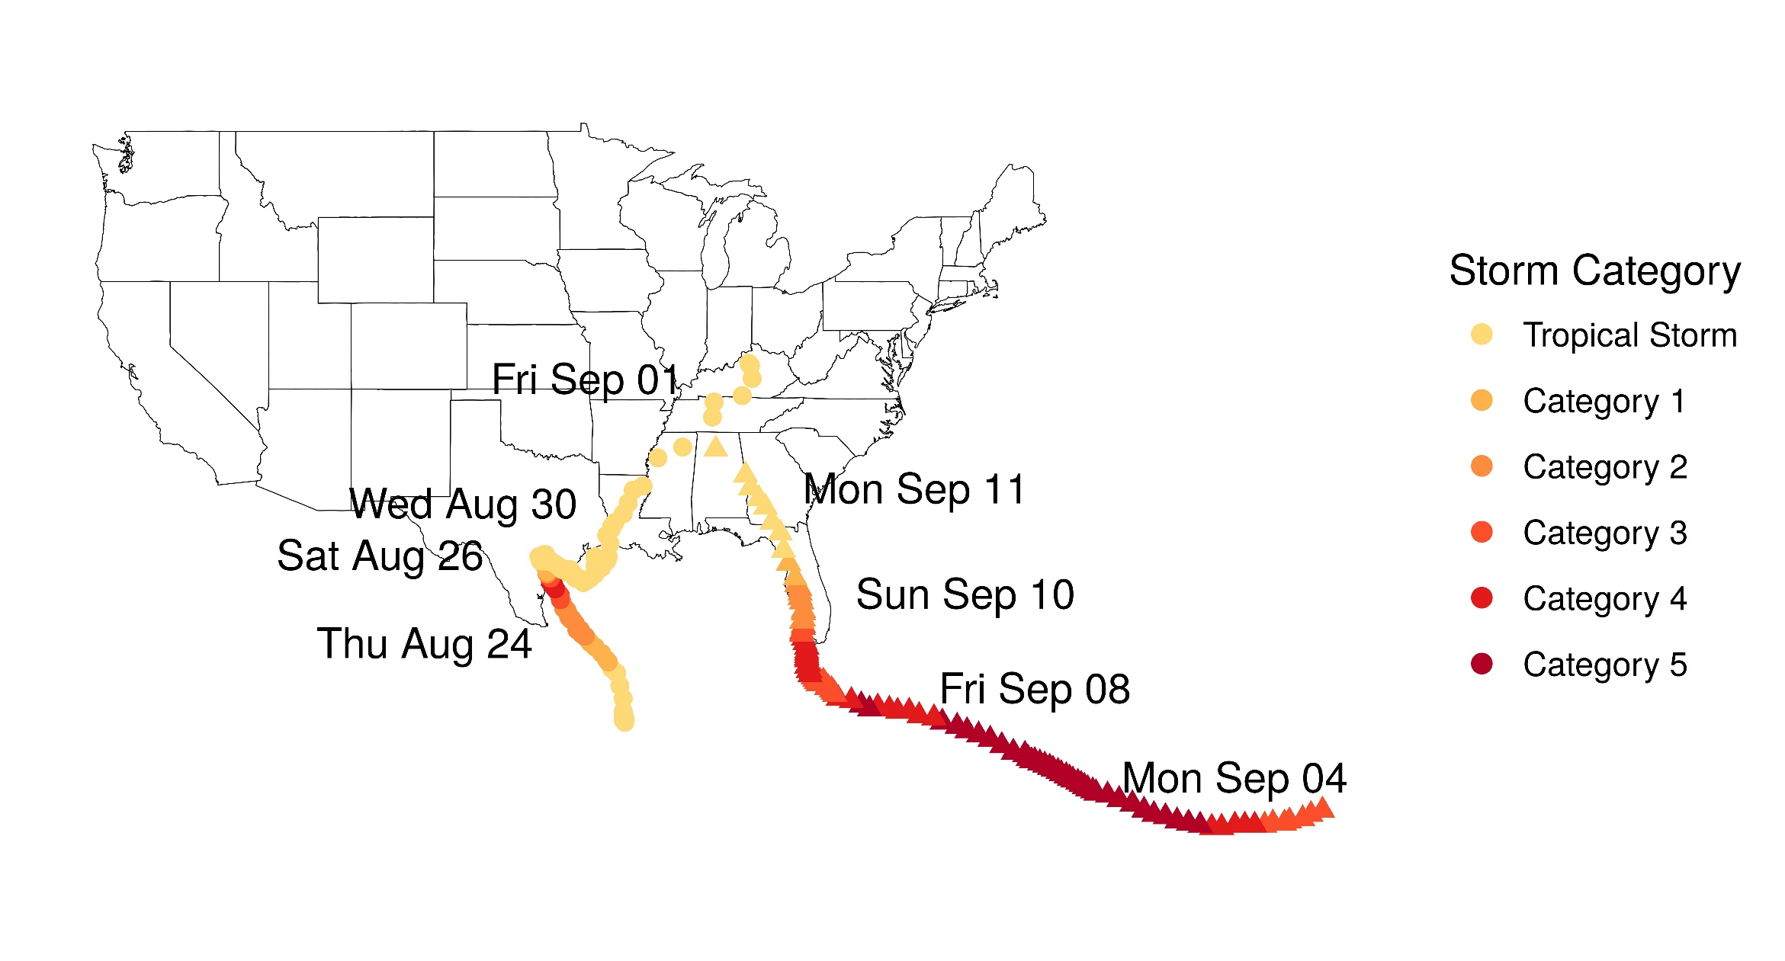
Application: Spending in the direct path of Hurricanes Harvey and Irma

Slide 20
The effects of Hurricanes Harvey and Irma on national and local spending
Using the daily, state and MSA-level indexes, we examined the pattern of activity in the days surrounding the occurrences of Hurricanes Harvey and Irma.
We estimated the following regression for each affected state:
$$\ln\left(Spending_{t}\right)= \sum_{i= −7}^{i=14}{β_{i}∗H_{t−i}}+ \sum_{w=Mon}^{w=Sun}{δ_{w}∗I\left({Day}_{t}=w\right)+}\sum_{m=July}^{m=Nov}{δ_{m}∗I\left(Month_{t}=m\right)+T_{t}+ε_{t}}$$
Daily dummies surrounding hurricane
Day-of-week fixed effects
Month-of-year fixed effects
Time trend

Slide 21
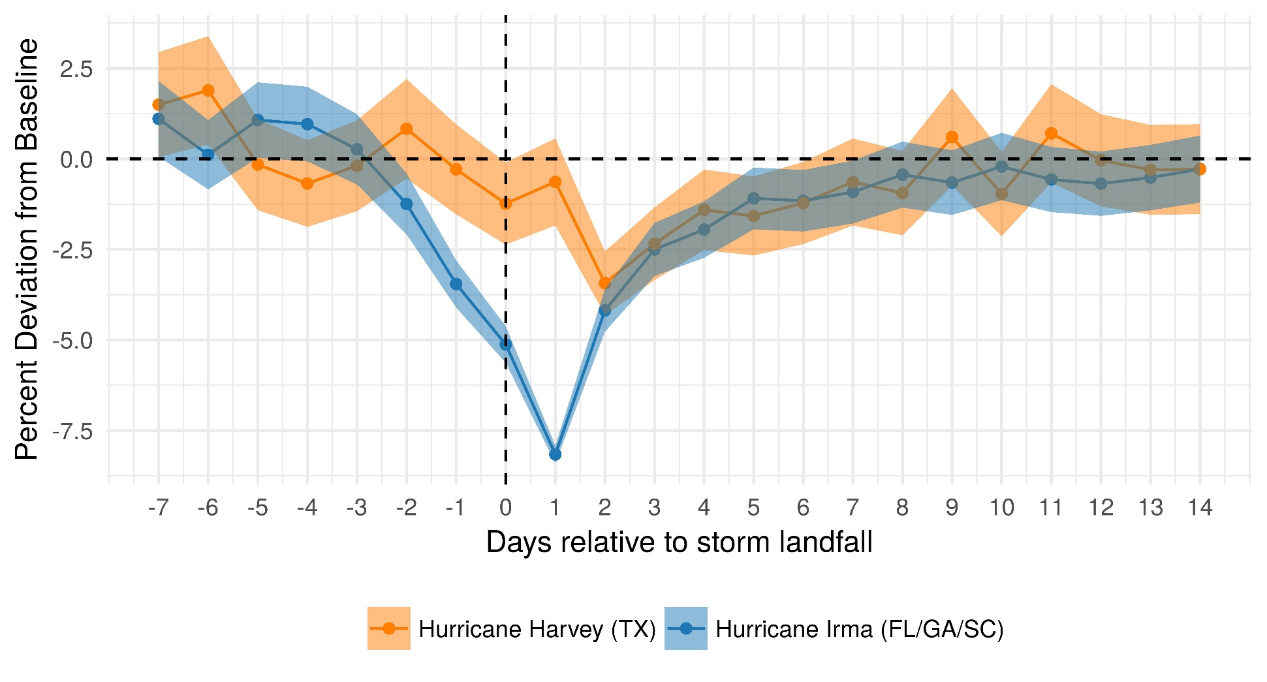
The effects of Hurricanes Harvey and Irma on national spending
We find that together both hurricanes reduced GDP growth by almost ½ percentage point (annual rate) in the third quarter of 2017.

Slide 22
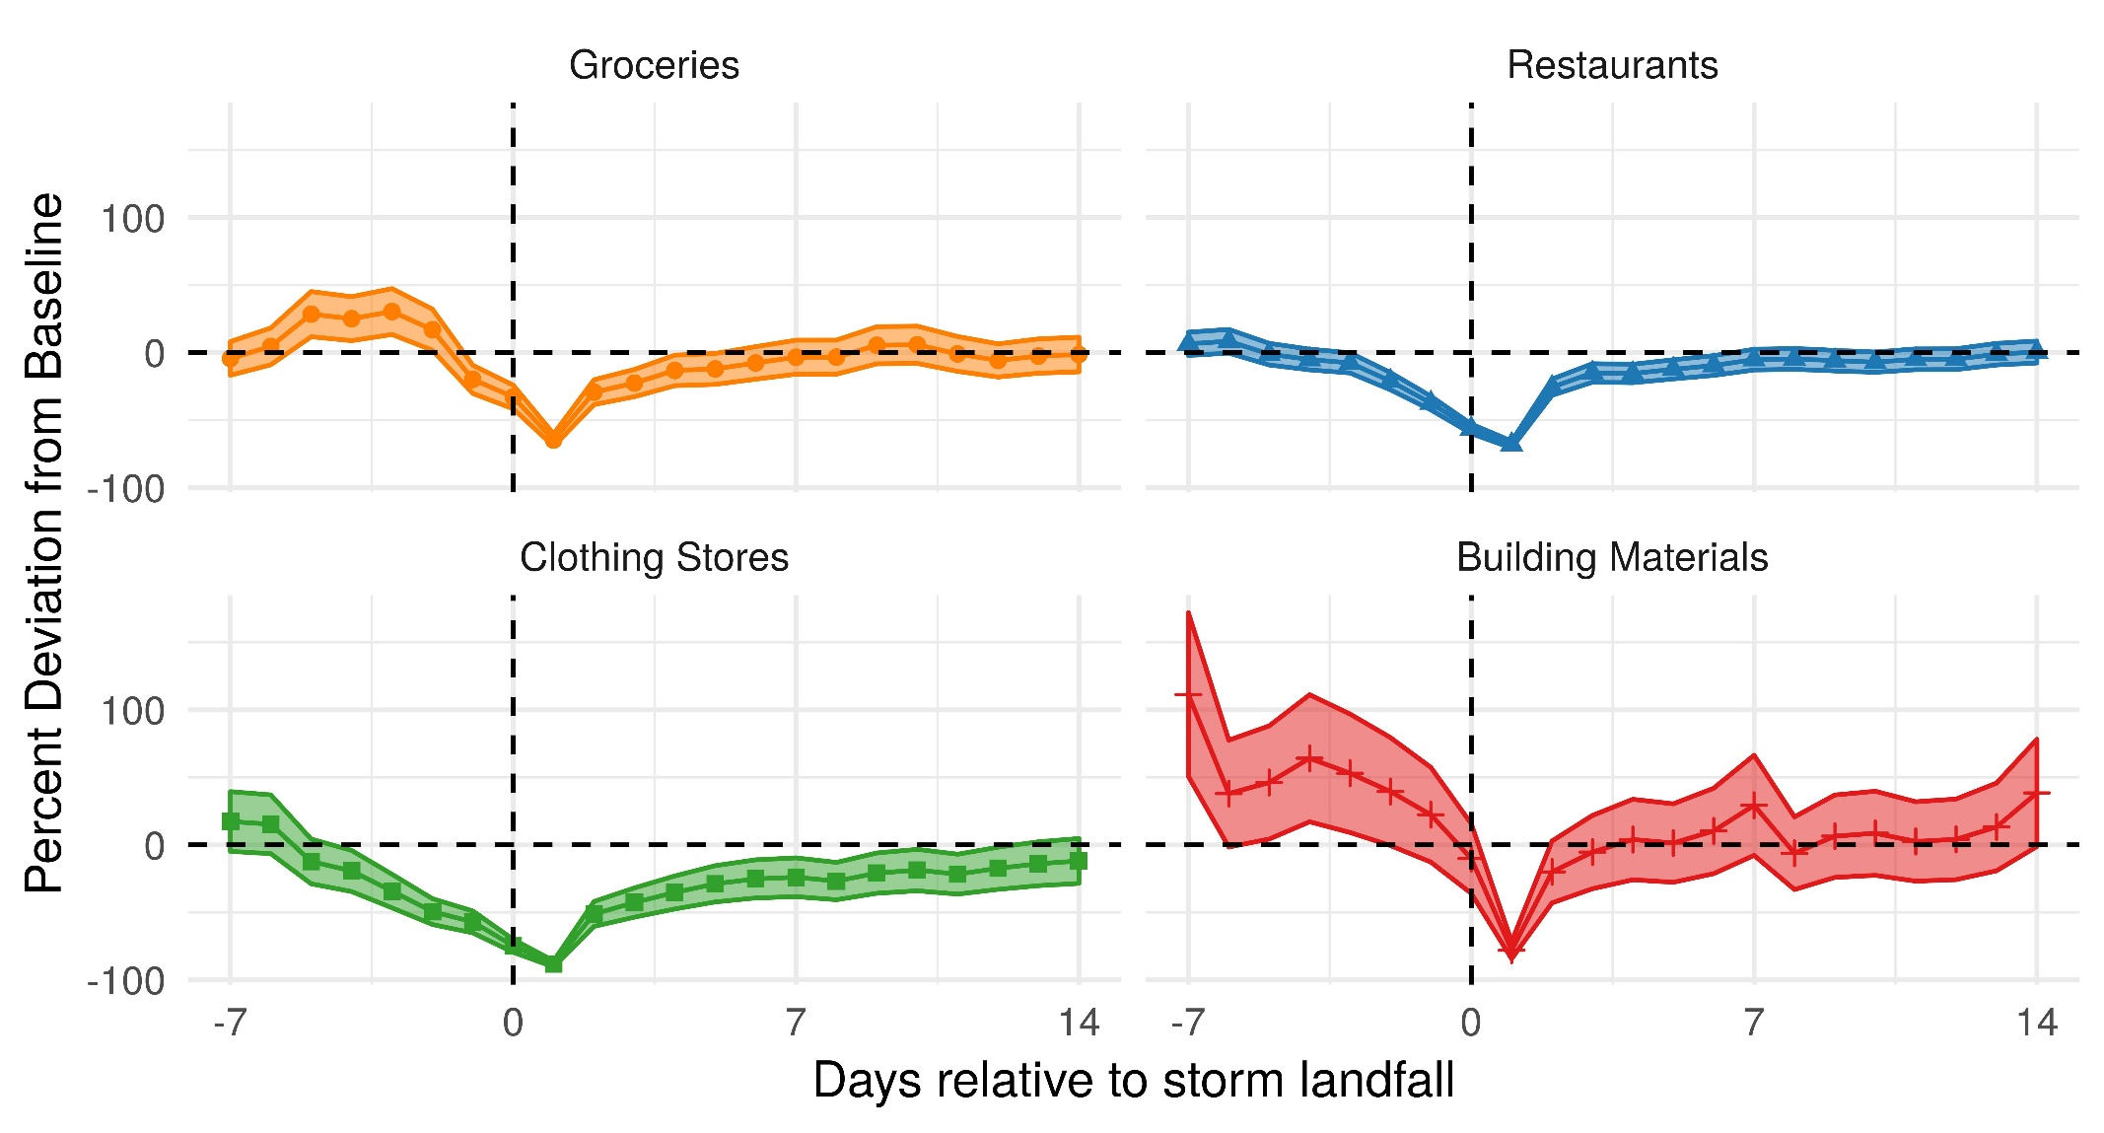
Spending responses to Hurricane Irma vary among categories

Slide 23
Concluding remarks
Concluding remarks
These new spending indexes are well-suited to study high-frequency, localized shocks, such as weather effects, delays in EITC disbursement (FEDS Note, June 2018), and the effect of sales-tax holidays on spending (FEDS Note, March 2017)
At early stages of using these time series for macro policy analysis; they proved useful during the government shutdown when the Census data were delayed
Exploring extensions to data set, including:
    Defining geography by inferred home location of card holder
    Use card attributes (Bank Identification Numbers) to further characterize spending, including with electronic benefit payments
    Use merchant spending patterns to estimate births/deaths

Slide 24
Concluding remarks
Thank you!
Laura.j.Feiveson@frb.gov

Slide 25
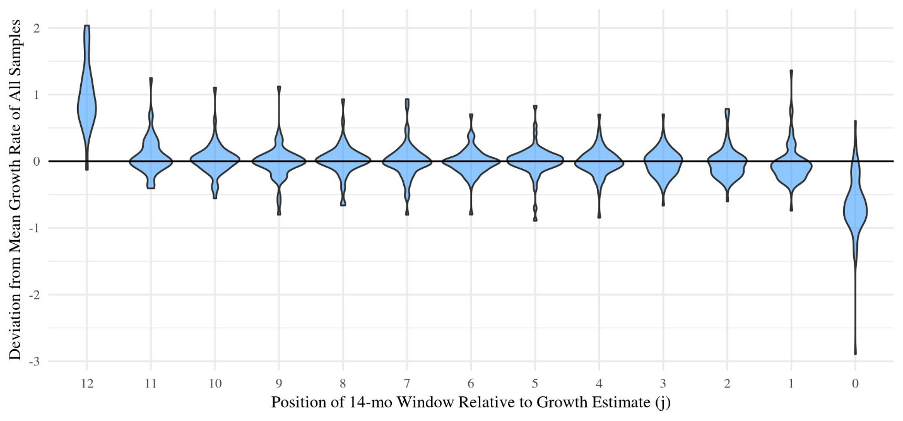
Monthly growth estimates are stable with two exceptions
Deviation from Mean Growth in Each Month of the 14-Month Sample
First month of sample subject to “ramping up” bias
Last month of sample subject to “ramping down” bias
We adjust both first and last month of samples accordingly
Back

Slide 26
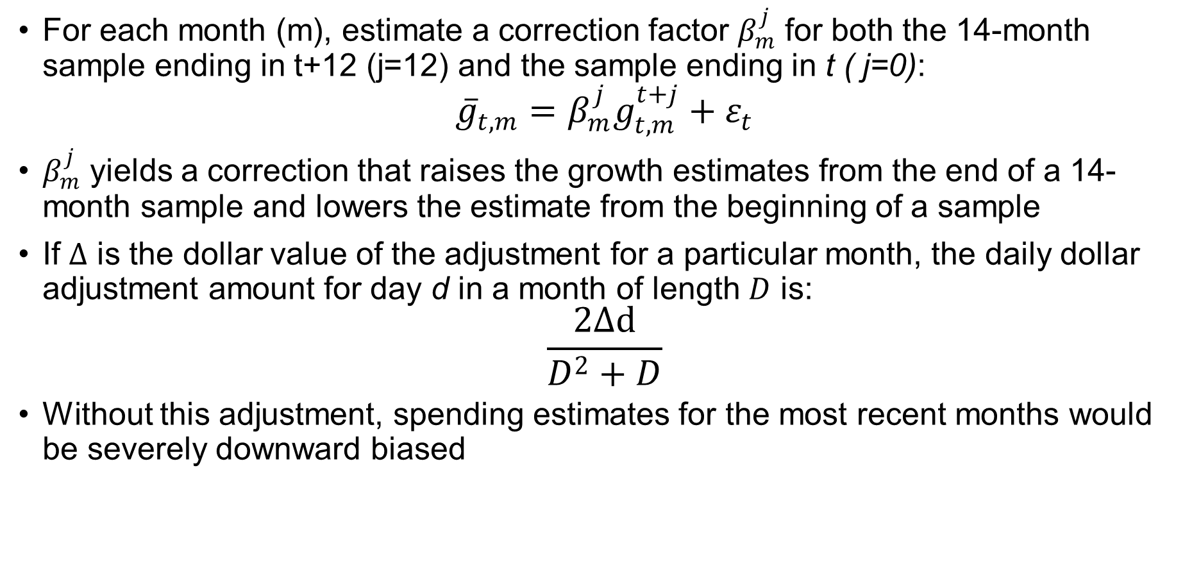
Adjustments to the first and last month of the sample
For each month (m), estimate a correction factor $β_{m}^{j}$ for both the 14-month sample ending in t+12 (j=12) and the sample ending in t ( j=0):
$${\overline{g}}_{t,m}=β_{m}^{j}g_{t,m}^{t+j}+ε_{t}$$
$β_{m}^{j}$ yields a correction that raises the growth estimates from the end of a 14-month sample and lowers the estimate from the beginning of a sample
If $Δ$ is the dollar value of the adjustment for a particular month, the daily dollar adjustment amount for day d in a month of length $D$ is:
$$\frac{2Δd}{D^{2}+D}$$
Without this adjustment, spending estimates for the most recent months would be severely downward biased

Slide 27
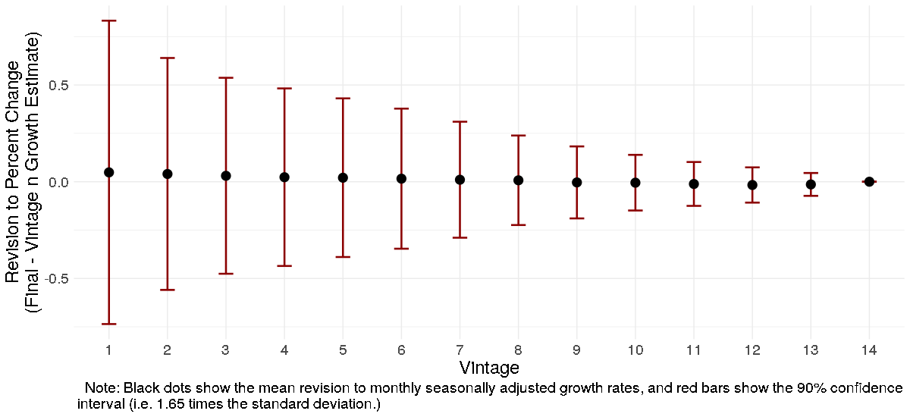
Revision properties of monthly estimates
Revisions for the first few vintages can be fairly large but appear unbiased
Preliminary estimates from Census have comparable standard errors

Slide 28
Removing seasonal and other predictable variation
Removing seasonal and other predictable variation

Slide 29
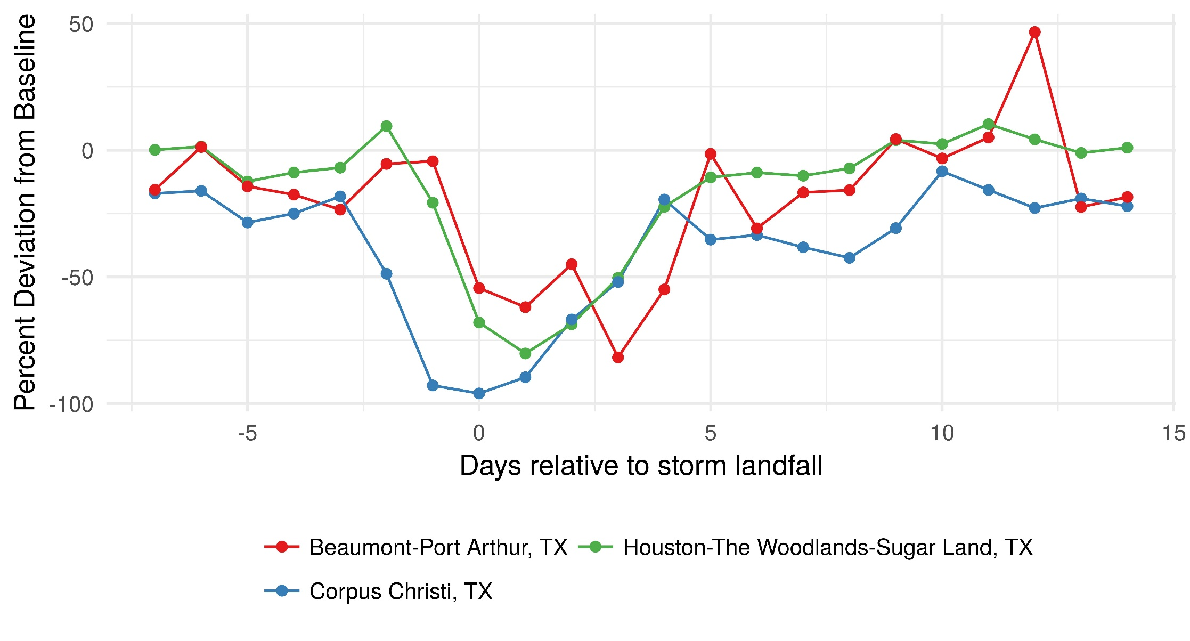
The effects of Hurricanes Harvey and Irma on local spending: Texas
The effects of Hurricanes Harvey and Irma on local spending: Texas

Slide 30
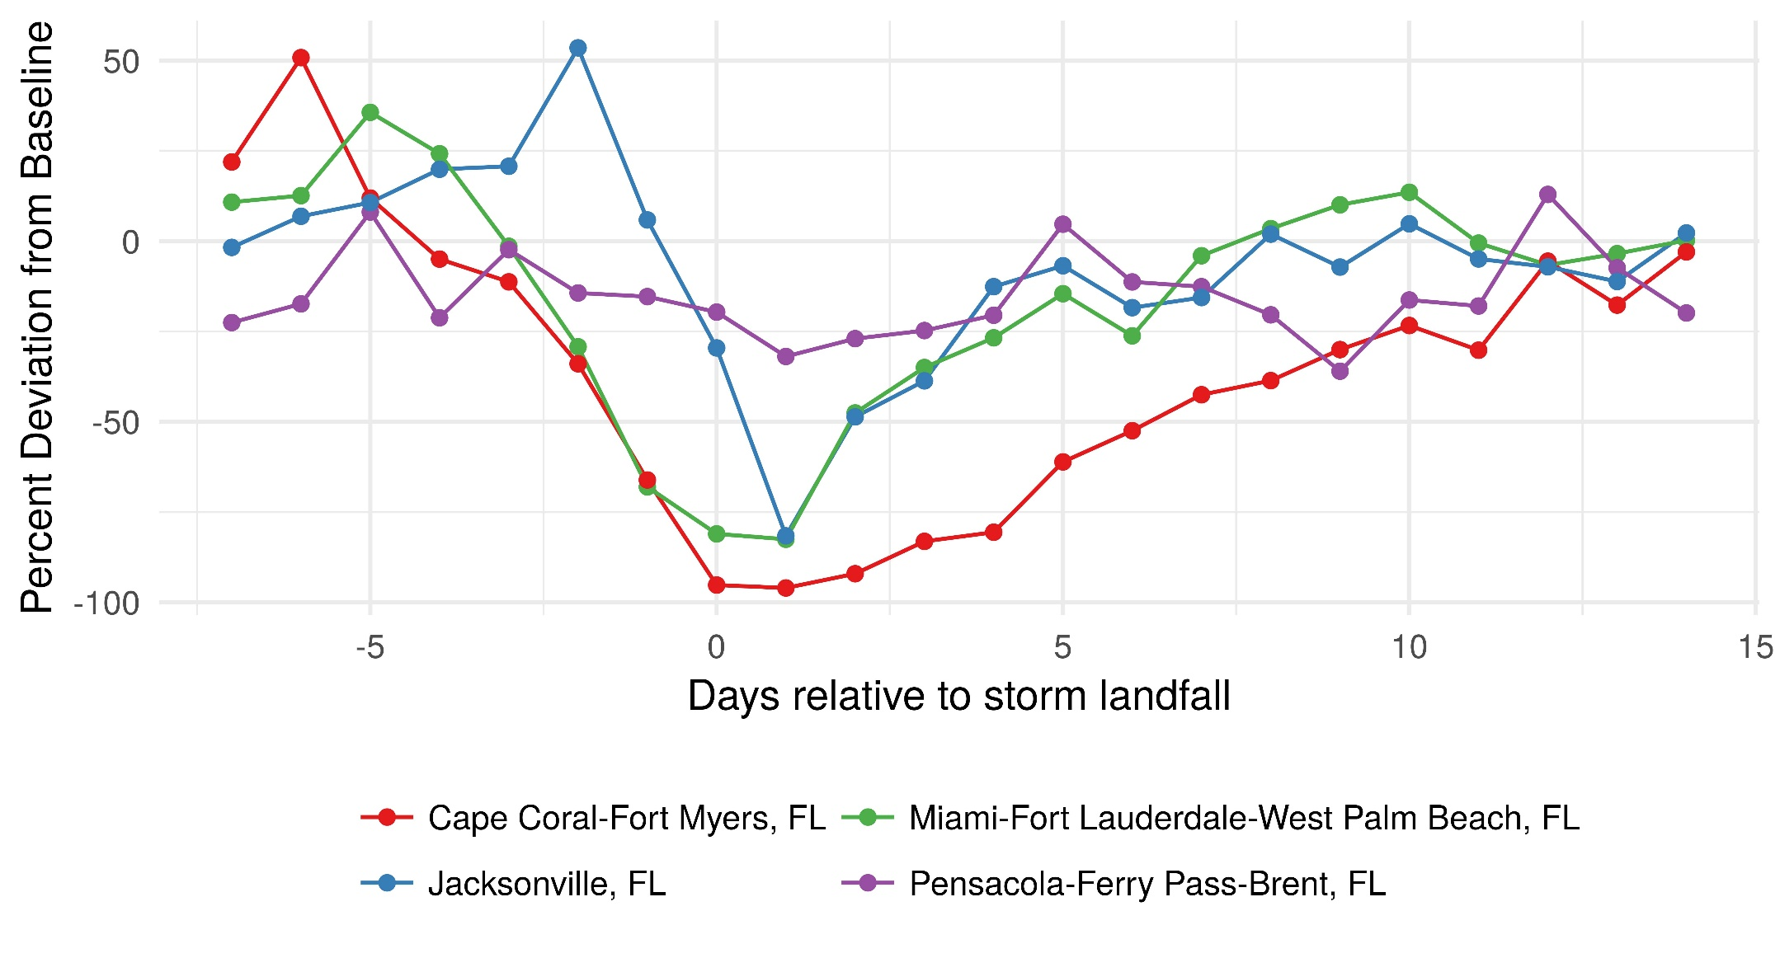
The effects of Hurricanes Harvey and Irma on local spending: Florida

Slide 31
National spending effects of other recent hurricanes
Effect on national spending depends on severity and population in storm’s path
Within week, spending back to normal, but no rapid make up for prior losses
Source: First Data Merchant Services, Board estimates.

Slide 32
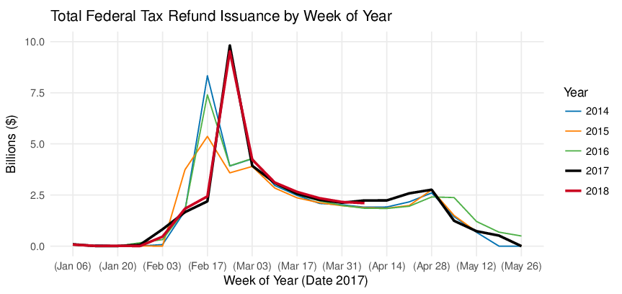
Federal Tax Refund Issuance by Week of Year
Source: Daily Treasury Statement. Note: Weeks are aligned from start of year. Labels shown are dates in 2017.

Slide 33
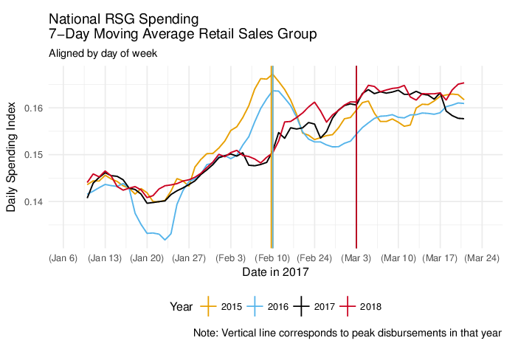
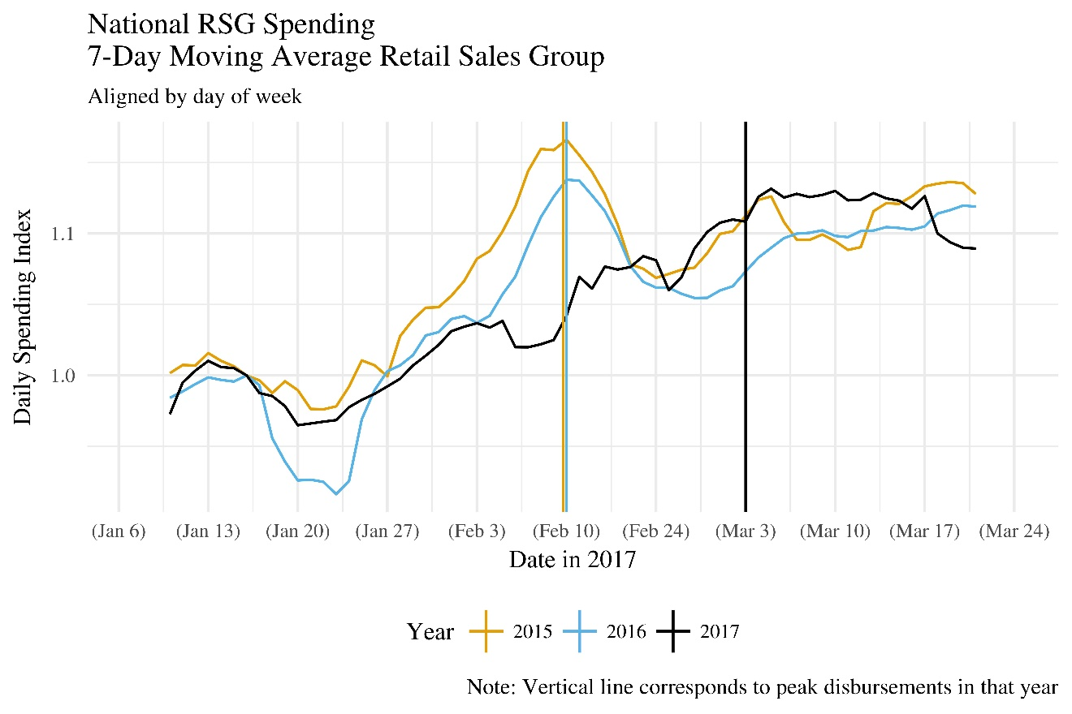
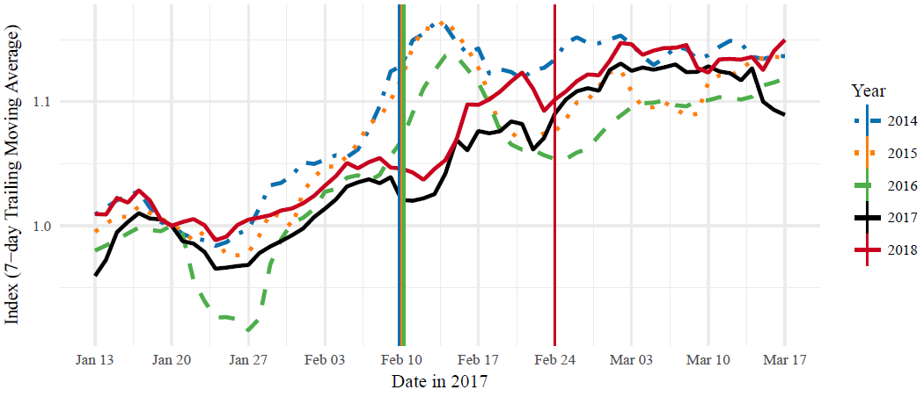
Spending Lower During Refund Delay
Components
Source: First Data Merchant Services. Note: Spending is a trailing, seven-day moving average, indexed to the second week of January in each year. Vertical lines correspond to week of peak refund issuance. The peak is the same in 2015 and 2016, and roughly two weeks later in 2017 and 2018.

Slide 34
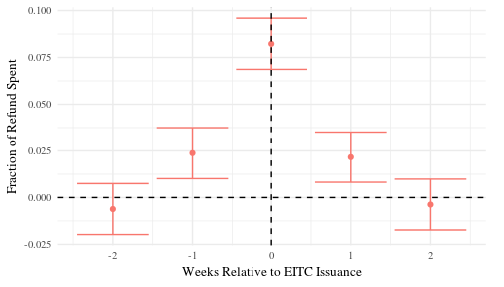
Spending Response in Retail Sales
Spending rises $0.15 per dollar of refund
Likely a lower bound as retail only 30% of total PCE
Interpreted as impact of 2-4 paycheck lump sum
Source: Authors’ calculations using First Data, IRS, NOAA
Note: 95 percent confidence bands

Slide 35
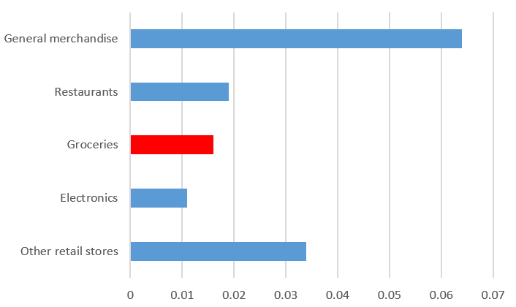
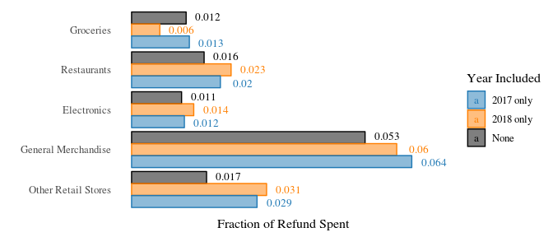
Spending Response by Merchant Type
Source: Authors’ calculations using First Data, IRS, NOAA
Note: 95 percent confidence bands, Newey West Standard Errors

