Slide 1
Use of Public Data to Generate NAICS Codes for Business Establishments.
John Cuffe, Sudip Bhattacharjee, Justin C Smith, Nevada Basdeo: U.S. Census Bureau
Ugochukwu Etudo: Uconn
All views expressed are those of the authors and not necessarily those of the U.S. Census Bureau. All results have been reviewed to ensure no confidential data have been disclosed.

Slide 2
Why NAICS Codes Present a Problem
Important element of Census operations, BUT….
  Potentially outdated information.
  Burdensome to respondents.
  Not all sources agree.
    Unable to share data.
Economic Census
80 %
86 %
SSA
BLS
70 %
Notes:
Figures are from the 2012 BR for single-unit estabs. Show the agreement when all sources coded the estab on the 2-digit level
Outdated information—autocoded uses 2002-2004 EIN applications, how often does the term “electric scooter sharing app” appear?

Slide 3
Proposal
We can combine publicly available data, Census data, and machine learning techniques to generate NAICS codes.
  Reduce costs:
    Reduce dependence on SMEs.
    Enhance survey efficiency.
  Reduce Respondent burden:
    Respondents to not have to identify precise NAICS codes.
  Enhance data quality:
    Give us a better sense of a business’ customers and products sold.
  More timely data.
Multiple Statistical agencies worldwide attempting similar research
  Netherlands, Australia, Britain, Italy
Notes:
Our overall goal: WE can use the autocoder system as a baseline, and if we add the extra richness form the textual data can improve our accuracy and the number of observations receiving a code, which will lower costs.

Slide 4
Methods: Overview
Gathered Population of 290,000 businesses from Google Places API.
  Extract Google types tags, user reviews, websites.
Match to the Business Register (Single-Units (SU), 2015-16)
Natural Language Processing to create numeric representation of text on websites, user reviews, and business names.
Random Forest to generate predictions at 2 digit NAICS level.
Notes:
Source of data: Yelp and Google APIs, scraped nationally based on industry and geography.

Slide 5
What Does the API Give Us?
API allows us to gather textual data not otherwise available.
Gather:
  Type tags (e.g. restaurant, auto repair).
  User reviews.
  Then visit website, extract HTML text.
Example return:
{
‘website’ : ’www.KrustyBurger.com’
‘types’ : [‘restaurant’, ‘meal_delivery’, ‘meal_takeaway’],
‘vicinity’ : ‘Springfield’
‘reviews’ : [‘mmm…I don’t mind the taste’, ‘why are these called steamed hams when they are clearly fried?’, ‘Try the Clogger!’]
}

Slide 6
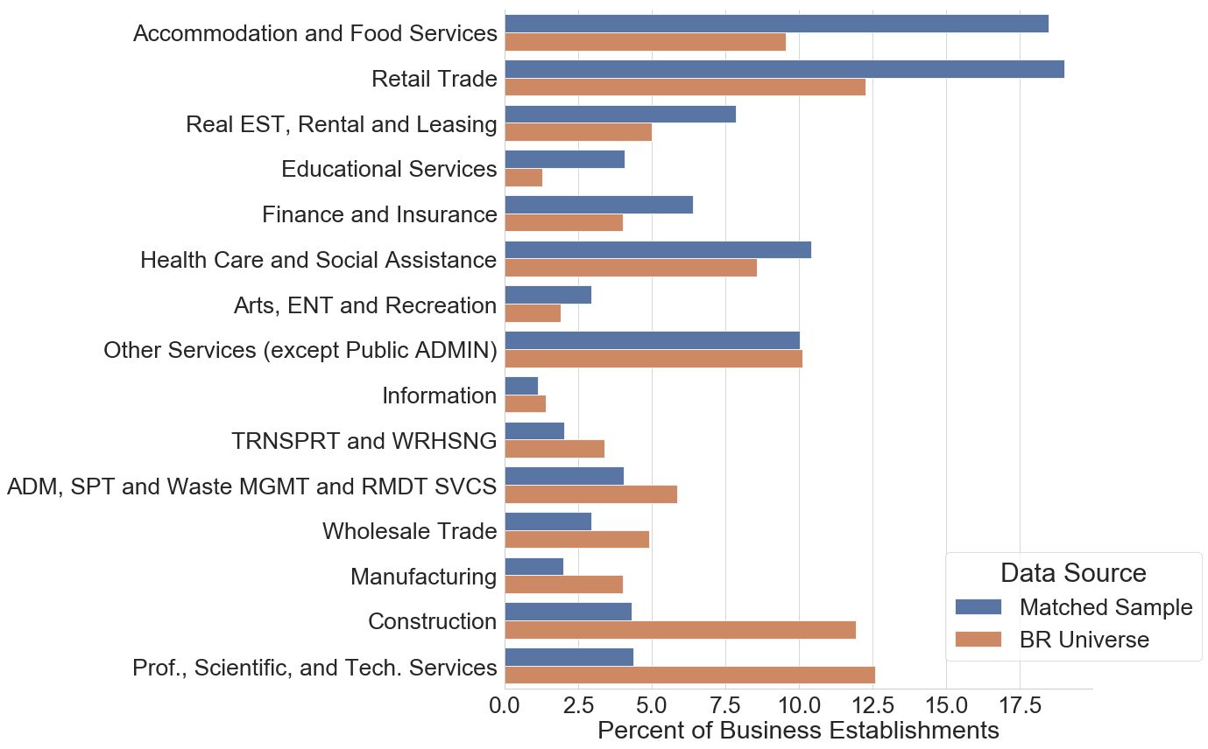
Matching Data to BR
Able to match ~120,000 SU records with MAMBA (Cuffe and Goldschlag, 2018)
  Additional 85,000 Multi-unit estabs.
Unable to match
  New businesses
  Non-employers
  Closed businesses?
Figure shows percentage of Matched Sample (blue) and BR SU Universe (orange) in each NAICS Sector
Notes:
Why this means you should do targeted searches, instead of trying to replicate the BR

Slide 7
Natural Language Processing (1)
NLP can be used to identify
  Parts of speech (Noun, Verb)
  Tokens of related words (San and Francisco probably combined to San Francisco)
  Find the probability of words appearing in a corpus of text.
  Identify sentiment.
  Probability of word associations
    e.g. ‘England’ and ‘Queen’ should be more common than pairing ‘England’ and ‘Sunshine’
Notes:
Note: We stem and lemmatize the words to find common phrases, as well as removing stop words

Slide 8
Natural Language Processing (2)
Using Doc2Vec (Le and Mikolov, 2014)
Identify how similar documents of text are given the words that appear near one another.
Use as features in Random Forest classifier.

Slide 9
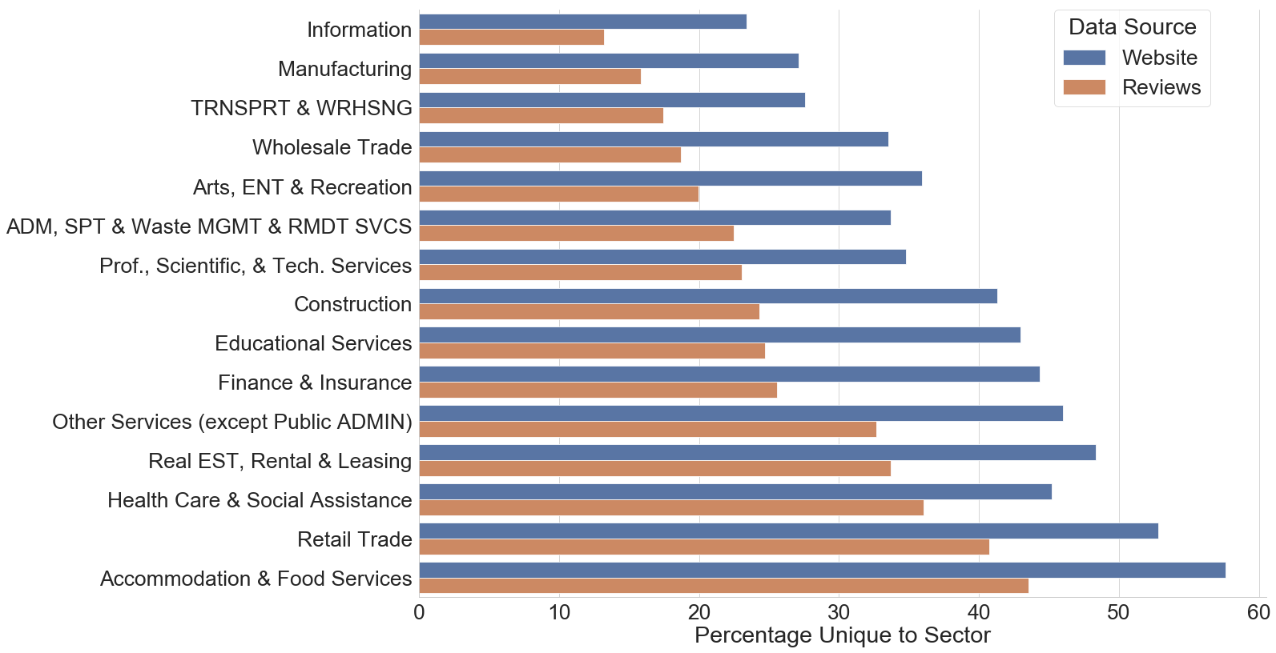
Looking for Signals: Words Unique to a Sector
Figure shows percentage of unique words from websites and user reviews only appearing in the given sector
Notes:
We have about 3.2 million unique words.
In the simplist possible model, we would want to see, for each sector, groups of words that only appear in that sector.
Note the website may be an artifact of HTML parsing

Slide 10
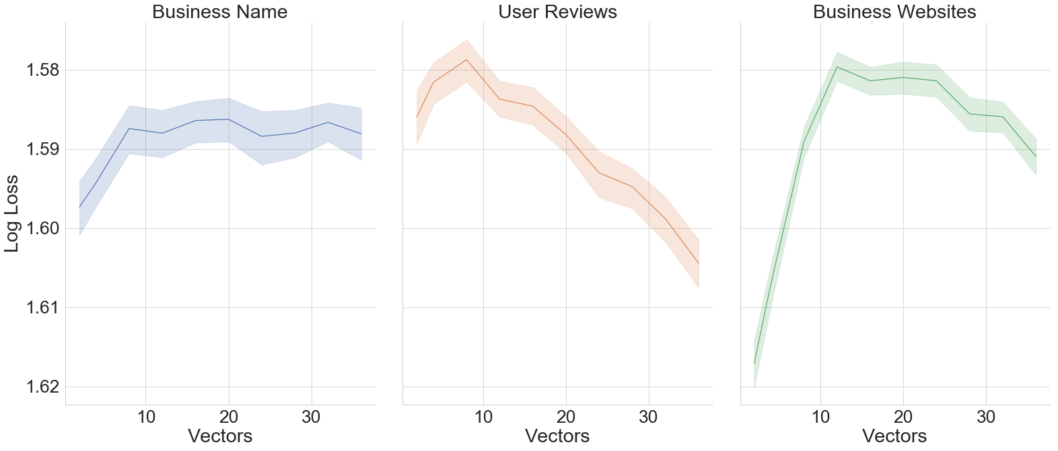
Fewer Dimensions = Better Fit
Figure shows mean and 95% CI for a model with the number of features for each data source for Random Forest grid search. Log Loss inverted to aide interpretation
Notes:
Initial expectations: More vectors (dimensions) leads to better fit.
Not met
Possible causes:
Relatively small number of sectors
Relatively small number of observations

Slide 11
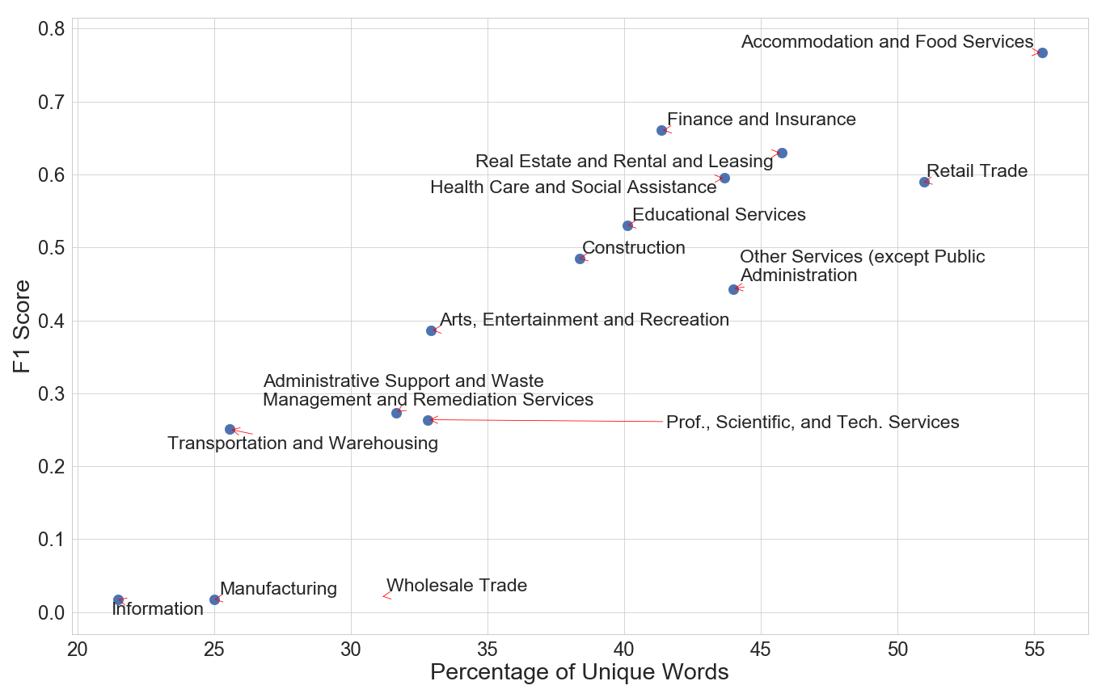
Random Forest Results--More Unique Words = Better Fit
Figure shows percentage of unique words (x-axis) and F1 ratio (y-axis) for best fitting model for each NAICS sector.

Slide 12
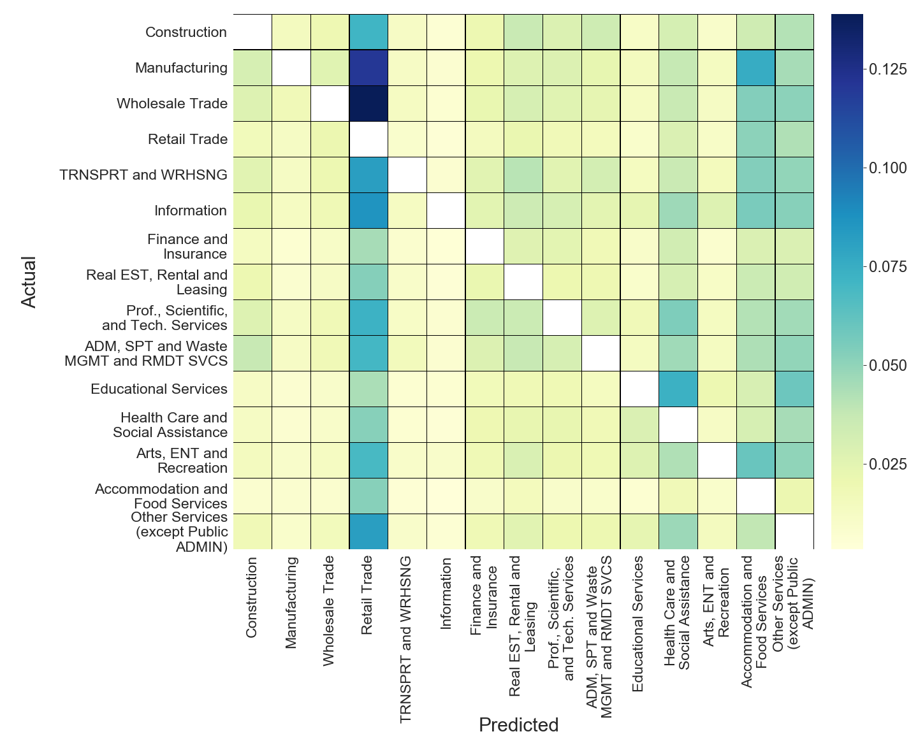
Where are we wrong?
Figure shows average predicted probability of a business in each true NAICS code (y-axis) for each NAICS code (x-axis). Diagonal removed.
Notes:
Show the heatmap here.
Things to note: everything confused with retail trade (esp. wholesale trade), but correct prediction always most likely on average for all NAICS codes.

Slide 13
Discussion
Substantial promise to the methods, could be used as supplement to current operations.
Use on targeted populations versus sampling.
Current research investigating different textual data analysis methods.
Implementation concerns:
  Privacy
  Costs
Notes:
Promise to the model:
When we have larger numbers of observations, have a better fit.
Makes logical mistakes (confusing wholesale and retail trade).
Excellent performance when relatively certain about the outcome.
Targeted populations versus sampling:
Say how APIs are designed so you cannot replicate the database underneath. BUT we have done work that took records from the BR, salted them, and then got a high match rate.
Current methods: improved fit with similar methods.
Costs—APIs are not free, though are cheaper.

Slide 14
Thank You!
John Cuffe John.cuffe@census.gov | Sudip Bhattacharjee Sudip.bhattacharjee@census.gov

Slide 15
BACKUP

Slide 16
Goals
Our project aims to investigate new methods of data collection and analysis can improve the process for generating NAICS codes.
  Lower costs.
  Reduce respondent burden.
How
  Combine publically available data from websites and APIs with natural language processing and machine learning methods.
Notes:
Metion Follow-on from SIC codes

Slide 17
Methods: Natural Language Processing
Natural Language Processing is a type of method designed to give mathematical meaning to human language.
Extremely powerful as a vector reduction tool.
Here, our goals are to find factor loadings to generate likelihood of presence in a given NAICS code.

Slide 18
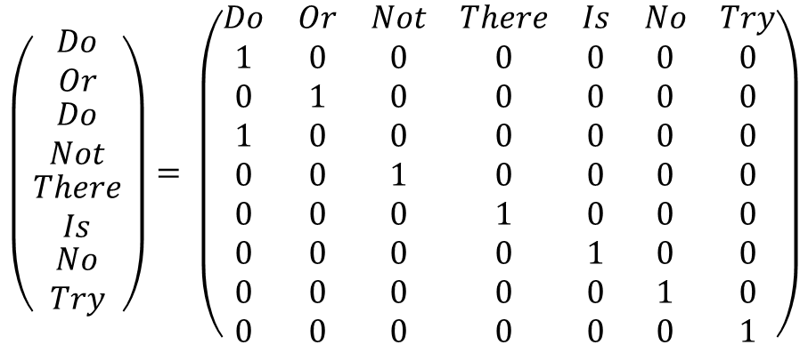
Approach 1: Word Vector Creation
The matrix right shows a vector representation of a phrase.
  Manageable with small vocabularies
  Strips context from words
For our data, take the 5,000 most common words in textual data, via term frequency inverse document frequency.
$$\left(\begin{matrix}Do \\ Or \\ \begin{matrix}Do \\ Not \\ \begin{matrix}There \\ Is \\ \begin{matrix}No \\ Try\end{matrix}\end{matrix}\end{matrix}\end{matrix}\right)= \left(\begin{matrix}Do & Or & Not & There & Is & No & Try \\ 1 & 0 & 0 & 0 & 0 & 0 & 0 \\ 0 & 1 & 0 & 0 & 0 & 0 & 0 \\ 1 & 0 & 0 & 0 & 0 & 0 & 0 \\ 0 & 0 & 1 & 0 & 0 & 0 & 0 \\ 0 & 0 & 0 & 1 & 0 & 0 & 0 \\ 0 & 0 & 0 & 0 & 1 & 0 & 0 \\ 0 & 0 & 0 & 0 & 0 & 1 & 0 \\ 0 & 0 & 0 & 0 & 0 & 0 & 1\end{matrix}\right)$$

Slide 19
Approach 2: doc2vec models
Doc2vec (Le and Mikolov, 2014) are a class of models that seek to identify latent classes from sentances.
  E.g. Related words (e.g. ‘England’ and ‘Queen’ should be more common than pairing ‘England’ and ‘Sunshine’)
As with the word vector methods, goal is to generate a vector.
  Here, the vectors are latent, rather than explicit.

Slide 20
Methods: The Population
Table 1: Counts of BR Establishments, 2012-2015
Type | Count
Appear in the Business Register | 21,390,000
Appear as Single Unit | 15,620,000
Coded by 2012 ECON Census | 4,532,000
SS4 Between 2010 and 2012 | 130,000
Use 2012 Economic Census as ground truth.
Find businesses
  With SS4 between 2010 and 2012
  Appear as employer business between 2012 and 2016.
  Appear as a single establishment.
Notes:
Notes:
Ground truth for 2012 ECON census is debateable. But so long as we compare the SS4 to the same then we will make sure we are comparing more accurately
Business Register: The population of non-farm employer businesses. Serves as our sampling universe for business surveys

Slide 21
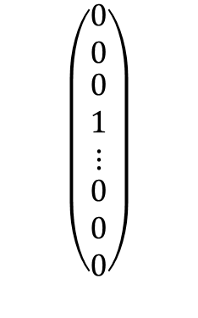


The Skip-Gram Model
Output Layer (Length N)
Hidden Layer (Length K)
Word- and Doc2Vec models build Neural Networks that seek to identify the likelihood of an output word given the words surrounding it.
Original Word Vector (Length N)
Ʃ
Ʃ
Ʃ
$$\left(\begin{matrix}0 \\ 0 \\ \begin{matrix}0 \\ 1 \\ ⋮ \\ \begin{matrix}0 \\ 0 \\ 0\end{matrix}\end{matrix}\end{matrix}\right)$$
Ʃ
Ʃ
$$⋮$$
$$⋮$$
Ʃ
Ʃ
Adapted from: http://mccormickml.com/assets/word2vec
Notes:
Highlight the hidden layer here. That’s the goal. Tell them to think about it as factor loadings from a PCA
Why doc instead of word to vec? Because doc gives us that hidden layer for the entire document.
Once we have the hidden layer, we can:
Tell how similar words or documents are.
Use the weights for individual words/documents as features in machine learning algorithms.

Slide 22
Methods: Machine Learning
Current Autocoder uses logit
  Not ideal—heavy assumptions, which may not hold with new data.
Our proposal:
  Random Forest Classifier, using vectors of weights/word counts for each of the following:
    SS4 Business Name + Primary Merchandise Sold
    When available:
      Google Type Tags
      Google User Reviews
      Website Text
Notes:
Using a random forest versus a logit because am unsure on the levels of correlation amongst this many features.

Slide 23
Previous Work: Strategy
We ran different models, attempting to correctly identify 2-digit NAICS codes from the 2012 Economic Census, with the following features:
  SS4 Business Name and Primary Merchandise Sold (SS4) (80,000)
  SS4 + Google Types (Types) (28,000)
  SS4 + Types + Google Reviews + Website Text (22,000)
Take ensemble of predictions, compare to Autocoder.

Slide 24
Previous Results: Google Scrape
Most likely to appear in Google API:
  Accommodation and Food Services (~35%), Other Services, Retail Trade, Health Care (all ~30%)
Least likely to appear in Google API:
  Construction
  Mining
  Utilities
  Management of Companies
Notes:
Totals: Only have about 50k google records, bulk (30k) of which only have types tags. But have to remember many of these businesses have disappeared/merged.
In general these all macke sense. The first four are the most ‘public customer facing’ codes, so you’d expect them to appear in a search tool
Ones that are missing: Tend to have relatively few SU firms. E.g. 551111, which is offices of bank holding companies,
This esp relevant with Accomdation and food—google definitely has more than 35% or so of businesses that are in that NAICS code, more likely that they have disappeared. Either they went out of business (1/3 or restaurants within a year) OR Franchises particular problem when searching for old businesses—give e.g. of hotel that changes from best western to motel 6—in BR we are still looking for motel 6, but google may not recognize.
Bulk of our google information comes from the type tags, not the website or reviews, as those are rare in these cases (probably due to data age/inefficient scraping)

Slide 25
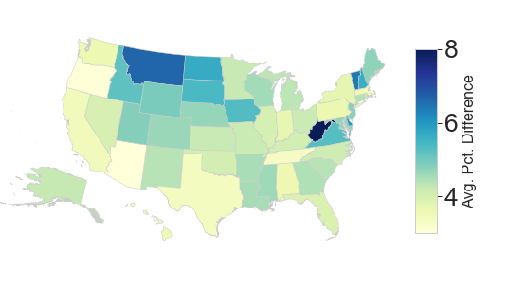
Geographic Representation

Slide 26
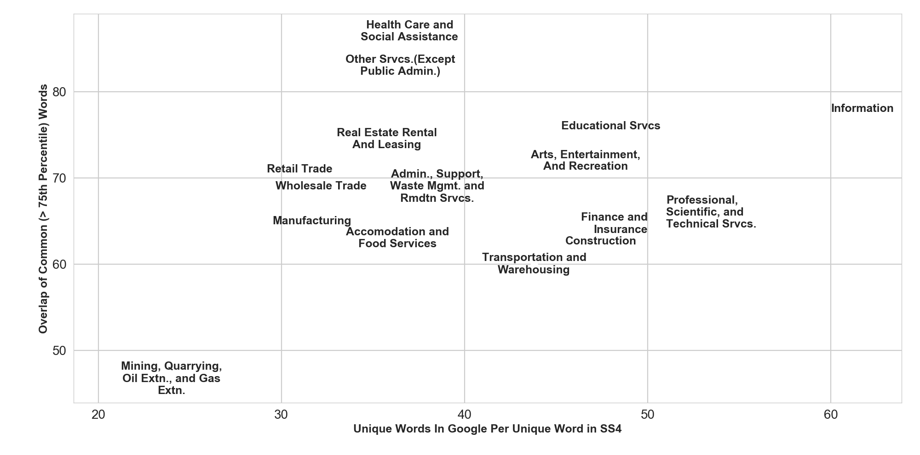
Previous Results: Data Richness
Notes:
Some notes
Legend added: Orange is the ration of google words to ss4 words (the left axis) and is designed to show the richness of the data. Blue is the overlap between the top25% most common SS4 words and the Google top 25% words (the disjoint set). This is meant to show that just because there are more words in google, doesn’t mean they are the right ones. For example, On the right of the plot we tent to have fewer average google words compared to ss4 words, but the overlap is much higher. Congrast with the left, where we have more google words but the sets don’t overlap as much.
Alternatives to this plot:
A scatter plot with labelled NAICS codes.
A table with this information and the top 5-10 most common words in the SS4 and Google texts for each NAICS codes.
Obviously formatting and fonts need to be fixed, and a legend added.

Slide 27
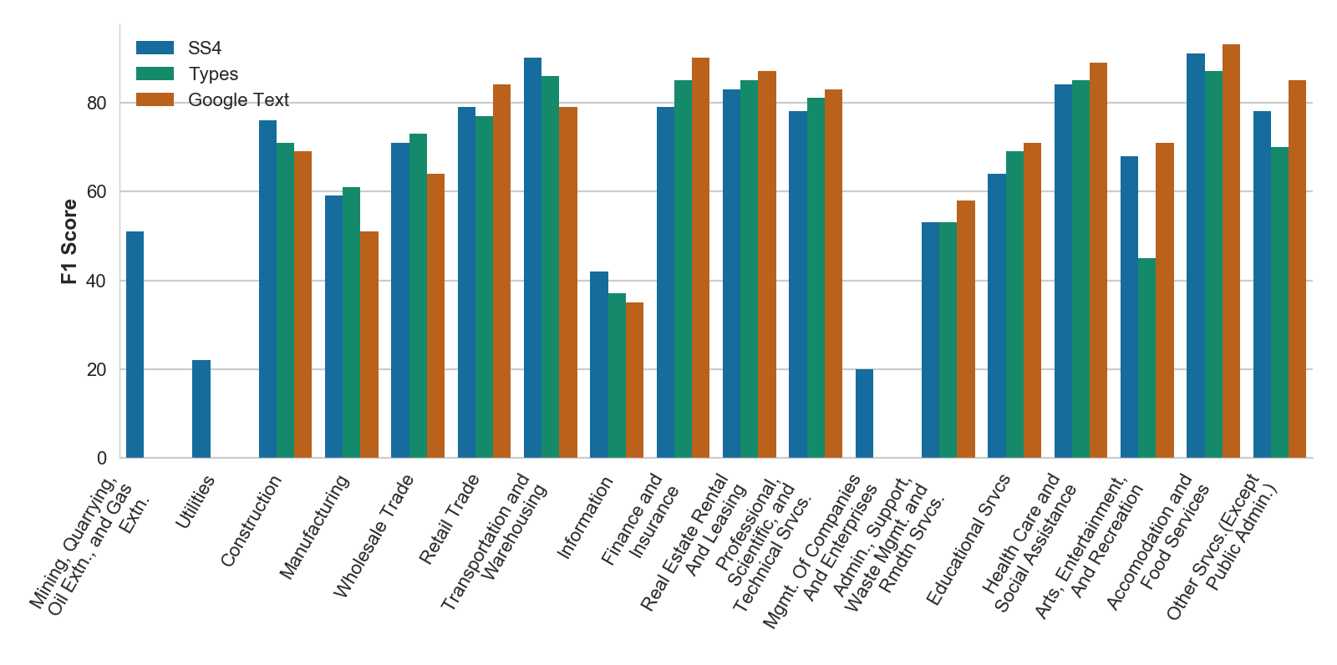
Results: Model Performance
Notes:
Again formatting needs to be done. Some notes
Blank entries could be dropped, they indicate that we didn’t have any data that could pass disclosre in that NAICS code
There doesn’t seem to be a clear pattern of benefit of the types/text/ss4. In some NAICS codes the ss4 is better (23 (construction), 48/9 (wholesale)), others the google review/website text is better (almost all the rest)
Interestingly, the google type tags sometimes do WORSE than the text (accomdation, other servies (72 and 81))

Slide 28
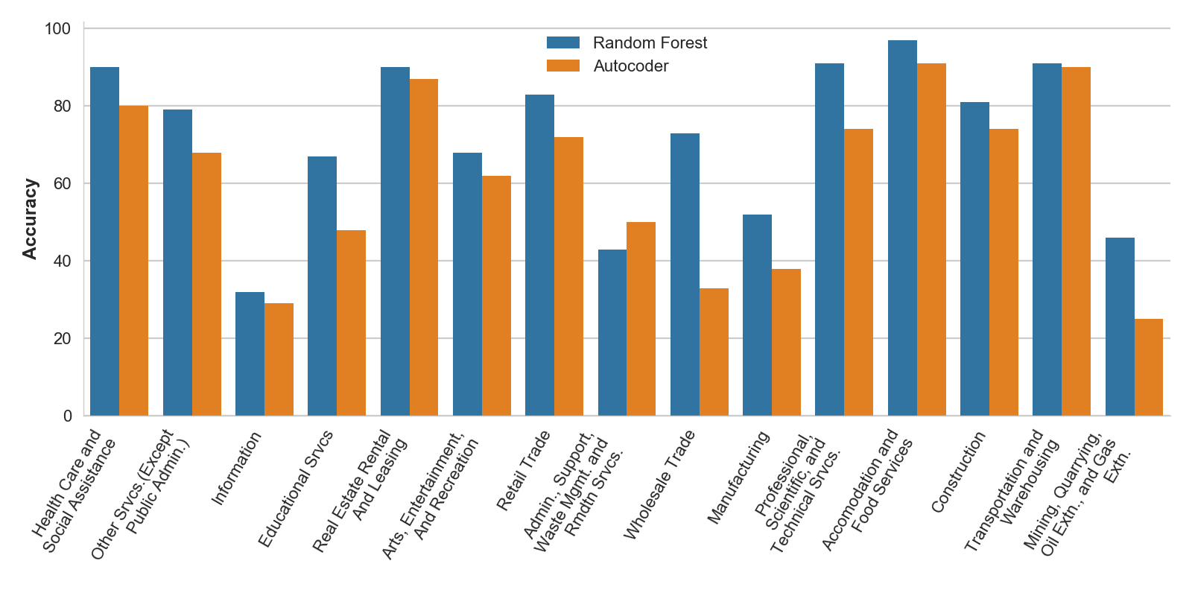
Results: Impact of Textual Information
Notes:
This is ordered (from left to right_) from most to least overlap between the words in Google and the SS4. Not much there, in terms of benefit to our models having a consistent pattern.
Note: Wholesale trade is where the typ tag was the most useful data type.

Slide 29
Weaknesses
Survivorship bias:
  Lower than expected match rate.
  About 30% of all restaurants fail within a year.
Changes over time
  Business can change NAICS codes over time.
  Websites more immediate source of information.
Cleaning of Website text.
  Better parsing and understanding of errors on NLP models.

Slide 30
The Future…
Begin modelling more detailed NAICS codes.
  Involves nested models.
Broader target population.
  Not just limit to 2010-12 SS4.
Compare Google vocabulary to Autocoder.
Test models on 2017 Economic Census.
Notes:
Mention for broader target population: Google search got about a 65% match rate just looking at BR entries from 2016 (last available year) so that’s some indication that the bad match is more down to age of sample.

Slide 31
Previous work
Took 130,000 single-unit establishments from Business Register
Found 48,000 in Google Places API
  Searched for Types tags, website text, and user reviews.
Fit into simple TF-IDF vectorizor, take results into Random Forest, Naive Bayes classifiers.

Slide 32
Common Words in Some Industries
Industry | Most Common Words in Google | Most Common Words in SS4
Information | new, 2018, business, news, contact | media, internet, production, publishing, software
Health Care And Social Assistance | doctor, care, staff, office, time | care, therapy, medical, physical, doctor
Retail Trade | store, staff, friendly, time, best | store, sales, convenience, retail, internet
Accomodation And Food Services | food, staff, friendly, time, best | restaurant, food, bar, shop, retail
Mining, Quarrying, Oil Extn., And Gas Extn. | safety, contact, oil, energy, construction | oil, gas, oilfield, drilling, energy
Finance And Insurance | insurance, financial, business, investment, help | investment, insurance, management, financial, advice
Notes:
Note these are the raw words, not the stemmed/lemmatized/tokenized versions
Designed to give a quick sense of how they can differ.
Point out NONE of the information ones match (this is probably due to reliance on reviews),
close matching of retail trade and accommodation (again, probably because of reviews)

Slide 33
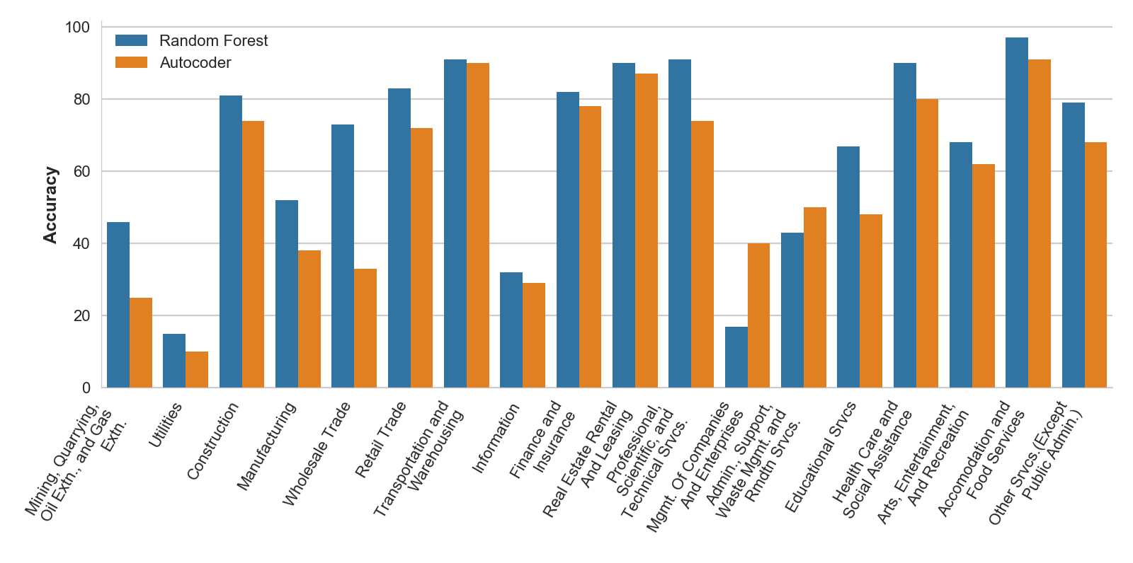
Results: Comparing to Autocoder
Notes:
Autocoder comparison—
Show the overall accuracy of the ensemble of models compared to the autocoder
Autocoder: about 71% correct, 16% incorrect, remainder not coded
Us: about 80% correct, 20% incorrect (when weighting for size of NAICS codes)

Slide 34
Research Plan
Current results show we are at least competitive with current methods.
We will expand upon our findings:
  Larger sample.
    Use salting records from previous scrape.
    Additional scraping activities underway.
  Match to BR using MAMBA data linkage tool (Cuffe and Goldschlag, 2018).
  Improve predictive model.
    Full use of doc2vec (Le and Mikolov, 2014).
    Hierarchical modelling.

